Slide 1

Matrix Operations

Slide 2
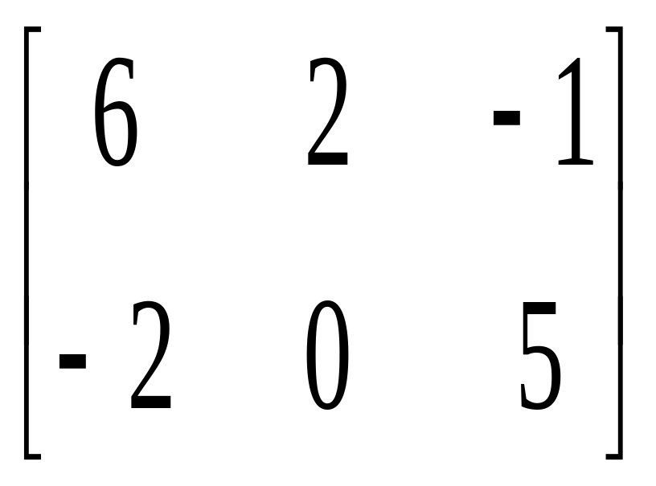
What is a Matrix?
MATRIX: A rectangular arrangement of numbers in rows and columns.
The ORDER of a matrix is the number of the rows and columns.
The ENTRIES are the numbers in the matrix.
This order of this matrix is a 2 x 3.
columns
rows

Slide 3
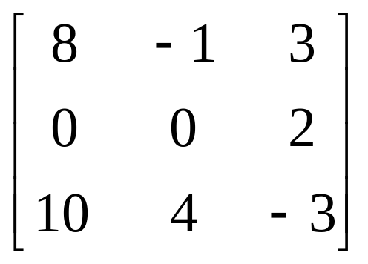
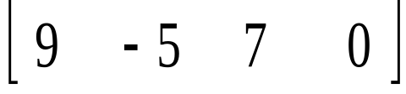
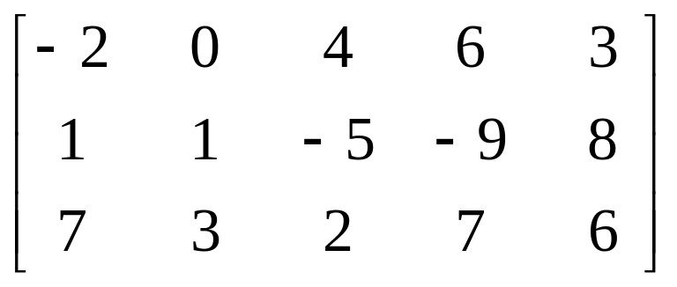
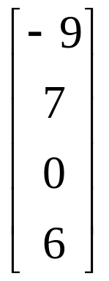
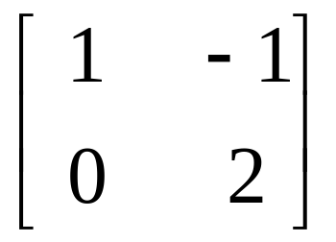
What is the order?

Slide 4
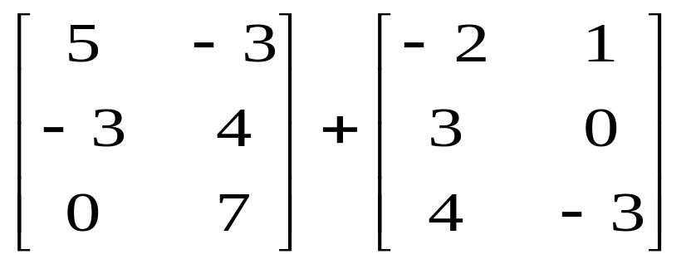
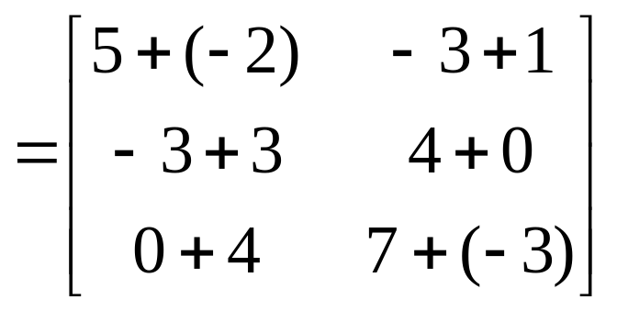
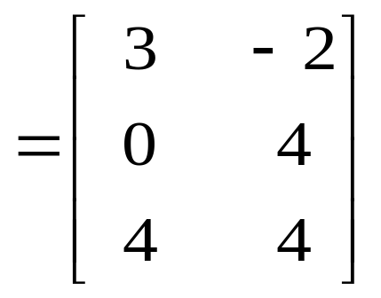
Adding Two Matrices
To add two matrices, they must have the same order. To add, you simply add corresponding entries.

Slide 5
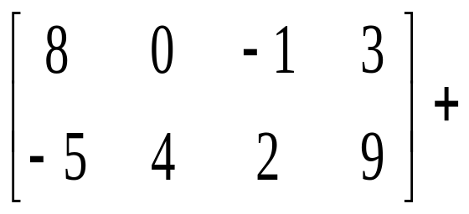
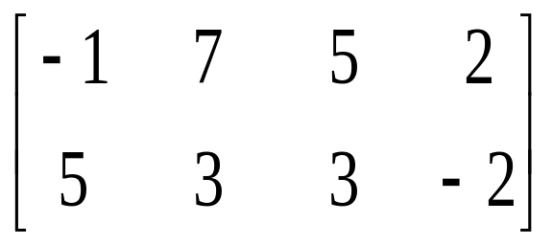




=
=

Slide 6
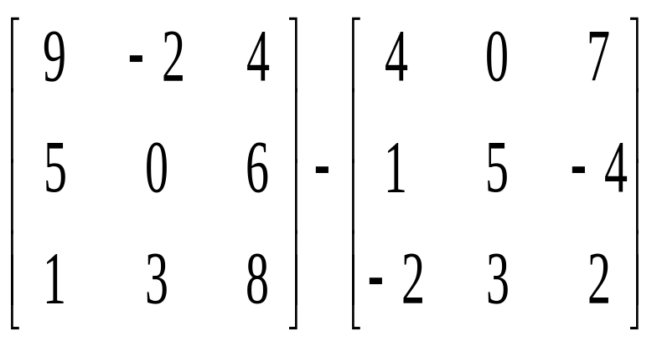
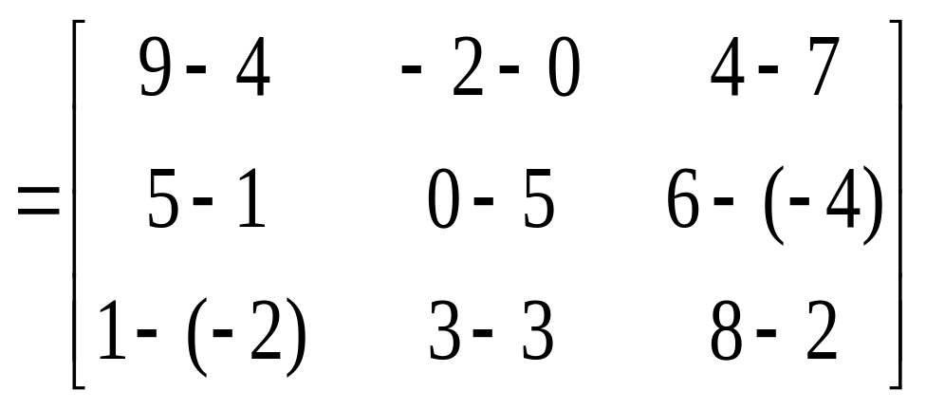
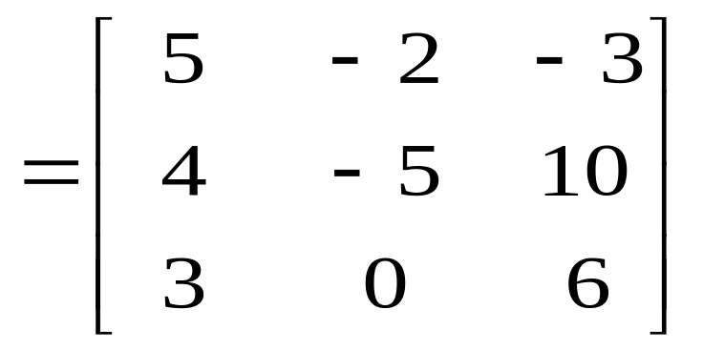
Subtracting Two Matrices
To subtract two matrices, they must have the same order. You simply subtract corresponding entries.

Slide 7
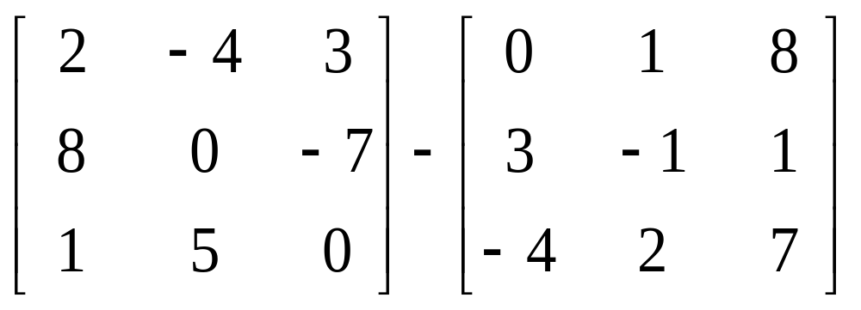




=
=

Slide 8
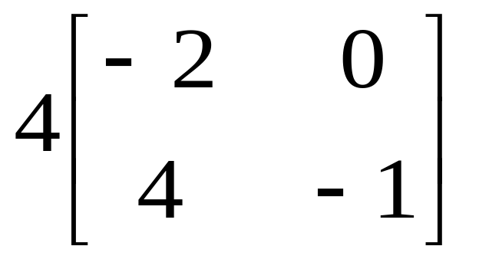
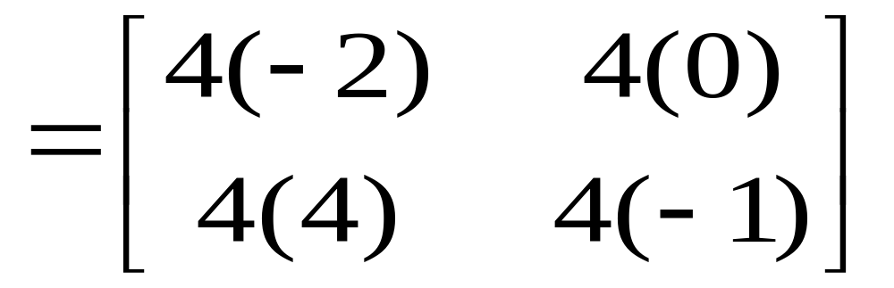
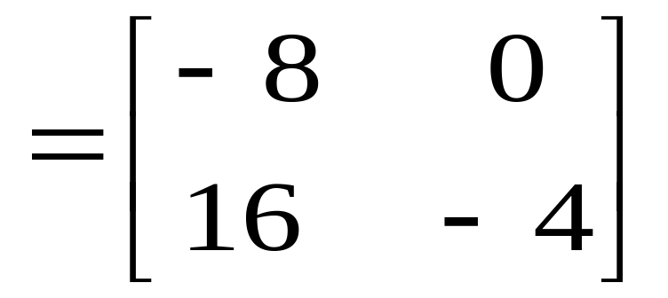
Multiplying a Matrix by a Scalar
In matrix algebra, a real number is often called a SCALAR. To multiply a matrix by a scalar, you multiply each entry in the matrix by that scalar.

Slide 9
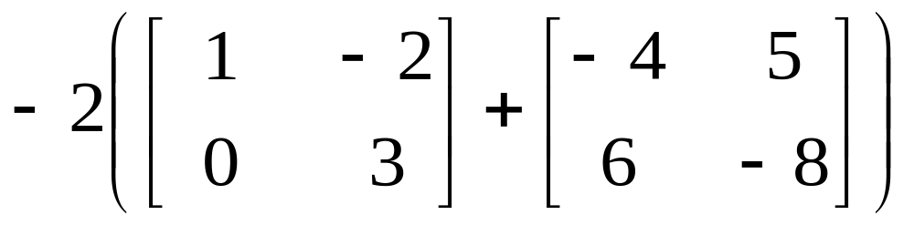
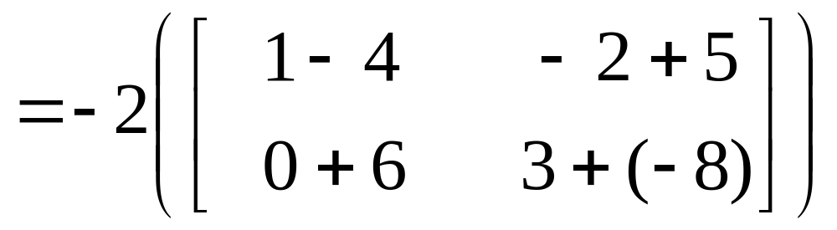





-2

Slide 10
This powerpoint was kindly donated to www.worldofteaching.com
http://www.worldofteaching.com is home to over a thousand powerpoints submitted by teachers. This is a completely free site and requires no registration. Please visit and I hope it will help in your teaching.

