Slide 1
Section 2-5
Midpoint Formula
Part 1 – The Number Line

Slide 2
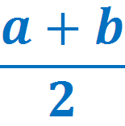







Midpoint Formula – The Number Line

Slide 3




Midpoint Formula

Slide 4
Section 2-5
Midpoint Formula
Part 2 – The Coordinate Plane

Slide 5
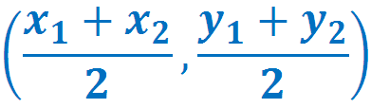
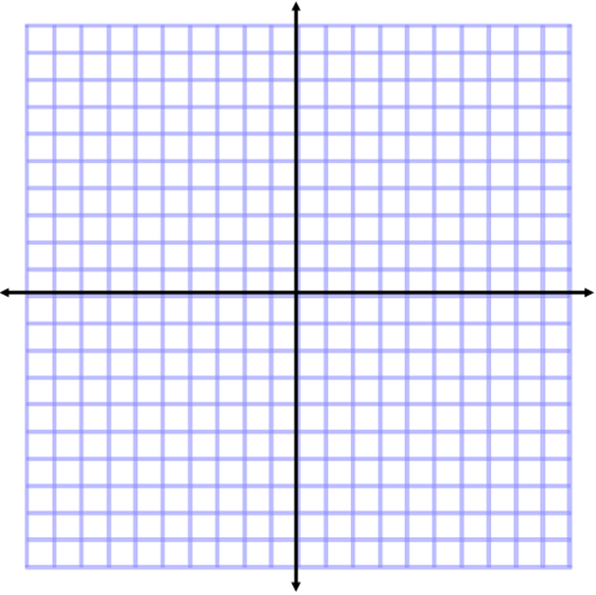






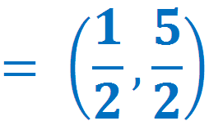
Midpoint Formula -The Coordinate Plane

Slide 6










Midpoint Formula -The Coordinate Plane

