Slide 1
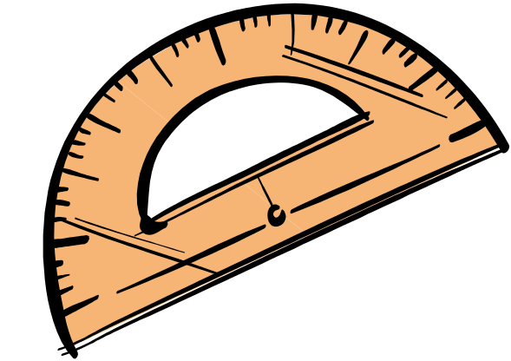
Measuring, calculating and drawing angles...
Our learning objectives today
To use a protractor to:
measure acute and obtuse angles to the nearest degree.
draw acute and obtuse angles to the nearest degree.
To calculate angles on a straight line.

Slide 2
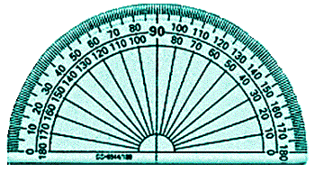
What do we use to help us?
A protractor
Here is a standard protractor like you
use in the classroom.

Slide 3
When we use a protractor, we need to line it up correctly.
You need to make sure the protractor is lined up correctly.
Is this ready to measure the angle?

Slide 4
Were you right......................it wasn’t
Look for the upside down ‘T’ in the middle of the straight line on your protractor.
This needs to be exactly on the vertex of your angle.

Slide 5
We need to remember.....
It doesn’t
matter which
way round the
angle is, you
ALWAYS need
to line the upside
down ‘T’ to the vertex
of the angle.

Slide 6
Now you are ready.
Read from the 0°, and follow the inner set of numbers.

Slide 7
Once you reach 30° you need to be careful!!!
You then need to look at the 1° markings on the outer set of numbers.

Slide 8
What does it measure?
This angle measures 35°.

Slide 9
Measuring, calculating and drawing angles...
Remember our learning objectives today are
To use a protractor to:
measure acute and obtuse angles to the nearest degree.
draw acute and obtuse angles to the nearest degree.
To calculate angles on a straight line.

Slide 10
This powerpoint was kindly donated to www.worldofteaching.com
http://www.worldofteaching.com is home to over a thousand powerpoints submitted by teachers. This is a completely free site and requires no registration. Please visit and I hope it will help in your teaching.

