Slide 1
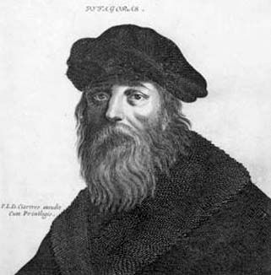
Pythagoras
Greece
560-480 BC

Slide 2

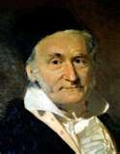
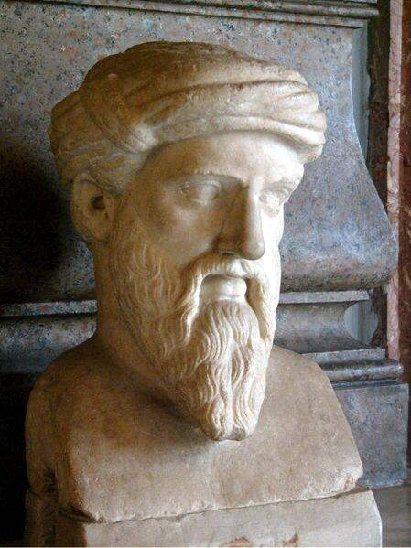
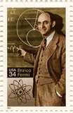
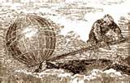

Math Blast
From the Past

Slide 3
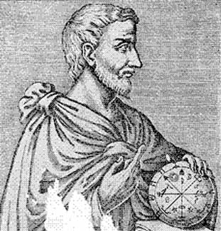
Pythagoras is often considered the first true mathematician.
The Pythagoreans' believed “All is Number,” meaning that everything in the universe depended on numbers. They were also the first to teach that the Earth is a Sphere revolving around the sun.

Slide 4
Pythagoras was born on Samos a Greek island off the coast of Asia Minor. He was born to Pythais (mom) and Mnesarchus (dad).
Life
As a young man, he left his native city for Southern Italy, to escape the tyrannical government. Pythagoras then headed to Memphis in Egypt to study with the priests there who were renowned for their wisdom. It may have been in Egypt where he learned some geometric principles which eventually inspired his formulation of the theorem that is now called by his name.
Towards the end of his life he fled to Metapontum because of a plot against him and his followers by a noble of Croton named Cylon. He died in Metapontum around 90 years old from unknown causes.

Slide 5
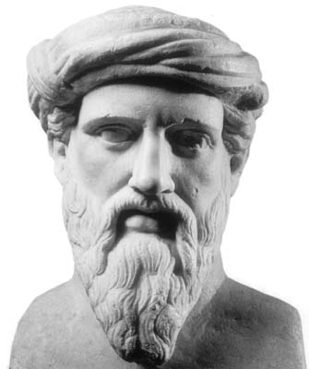
Many of Pythagoras’ beliefs reflect those of the Egyptians. The Egyptian priests were very secretive. The refusal to eat beans or wear animal skins and striving for purity were also characteristics of the Egyptians.

Slide 6
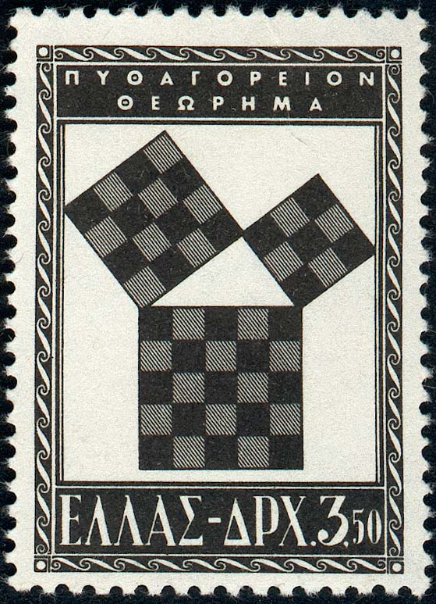
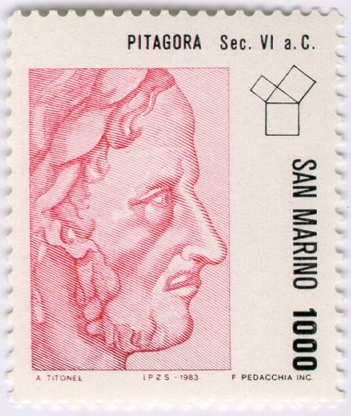
Pythagorean Theorem
a ² + b ² = c ²

Slide 7
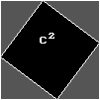
Proof of Pythagorean theorem by rearrangement of 4 identical right triangles. Since the total area and the areas of the triangles are all constant, the total black area is constant. But this can be divided into squares delineated by the triangle sides a, b, c, demonstrating that a² + b² = c² .

Slide 8
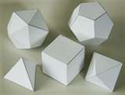
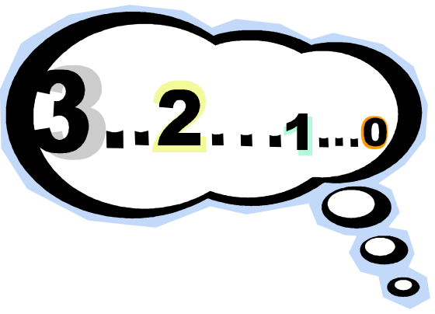
The sum of the angles of a triangle is equal to two right angles or 180 degrees
Venus as an evening star was the same planet as Venus as a morning star.
The five regular solids
The abstract quantity of numbers. There is a big step from 2 ships + 2 ships = 4 ships, to the abstract result 2 + 2 = 4

Slide 9
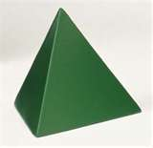
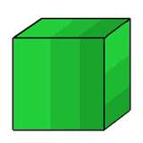
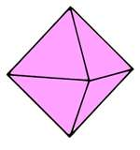
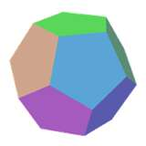
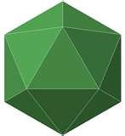
Regular Solids
Tetrahedron
Cube
Octahedron
Dodecahedron
Icosahedron

Slide 10
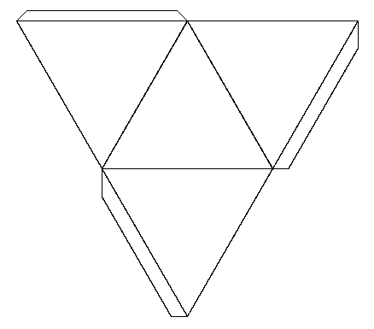
Regular Solids
Measure the net of this Tetrahedron and find the surface area

Slide 11
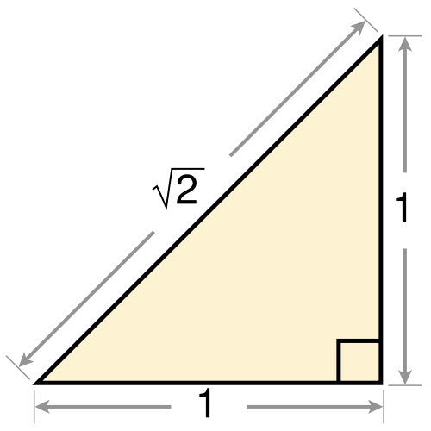
One of the Pythagoreans’ most important discoveries was that the diagonal of the square is longer than its sides. This showed that irrational numbers existed (decimal numbers that never end).
c
a < c
b < c
a
2
b
3.1415927...

Slide 12
This powerpoint was kindly donated to www.worldofteaching.com
http://www.worldofteaching.com is home to over a thousand powerpoints submitted by teachers. This is a completely free site and requires no registration. Please visit and I hope it will help in your teaching.

