Slide 1
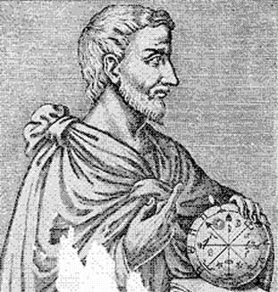

The Pythagorean Theorem
Mr. Clutter
VMS Library

Slide 2

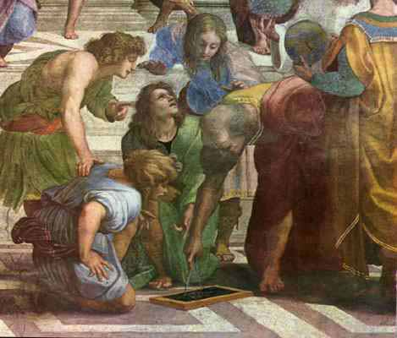
Pythagoras
Lived in southern Italy during the sixth century B.C.
Considered the first true mathematician
Used mathematics as a means to understand the natural world
First to teach that the earth was a sphere that revolves around the sun

Slide 3

Right Triangles
Longest side is the hypotenuse, side c (opposite the 90º angle)
The other two sides are the legs, sides a and b
Pythagoras developed a formula for finding the length of the sides of any right triangle

Slide 4
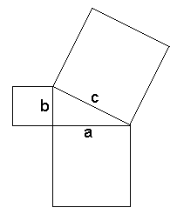
The Pythagorean Theorem
“For any right triangle, the sum of the areas of the two small squares is equal to the area of the larger.”
a² + b² = c²

Slide 5
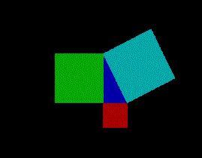
Proof

Slide 6
Applications
The Pythagorean theorem has far-reaching ramifications in other fields (such as the arts), as well as practical applications.
The theorem is invaluable when computing distances between two points, such as in navigation and land surveying.
Another important application is in the design of ramps. Ramp designs for handicap-accessible sites and for skateboard parks are very much in demand.

Slide 7
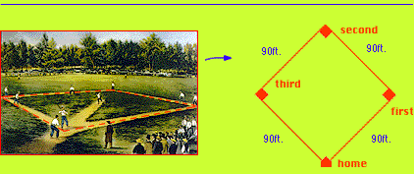
Baseball Problem
A baseball “diamond” is really a square.
You can use the Pythagorean theorem to find distances around a baseball diamond.

Slide 8
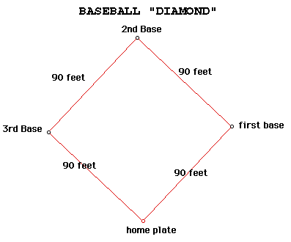
Baseball Problem
The distance between
consecutive bases is 90
feet. How far does a
catcher have to throw
the ball from home
plate to second base?

Slide 9
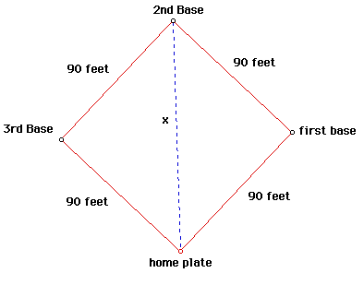
Baseball Problem
To use the Pythagorean theorem to solve for x, find the right angle.
Which side is the hypotenuse?
Which sides are the legs?
Now use: a² + b² = c²

Slide 10
Baseball Problem
Solution
The hypotenuse is the distance from home to second, or side x in the picture.
The legs are from home to first and from first to second.
Solution:
x² = 90² + 90² = 16,200
x = 127.28 ft

Slide 11

Ladder Problem
A ladder leans against a second-story window of a house.
If the ladder is 25 meters long,
and the base of the ladder is 7 meters from the house,
how high is the window?

Slide 12
Ladder Problem
Solution
First draw a diagram that shows the sides of the right triangle.
Label the sides:
  Ladder is 25 m
  Distance from house is 7 m
Use a² + b² = c² to solve for the missing side.
Distance from house: 7 meters

Slide 13
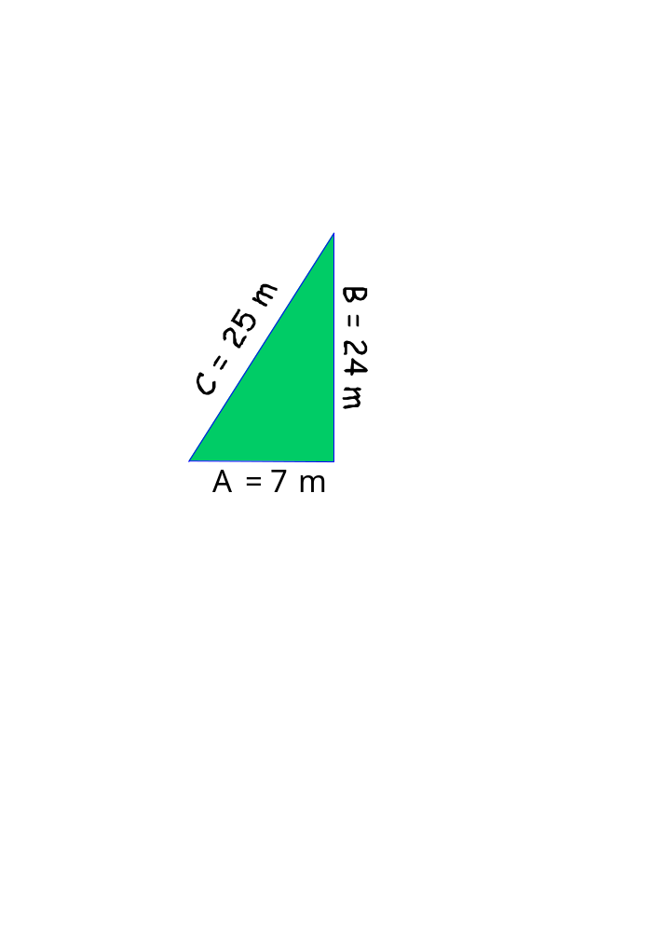
Ladder Problem
Solution
7² + b² = 25²
49 + b² = 625
b² = 576
b = 24 m
How did you do?

Slide 14
This powerpoint was kindly donated to www.worldofteaching.com
http://www.worldofteaching.com is home to over a thousand powerpoints submitted by teachers. This is a completely free site and requires no registration. Please visit and I hope it will help in your teaching.

