Slide 1
RIGHT PRISM
A right prism is a solid which has two parallel planes of same shape and size. Also, its lateral surface are perpendicular to its parallel sides

Slide 2
Volume of Right Prism
Parallel sides
h
h
h
base
Volume = Area of cross-section x Distance between parallel sides
= Base area x height

Slide 3
Triangular Prism
b₃
Length
b₂
h
b₁
Base
Volume = Base area x height
= Triangle area x length of the solid
= ½ x base x height x length

Slide 4
Net of Triangular Prism
b₂
h
b₃
b₁
L
Total surface area = Two triangles + three rectangles
= 2 x ½ x b x h + L x b₁ + L x b₂ + L x b₃
= 2 x base area + (b₁ + b₂ + b₃) x L
= 2 base area + Perimeter of the base x Length

Slide 5
Volume of a Prism
20cm
30cm
12cm
16cm
Volume = Base Area x Height
= ½ x 12 x 16 x 30
= 2880 cm³

Slide 6
Total Surface area
16cm
12cm
16cm
20cm
30cm
12cm
12cm
20cm
20cm
16cm
Perimeter of the base = 12 + 16 + 20
= 48cm
T.S.A = 2 x Base Area + Perimeter of the base x height
= 2 x 96 + 48 x 30
= 1632cm².

Slide 7
Trapezoid
8cm
12cm
13cm
20cm
10cm
15cm
Volume = Base Area x Length
= ½ x (8 + 15) x 10 x 20
= 2300cm³.

Slide 8
The Net
8cm
12cm
13cm
12cm
13cm
8cm
15cm
30cm
30cm
15cm
12cm
13cm
8cm
8cm
T.S.A = 2 x Base area + Perimeter of the base x height
= 1670 cm².

Slide 9
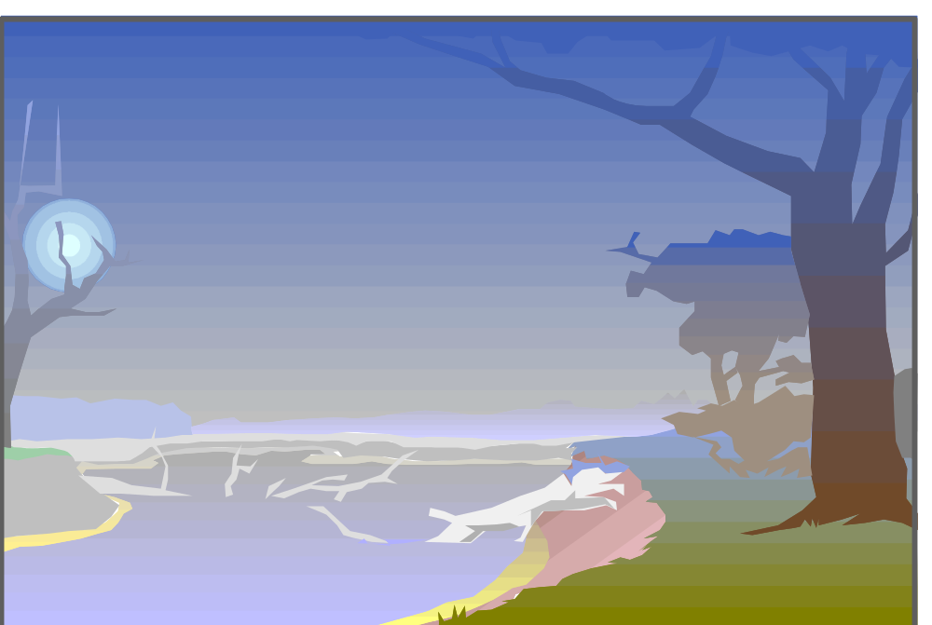

Happiness is not success, But the path leading to success.
THE END

Slide 10
This powerpoint was kindly donated to www.worldofteaching.com
http://www.worldofteaching.com is home to over a thousand powerpoints submitted by teachers. This is a completely free site and requires no registration. Please visit and I hope it will help in your teaching.

