Slide 1
March 1, 2006
Mr. Galilei
Monessen High School
Algebraic Equations
SOLVING MULTI-STEP EQUATIONS
Powerpoint hosted on www.worldofteaching.com
Please visit for 1000’s more free powerpoints

Slide 2
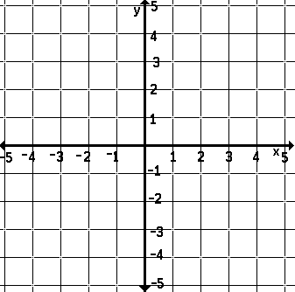
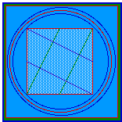
Algebraic Equations
Multiplication with Subtraction
2x – 4 = 8
+4
+4
2x
=
12
2
2
x
=
6

Slide 3
Algebraic Equations
Multiplication with Addition
5x + 10 = 80
-10
-10
5x
=
70
5
5
x
=
14

Slide 4
Algebraic Equations
Multiplication with Subtraction
-3x – 4 = -82
+4
+4
-3x
=
-78
-3
-3
x
=
26

Slide 5
Algebraic Equations
Multiplication with Addition
2/3x + 2 = 8
-2
-2
3
2
2
3
x
=
6
3
2
(HINT)
Reciprocal
x
=
18/2 = 9

Slide 6
Algebraic Equations
Division with Addition
x/5 + 2 = 8
-2
-2
x
5
=
6
(5)
(5)
x
=
30

Slide 7
Algebraic Equations
C.L.T.
(
)
4x +6x + 20 = 80
10x + 20 = 80
-20
-20
10x
=
60
10
10
x = 6

Slide 8
Algebraic Equations
C.L.T.
(
(
)
)
3x + 2x + 20 - 8 = 92
5x + 12 = 92
-12
-12
5x
=
80
5
5
x = 16

Slide 9
Algebraic Equations
C.L.T.
6x + 15 = 125 + 4x
( )
( )
6x – 4x + 12 = 122 + 4x – 4x
2x + 12
=
122
-12
-12
2x = 110
X = 55
2
2

Slide 10
Algebraic Equations
Distributive Property
2(5x – 6) – 3x = 4(x + 12) – 9x
10x – 12 - 3x = 4x + 48 – 9x
( )
( )
10x – 3x -12 = 4x – 9x + 48
7x - 12
=
-5x + 48
( )
=
48
7x + 5x - 12
12x - 12
=
48

Slide 11
Algebraic Equations
Distributive Property
7x + 5x - 12
=
48
12x - 12
=
48
+12
+12
12x
=
60
12
12
X = 5

Slide 12

THE END
Homework:
Study Review Sheet
Test Tomorrow!!
Use Worksheets & Notes to review and practice for the test.

