Slide 1
Slope

Slide 2
Note
Note to browser’s
This slope lesson is interactive and I have students use graph paper as they follow along
This is formulated for the California High School Exit Exam math standards

Slide 3

How do engineers build bridges?

Slide 4


Slide 5
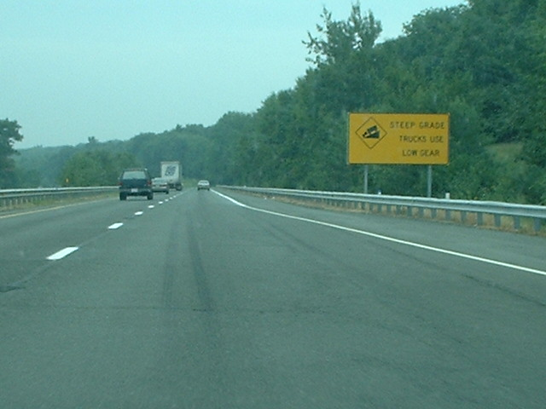
How do engineers build roads?

Slide 6
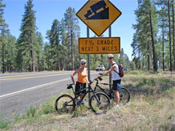
How can we write 7% as a fraction?

Slide 7
7% as a fraction??
Remember than any percent is a part of 100.

Slide 8

The grade of a road is the same as slope
Here is the picture:
7 feet
100 feet

Slide 9
Slope of a line
The slope measures the “rise” and “run” of the stairs beneath or above the line.
4
4

Slide 10
Slope of a line
The “stairs” are all through the line and the same size.

Slide 11
Slope of a line
Can I make a line if the stairs aren’t the same size?

Slide 12
Slope of a line (m)
To find the slope, use the formula
4
4

Slide 13
Slope of a line (m)
To find the slope, use the formula
4
4

Slide 14
Slope of a line (m)
Find the slope of the following lines:
A)
B)
2
2
1
3

Slide 15

Slope of a line (m)
Is the slope positive or negative?
Answer:
Positive, Read from left to right

Slide 16
Try for yourself
Draw 2 lines with the following slopes on your graph paper.
A) B)
Start anywhere on your coordinate plane.

Slide 19
Slope of a line (m)
The last 2 lines had a positive slope, let’s look at slopes with negative slopes

Slide 20
Slope of a line (m)
We still use rise over run, except the “stairs” are underneath the line.
-2
3

Slide 21
Try for yourself
Draw 2 lines with the following slopes on your graph paper.
C) D)
Start anywhere on your coordinate plane.

Slide 24
CAHSEE Standard
3.3 Graph linear functions, noting that the vertical change (change in y-value) per unit of horizontal change (change in x-value) is always the same and know that the ratio (“rise over run”) is called the slope of a graph.

Slide 25
What do you need to do?
Identify the slope on a graph
First find where the line goes through (intersects the grid lines)
Draw a triangle and calculate the slope

Slide 26
What do you need to do?
Decide if it’s a negative or positive slope
Trace the triangle on the graph paper
On the CAHSEE you can write on the test!

Slide 27
What do you need to do?
Use the formula
Rise is negative 1
Run is 2

Slide 28
Now it’s your turn
Identify the slope on each line.
First make points where the line intersects the grid
Then calculate the slope
If you finish early, then also identify where the line crosses the y-axis.

Slide 29
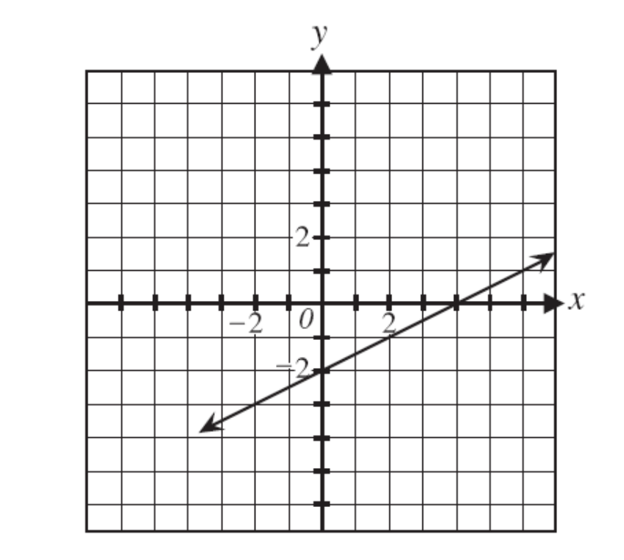
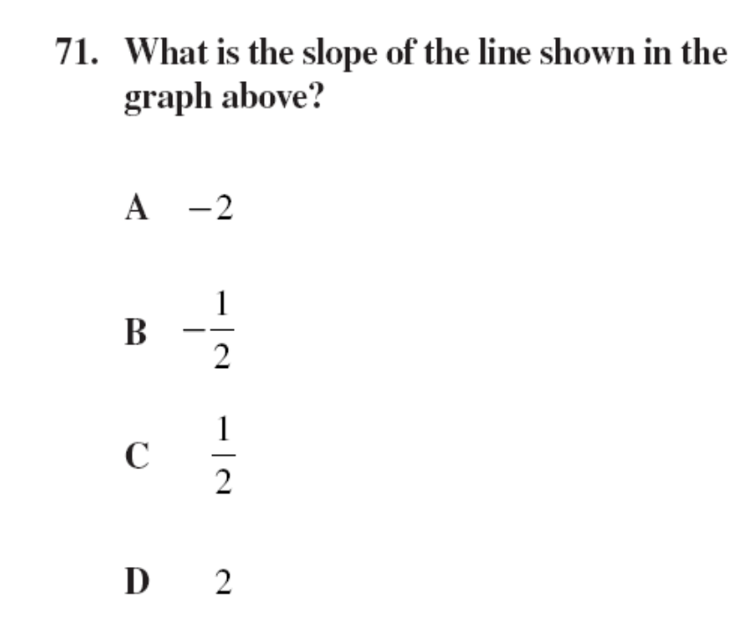
Released Question from CAHSEE

Slide 30
Released Question from CAHSEE

Slide 31
This powerpoint was kindly donated to www.worldofteaching.com
http://www.worldofteaching.com is home to over a thousand powerpoints submitted by teachers. This is a completely free site and requires no registration. Please visit and I hope it will help in your teaching.

