Slide 1
STRETCHES AND SHEARS

Slide 2
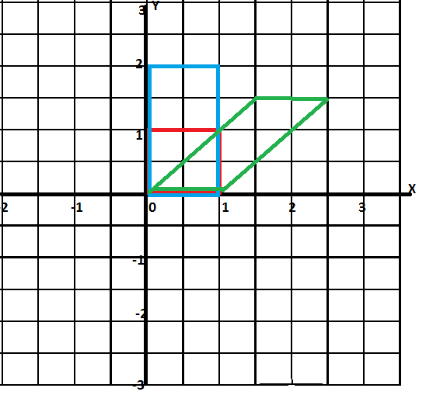
Which is which?
WHICH IS A STRETCH OF THE RED SQUARE?
WHICH IS A SHEAR OF THE RED SQUARE?

Slide 3
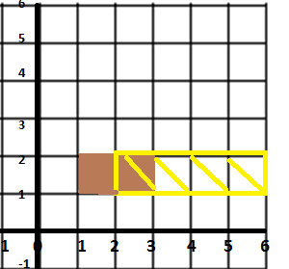
STRETCH
WHICH IS THE INVARIANT LINE?
THE STRETCH IS PARALLEL TO…..?
WHAT IS THE SCALE FACTOR?

Slide 4
DIFFERENCE BETWEEN STRETCH AND SHEAR
NOTICE THE ANGLES
NOTICE THE SHAPE
WHAT IS THE DIFFERENCE BETWEEN THE TWO IMAGES OF THE UNIT SQUARE ( THE BLUE IMAGE AND THE GREEN IMAGE)?

Slide 5
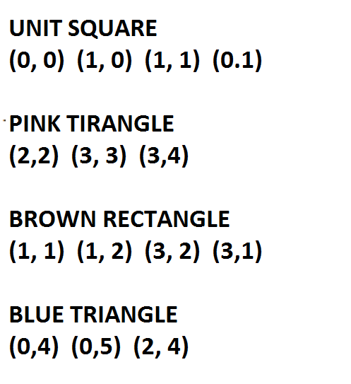
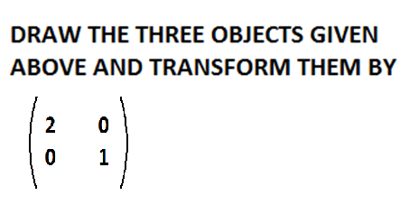
PLOT THE FOLLOWING POINTS

Slide 6
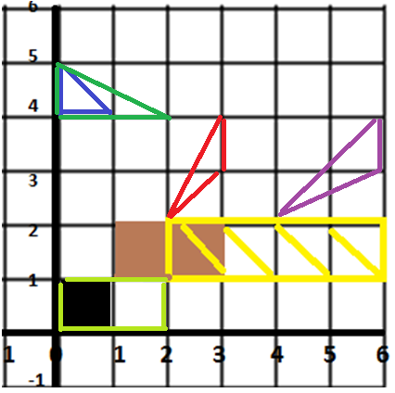

Slide 7
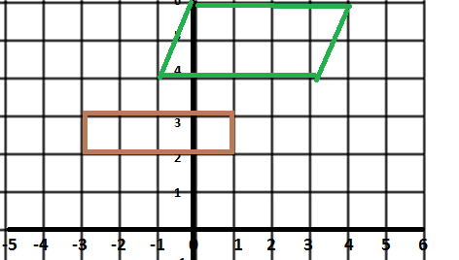
SHEAR

Slide 8
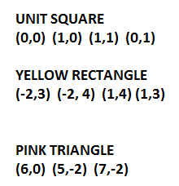
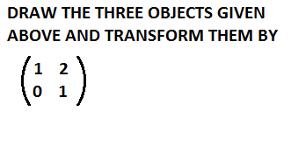
PLOT THE FOLLOWING POINTS

Slide 9
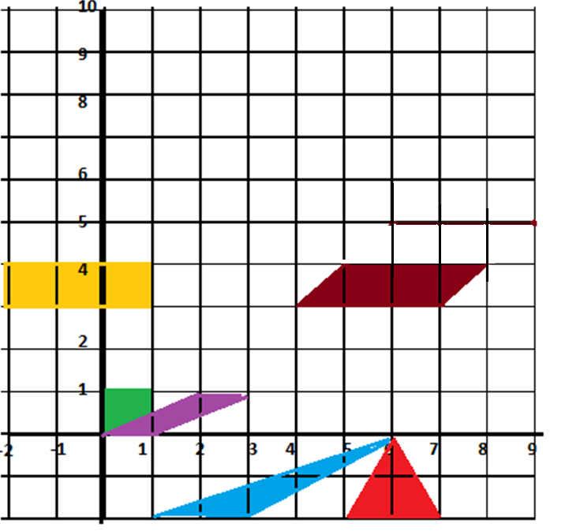

Slide 10
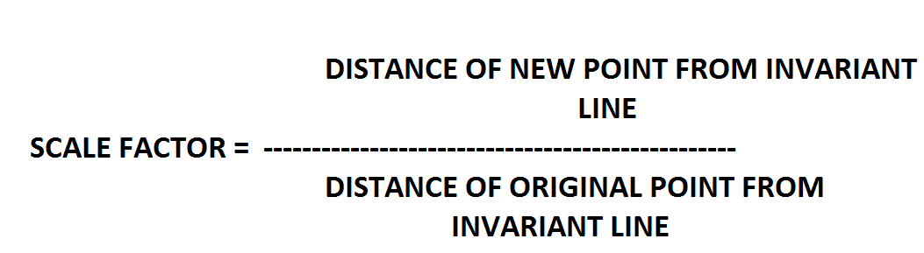
IMPORTANT
STRETCH SCALE FACTORfrom invariant line
= distance moved by a point divided by the distance of the shape

Slide 11
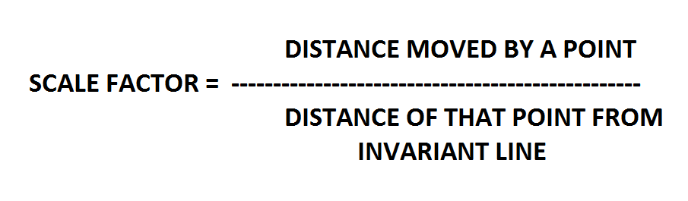
IMPORTANT
SHEAR SCALE FACTOR

