Slide 1
THE SINE RULE
Powerpoint hosted on www.worldofteaching.com
Please visit for 1000’s more free powerpoints

Slide 2
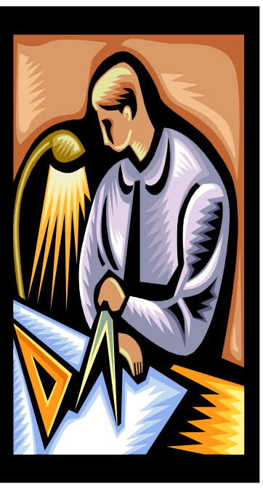
The Sine Rule is used to solve any problems involving triangles when at least either of the following is known:
a) two angles and a side
b) two sides and an angle opposite a given side
In Triangle ABC, we use the convention that
a is the side opposite angle A
b is the side opposite angle B
A
c
b
B
C
a
The sine rules enables us to calculate sides and angles
In the some triangles where there is not a right angle.

Slide 3
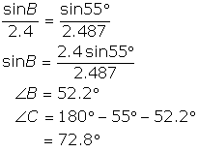
Example 2 (Given two sides and an included angle)
Solve triangle ABC in which ∠A = 55°, b = 2.4cm and
c = 2.9cm
By cosine rule,
a² = 2.4² + 2.9² - 2 x 2.9 x 2.4 cos 55°
= 6.1858
a = 2.49cm
<>

Slide 4
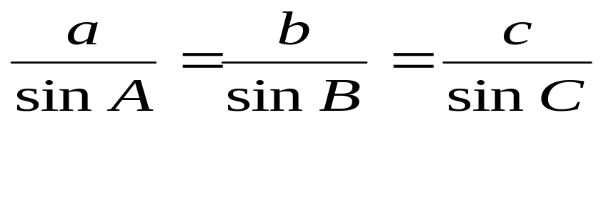
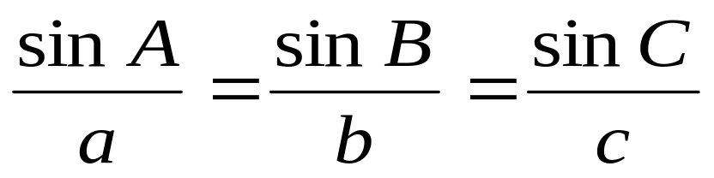

Using this label of a triangle,
the sine rule can be stated
Either
[1]
Or
[2]
Use [1] when finding a side
Use [2] when finding an angle

Slide 5
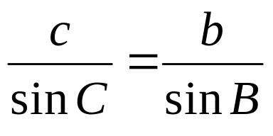
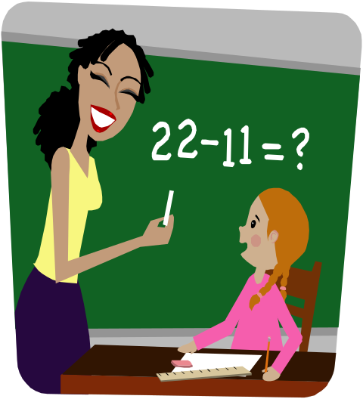
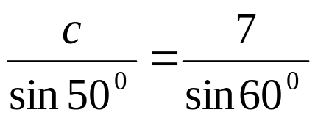
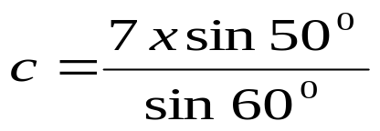
Example:
A
Given
Angle ABC =60⁰
Angle ACB = 50⁰
c
7cm
Find c.
B
C
To find c use the following proportion:
c= 6.19 ( 3 S.F)

Slide 6
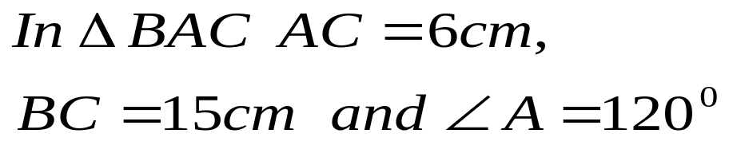
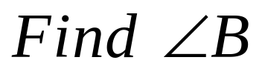
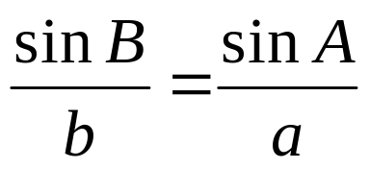
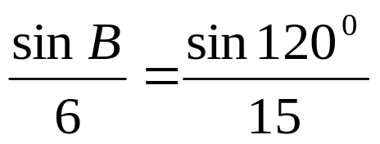
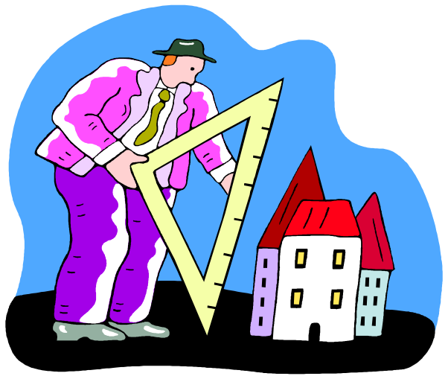
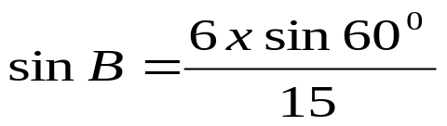
C
SOLUTION:
6 cm
15 cm
120⁰
A
B
sin B = 0.346
B= 20.3⁰

Slide 7
DRILL:
SOLVE THE FOLLOWING USING THE SINE RULE:
Problem 1 (Given two angles and a side)
In triangle ABC, ∠A = 59°, ∠B = 39° and a = 6.73cm.
Find angle C, sides b and c.
Problem 2 (Given two sides and an acute angle)
In triangle ABC , ∠A = 55°, b = 16.3cm and
a = 14.3cm. Find angle B, angle C and side c.
Problem 3 (Given two sides and an obtuse angle)
In triangle ABC ∠A =100°, b = 5cm and a = 7.7cm
Find the unknown angles and side.

Slide 8
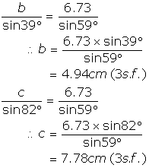
Answer Problem 1
∠C = 180° - (39° + 59°)
= 82°

Slide 9
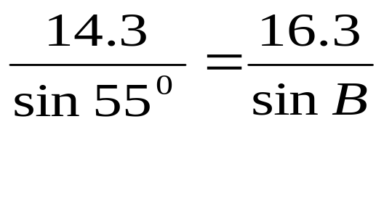
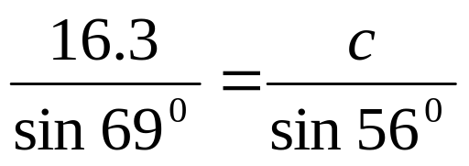
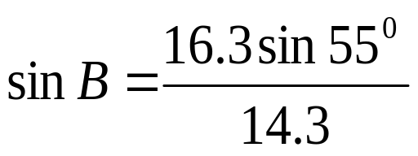
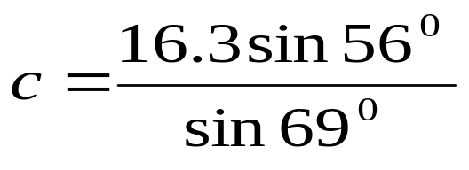
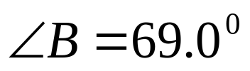

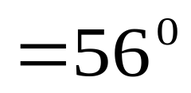
ANSWER PROBLEM 2
= 0.9337
= 14.5 cm (3 SF)

Slide 10
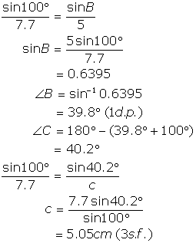
Answer Problem 3

Slide 11

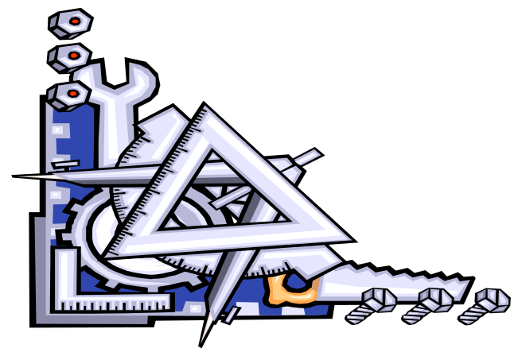
THE COSINE RULE

Slide 12
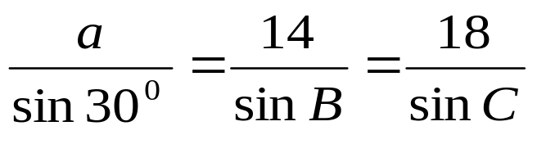
Sometimes the sine rule is not enough to help us
solve for a non-right angled triangle.
For example:
C
a
14
B
30⁰
18
A
In the triangle shown, we do not have enough information
to use the sine rule. That is, the sine rule only provided the
Following:
Where there are too many unknowns.

Slide 13
For this reason we derive another useful result, known as the
COSINE RULE. The Cosine Rule maybe used when:
Two sides and an included angle are given.
Three sides are given
C
a
C
A
B
b
a
c
c
A
B
The cosine Rule: To find the length of a side
a² = b²+ c² - 2bc cos A
b² = a² + c² - 2ac cos B
c² = a² + b² - 2ab cos C

Slide 14
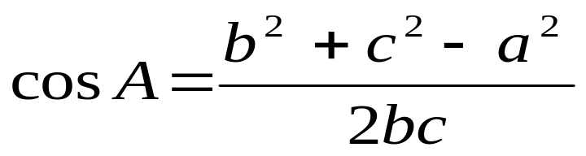
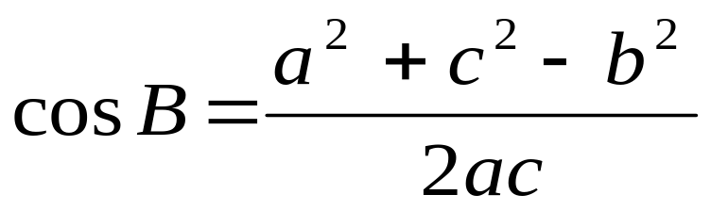
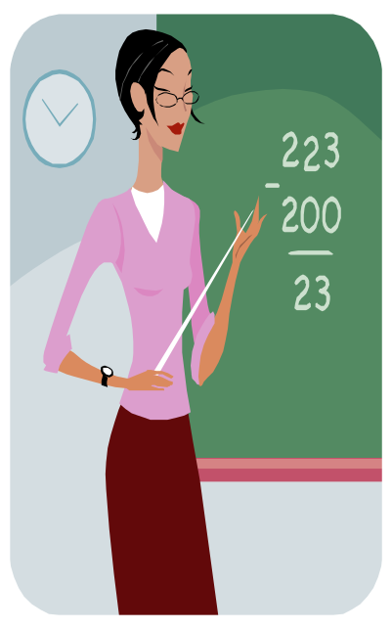
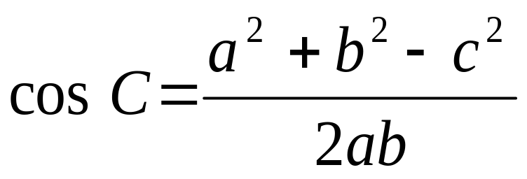
THE COSINE RULE: To find an angle when given all three
sides.

Slide 15
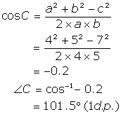
Example 1 (Given three sides)
In triangle ABC, a = 4cm, b = 5cm and
c = 7cm. Find the size of the largest angle. The largest angle is the one facing the longest side, which is angle C.

Slide 16
DRILL:
ANSWER
PAGE 203
#’S 1-10

Slide 17
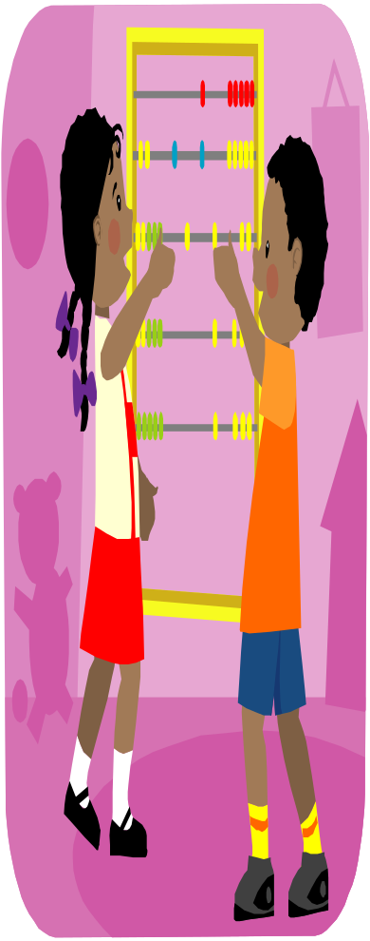
END
THANK YOU!!!

