Slide 1
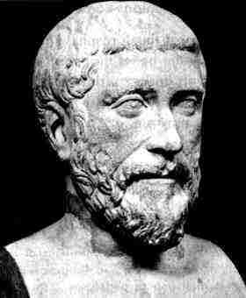
THE
PYTHAGORAS'
THEOREM
Powerpoint hosted on www.worldofteaching.com
Please visit for 1000’s more free powerpoints

Slide 2


Slide 3
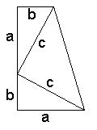
This proof was discovered by President J.A. Garfield in 1876 .
The key is the formula for the area of a trapezoid –
half sum of the bases times the altitude –
½ * (a+b) * (a+b).
Looking at the picture another way, this also
can be computed as the
sum of areas of the three triangles –
½*a*b + ½*a*b + ½*c*c.
As before, simplifications yield a²+ b²=c².
Here is the following calculation.
½(a + b)(a + b) = ½ab + ½ab + ½cc
½(a + b)² = ½(ab + ab + cc)
(a + b)² = (ab + ab + cc)
a² + b² + 2ab = 2ab + c²
a² + b² = c²

Slide 4
EXAMPLES: Find the unknown variable
4 cm
d
d
x
13cm
7cm
5cm
Solution:
Solution:
d² = 13² - 5²
d² ⁺ 4²=7²
d² = 169 - 25
d² = 49 - 16
d = 5.74 cm
d² = 144
d = 12 cm
Solve for x
x² = 12² +12²
x²=144+144
x² = 288
x = 17.0 cm

Slide 5
Problem Analysis:
Find the length of a diagonal of a rectangle
of length 9 cm and width 4 cm.
4 cm
9 cm
Solution:
d² = 9² + 4²
d² = 81 + 16
d² = 97
d = 9.85 cm

Slide 6

A square has diagonals of length 10 cm.
Find the sides of the square.
10 cm
s² + s² = 10²
2s² = 100
s² = 50
s = 7.07 cm

Slide 7

A ship sails 20 km due North and then 35 km
due East. How far is it from its starting point?
Solution:
35 km
X² = 20² + 35²
X² = 400 + 1225
20km
X² = 1625
x
X = 40.3 km

Slide 8
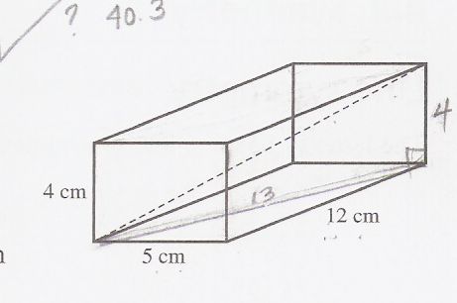
DRILL:
A 4 m ladder rests against a vertical wall
with its foot 2 m from the wall. How far up
the wall does the ladder reach?
2. Find the length of a diagonal of a rectangular box of length 12 cm, width 5 cm and height 4 cm.

Slide 9
“It is better wither to be silent, or to say things
of more value than silence.
Sooner throw a pearl at hazard
than an idle or useless word;
and do not say a little in many
words, but a great deal in a few. “
-Pythagoras

Slide 10

END
THANK YOU!!!

