Slide 1
Volume of a Cylinder

Slide 2
What is Volume?
The volume of a three-dimensional figure is the amount of space within it.
Measured in Units Cubed (e.g. cm3)

Slide 3

Volume of a Prism
Volume of a Prism is calculated by
Volume = Area of cross section x perpendicular height
V = Ah
V = (4 x 4) x 4 = 64 m3

Slide 4
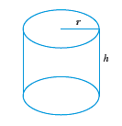
What is this?
It has 2 equal shapes at the base, but it is not a prism as it has rounded sides
It is a Cylinder

Slide 5
Volume of a Cylinder
How might we find the Volume of a Cylinder?

Slide 6

Example
V = Ah

Slide 7
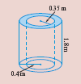
Pieces Missing
Find the volume of concrete used to make this pipe
Volume of Concrete = Volume of Big Cylinder – Volume of Small Cylinder (hole)

Slide 8

What shape is present here?

Slide 9
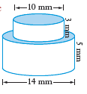
What 3D shapes can you see?

Slide 10
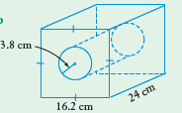
HOME WORK
Find the Volume of the Solid. To 1 decimal place

Slide 11
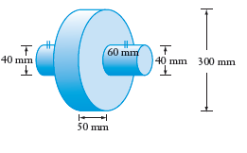
Homework/Challenge
Challenge Question

Slide 12
Volume of a Cylinder
How might we find the Volume of a Cylinder?
V = Ah
  =

Slide 13
Conversion of units
1cm – 10mm
1m – 100cm
1km – 1000m

Slide 14
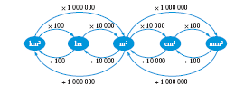
Conversions of Units
1 cm2 = 10 mm x 10 mm =100 mm2
1 m2 = 100 cm x 100 cm = 10 000 cm2
1 m2 = 1000 mm x 1000 mm = 1 000 000 mm2
1 ha = 100 m x 100 m = 10 000 m2
1 km2 = 100 ha

Slide 15
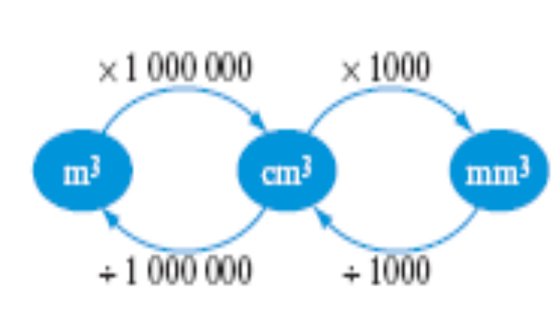
What about when cubic units?
1 cm³
= 1cm x 1cm x 1cm
= 10 mm × 10 mm × 10 mm
= 1000 mm³
1 m³
= 1m x 1m x 1m
= 100 cm × 100 cm × 100 cm
= 1 000 000 cm³

Slide 16

Capacity
Volume - The volume of a three-dimensional figure is the amount of space within it.
Measured in Units Cubed (e.g. cm3)
Volume and capacity are related.
Capacity is the amount of material (usually liquid) that a container can hold.
Capacity is measured in millilitres, litres and kilolitres.

Slide 17
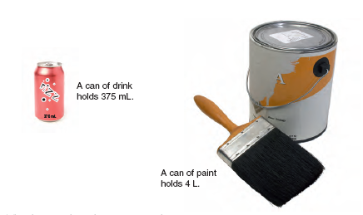
Examples of Capacity

Slide 18
How does Volume relate to Capacity?
1000 mL = 1 L
1000 L = 1 kL
1 cm³ = 1 mL
1,000cm³ = 1000ml = 1L
1 m³ = 1000 L = 1 kL

Slide 19
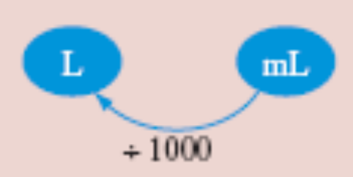
Examples
Convert 1800 mL to L
1800ml = 1800/1000
      = 1.8L
2.3 m3 to L 1m3 = 1000L (1kL)
2.3m3 = 2.3kL
      = 2300L

Slide 20
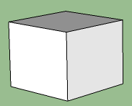
Capacity
Length = 5.53cm
Find the Capacity of this cube
Length = 5.53cm
V = Ah
= (5.53 x 5.53) x 5.53
= 169.11cm3 (1cm3 = 1ml)
Capacity = 169.11ml

Slide 21
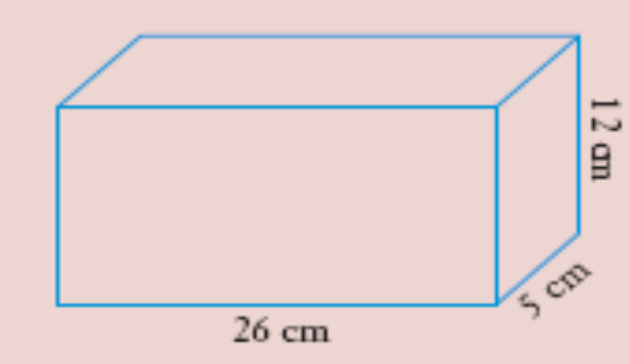
Example
Find the capacity of this rectangular prism.
Solution
Volume = Ah
= (26 x 12) x5
= 312 × 5
= 1560 cm3 (1cm3 = 1mL)
Capacity = 1560 mL or 1.56 L (1000mL = 1L)

Slide 22
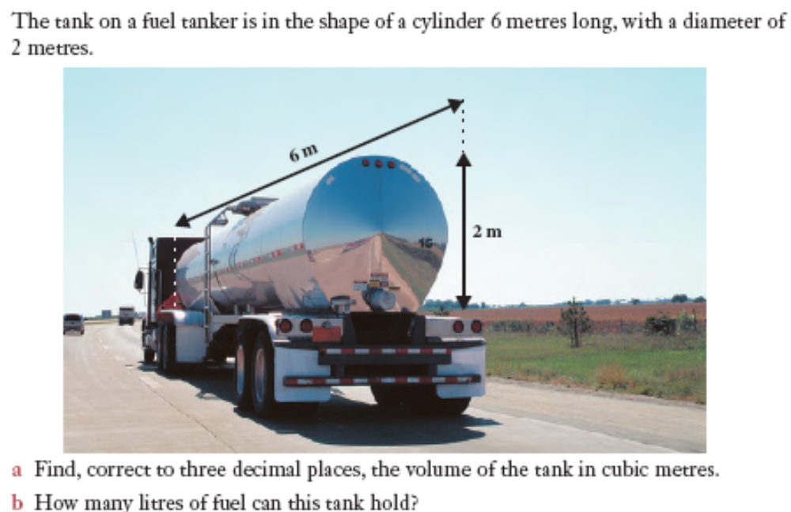
Ex 11.08 – Q 7.

Slide 23
What size rainwater tank would be needed to hold the run-off when 40 mm of rain falls on a roof 12 m long and 3.6 m wide? (Answer in litres.)

Slide 24
This powerpoint was kindly donated to
www.worldofteaching.com
http://www.worldofteaching.com
Is home to well over a thousand powerpoints submitted by teachers. This a free site. Please visit and I hope it will help in your teaching
Notes:
24

