Slide 1
GEOMETRY
Circle Terminology

Slide 2
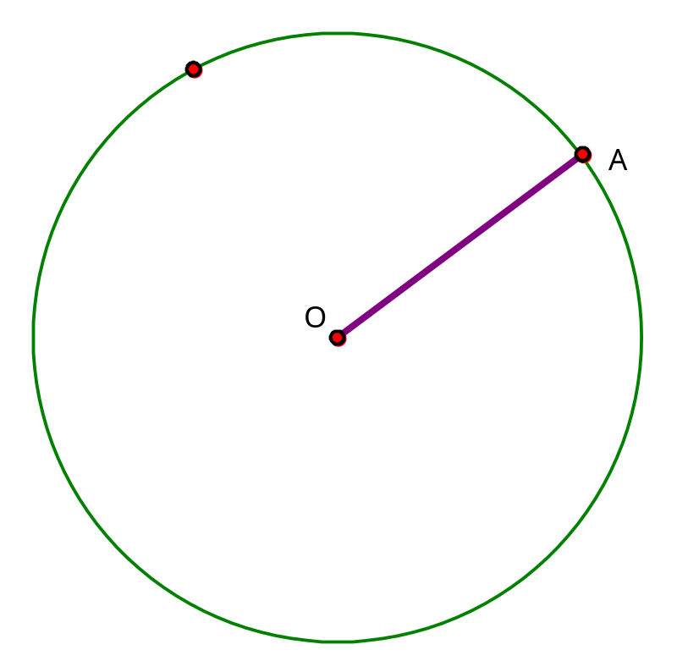
Radius (or Radii for plural)
The segment joining the center of a circle to a point on the circle.
Example: OA

Slide 3
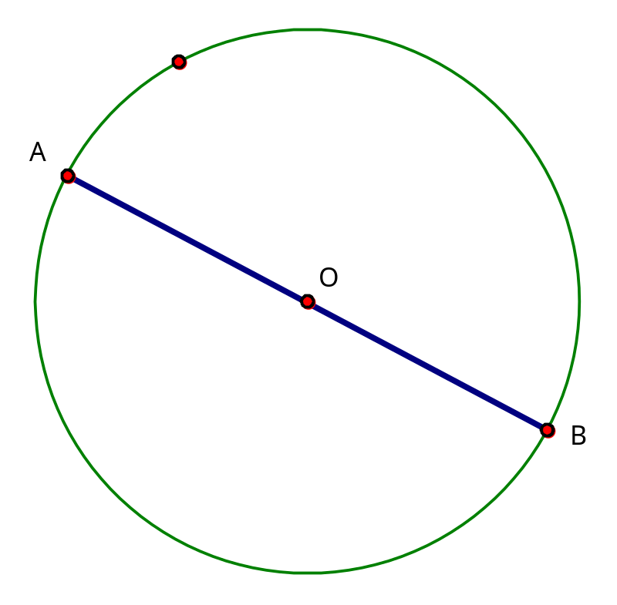
Diameter
A chord that passes through the center of a circle.
Example: AB

Slide 4
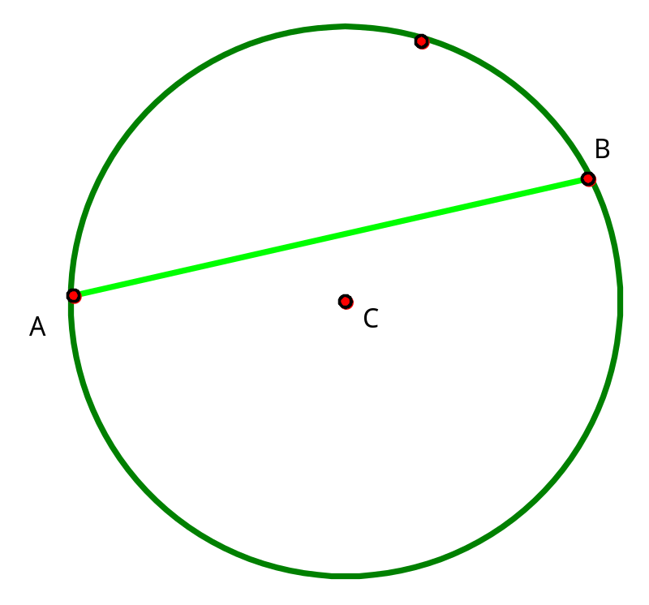
Chord
A segment joining two points on a circle
Example: AB

Slide 5
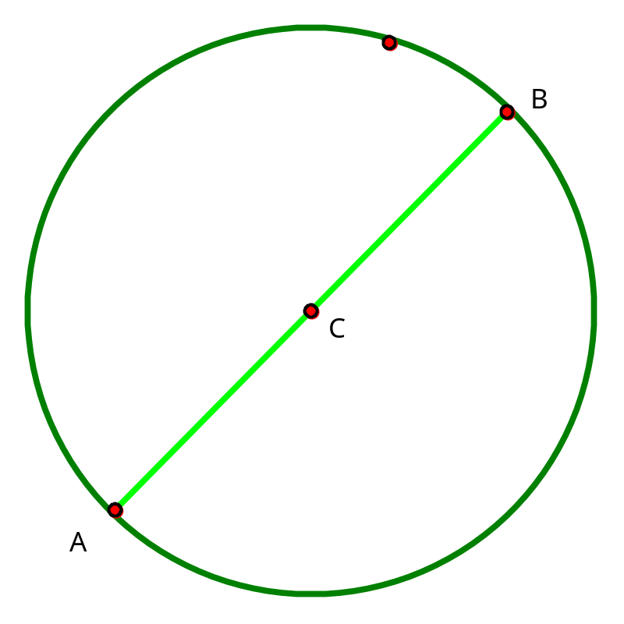
Chord
A segment joining two points on a circle
Example: AB

Slide 6
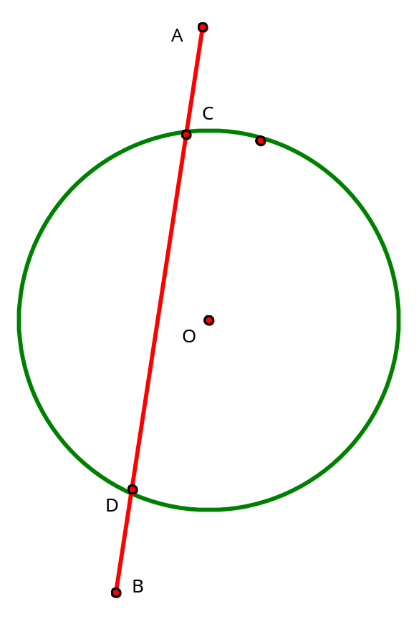
Secant
A line that intersects the circle at exactly two points.
Example: AB

Slide 7
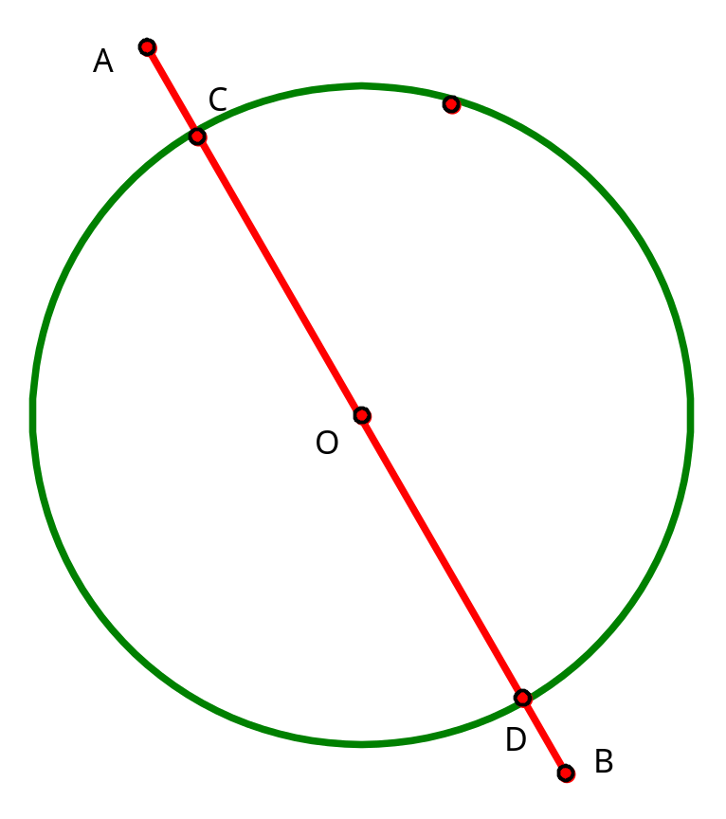
Secant
A line that intersects the circle at exactly two points.
Example: AB

Slide 8
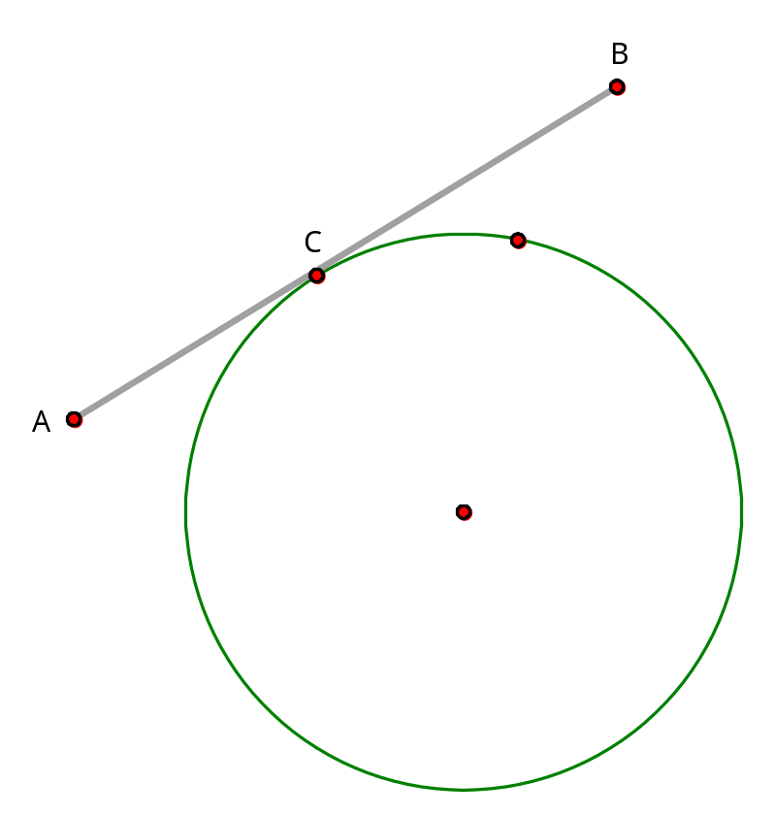
Tangent
A line that intersects a circle at exactly one point.
Example: AB

Slide 9
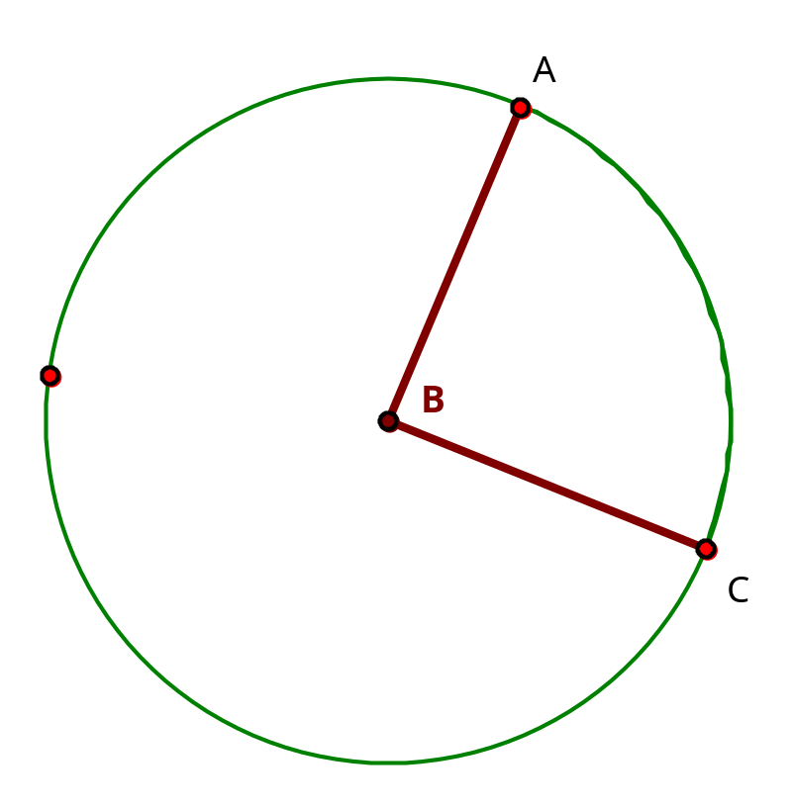
Central Angle
An angle whose vertex is at the center of a circle.
Example: Angle ABC

Slide 10
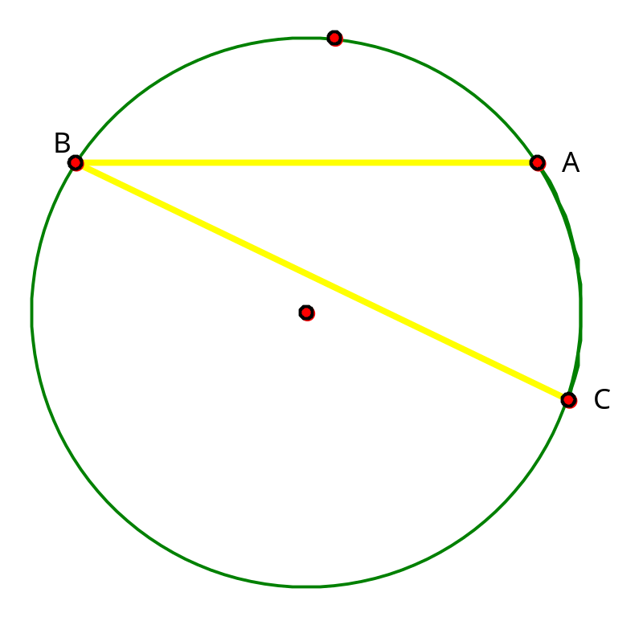
Inscribed Angle
An angle whose vertex is on a circle and whose sides are determined by two chords.
Example: Angle ABC

Slide 11
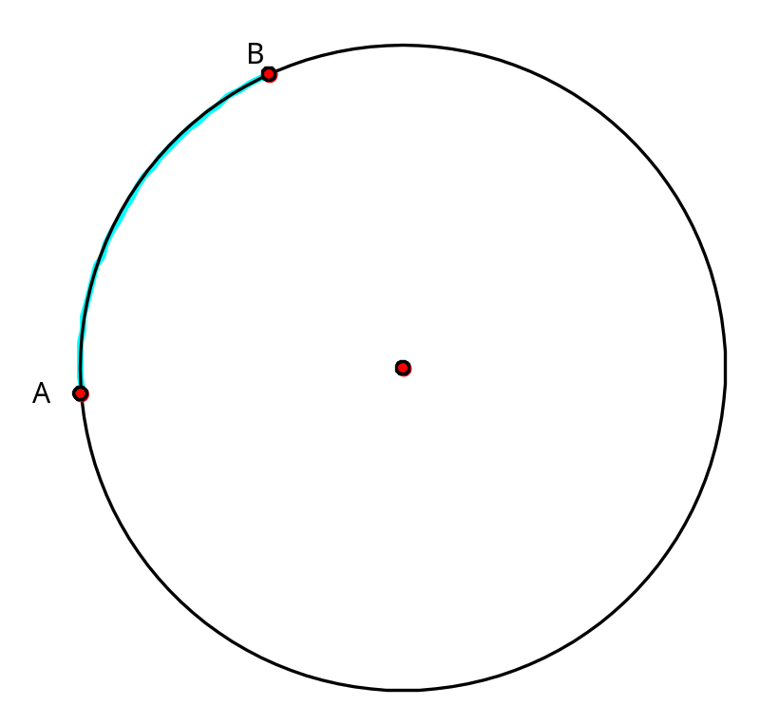
Arc
A figure consisting of two points on a circle and all the points on the circle needed to connect them by a single path.
Example: arc AB

Slide 12
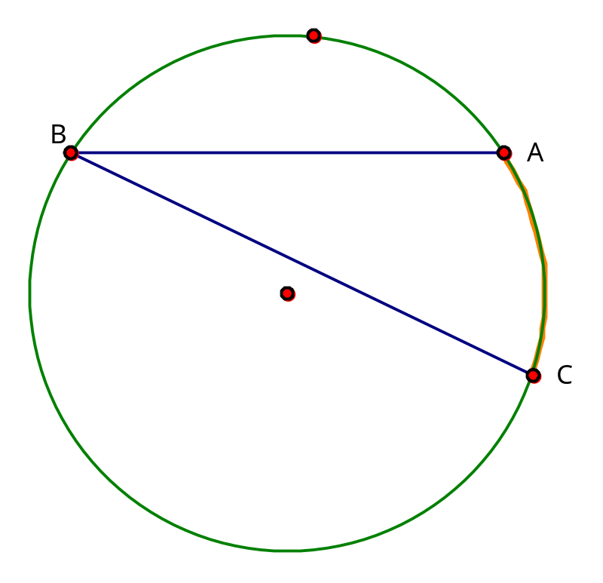
Intercepted Arc
An arc that lies in the interior of an inscribed angle.
Example: arc AC

Slide 13
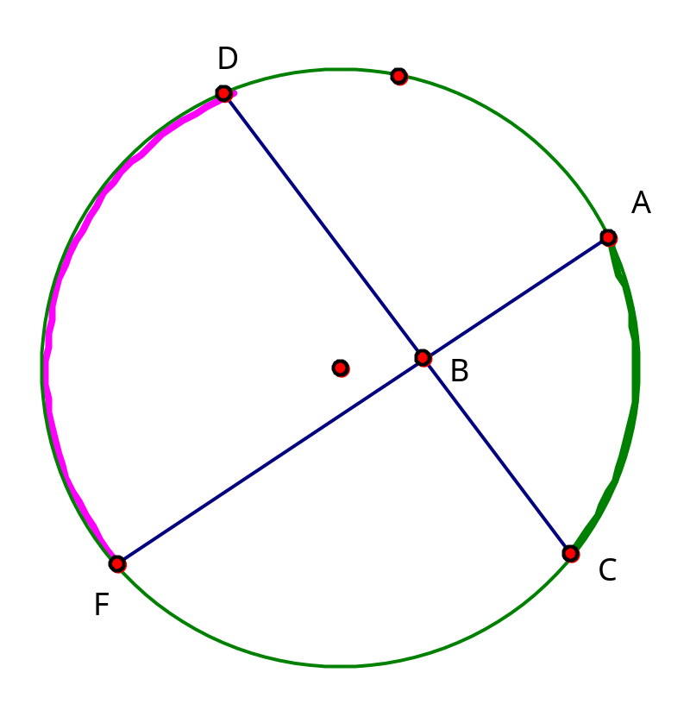
Two Intercepted Arc
If angle is inside the circle.
Example: arc AC
arc DF

Slide 14
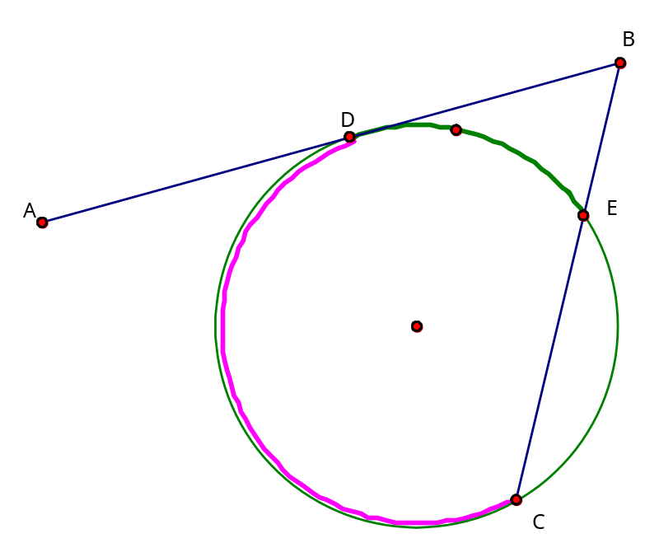
Two Intercepted Arc
If angle is outside the circle.
Example: arc DE
arc DC

Slide 15
Investigating Measures of Angles
Related to a Circle
Click on GSP 4.00 on the desktop.
Follow the instructions on the handout.

Slide 16
This powerpoint was kindly donated to www.worldofteaching.com
http://www.worldofteaching.com is home to over a thousand powerpoints submitted by teachers. This is a completely free site and requires no registration. Please visit and I hope it will help in your teaching.

