Slide 1
Proving Triangles Congruent

Slide 2
The Idea of a Congruence
Two geometric figures with exactly the same size and shape.
F
B
A
C
E
D

Slide 3
How much do you
need to know. . .
. . . about two triangles
to prove that they
are congruent?

Slide 4
Corresponding Parts
In Lesson 4.2, you learned that if all six pairs of corresponding parts (sides and angles) are congruent, then the triangles are congruent.
AB ≅ DE
BC ≅ EF
AC ≅ DF
∠ A ≅ ∠ D
∠ B ≅ ∠ E
∠ C ≅ ∠ F
B
A
C
ΔABC ≅ Δ DEF
E
F
D

Slide 5

Do you need all six ?
NO !
SSS
SAS
ASA
AAS

Slide 6
Side-Side-Side (SSS)
B
E
F
A
C
D
AB ≅ DE
BC ≅ EF
AC ≅ DF
ΔABC ≅ Δ DEF

Slide 7
Side-Angle-Side (SAS)
B
E
F
A
C
D
AB ≅ DE
∠A ≅ ∠ D
AC ≅ DF
ΔABC ≅ Δ DEF
included
angle

Slide 8
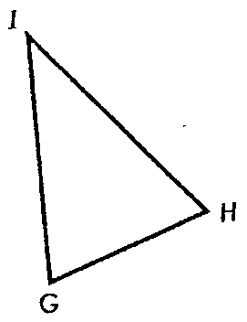
Included Angle
The angle between two sides
∠ G
∠ I
∠ H

Slide 9
Included Angle
Name the included angle:
YE and ES
ES and YS
YS and YE
E
∠ E
∠ S
∠ Y
Y
S

Slide 10
Angle-Side-Angle (ASA)
B
E
F
A
C
D
∠A ≅ ∠ D
AB ≅ DE
∠ B ≅ ∠ E
ΔABC ≅ Δ DEF
included
side

Slide 11
Included Side
The side between two angles
GI
HI
GH

Slide 12
Included Side
Name the included angle:
∠Y and ∠E
∠E and ∠S
∠S and ∠Y
E
YE
ES
Y
S
SY

Slide 13
Angle-Angle-Side (AAS)
B
E
F
A
C
D
∠A ≅ ∠ D
∠ B ≅ ∠ E
BC ≅ EF
ΔABC ≅ Δ DEF
Non-included
side

Slide 14
Warning: No SSA Postulate
There is no such thing as an SSA postulate!
B
E
F
A
C
D
NOT CONGRUENT

Slide 15
Warning: No AAA Postulate
There is no such thing as an AAA postulate!
B
E
A
C
F
D
NOT CONGRUENT

Slide 16
The Congruence Postulates
SSS correspondence
ASA correspondence
SAS correspondence
AAS correspondence
SSA correspondence
AAA correspondence

Slide 17
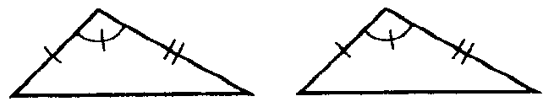
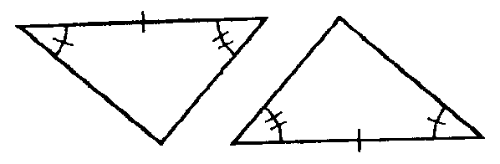
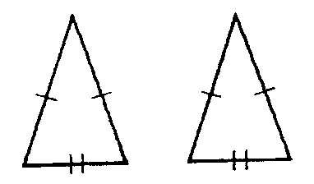
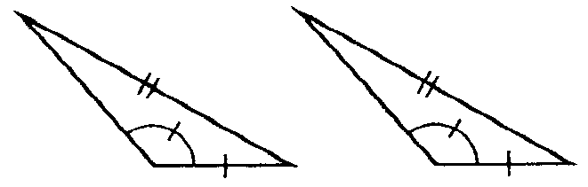
Name That Postulate
(when possible)
SAS
ASA
SSA
SSS

Slide 18
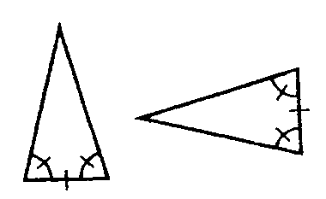
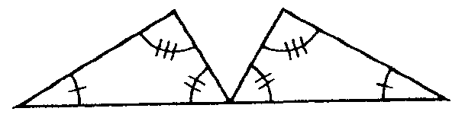
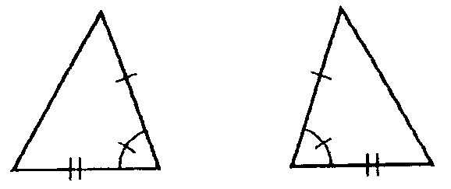
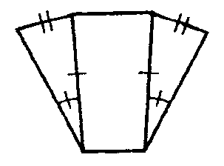
Name That Postulate
(when possible)
AAA
ASA
SAS
SSA

Slide 19
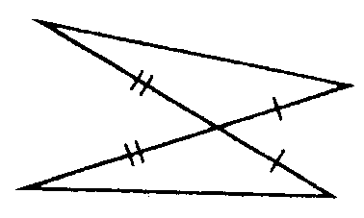
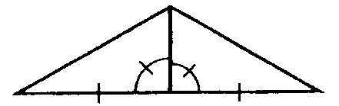
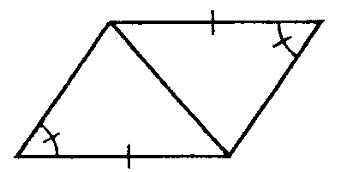
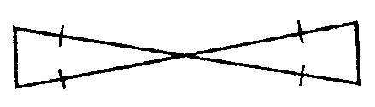
Name That Postulate
(when possible)
Vertical Angles
Reflexive Property
SAS
SAS
Vertical Angles
Reflexive Property
SAS
SSA

Slide 20
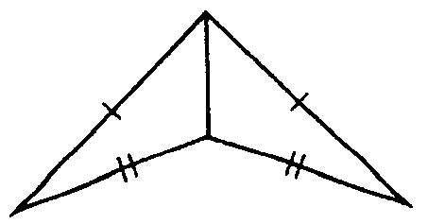
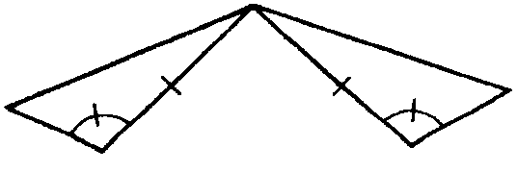
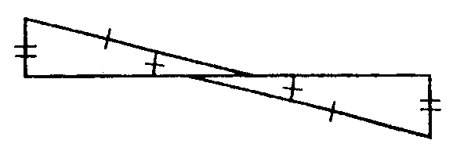
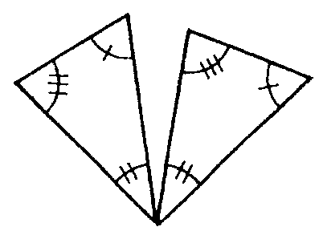
HW: Name That Postulate
(when possible)

Slide 21
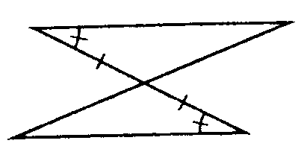
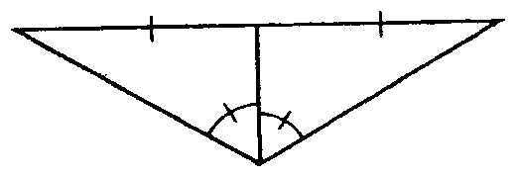
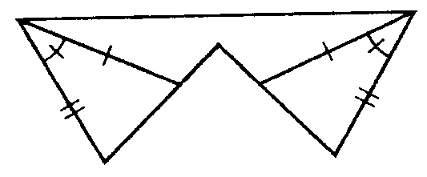
HW: Name That Postulate
(when possible)

Slide 22
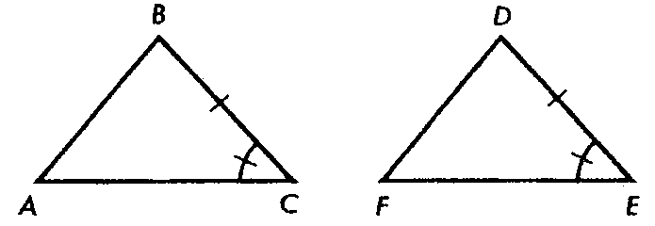
Let’s Practice
Indicate the additional information needed to enable us to apply the specified congruence postulate.
For ASA:
∠B ≅ ∠D
For SAS:
AC ≅ FE
For AAS:
∠A ≅ ∠F

Slide 23
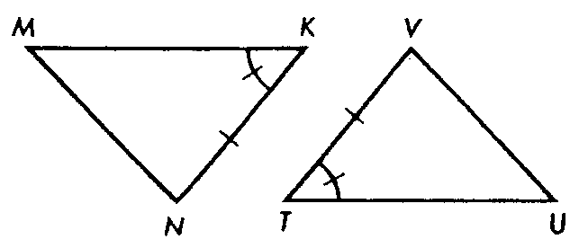
HW
Indicate the additional information needed to enable us to apply the specified congruence postulate.
For ASA:
For SAS:
For AAS:

Slide 24
This powerpoint was kindly donated to www.worldofteaching.com
http://www.worldofteaching.com is home to over a thousand powerpoints submitted by teachers. This is a completely free site and requires no registration. Please visit and I hope it will help in your teaching.

