Slide 1
Graphing Linear Equations
Linear Equations can be graphed on a Cartesian Coordinate system

Slide 2

y-axis
x-axis
Cartesian Coordinate system

Slide 3
y-axis
Quadrant II
Quadrant I
Origin
x-axis
Quadrant III
Quadrant IV

Slide 4
All points on a graph are plotted by first finding the x-coordinate and then the y-coordinate
You always graph a point starting from the Origin
All points are written in the form ( x , y )

Slide 5
Quadrant II
Quadrant I
x is negative
y is positive
x is positive
y is positive
Quadrant III
Quadrant IV
x is negative
y is negative
x is positive
y is negative

Slide 6
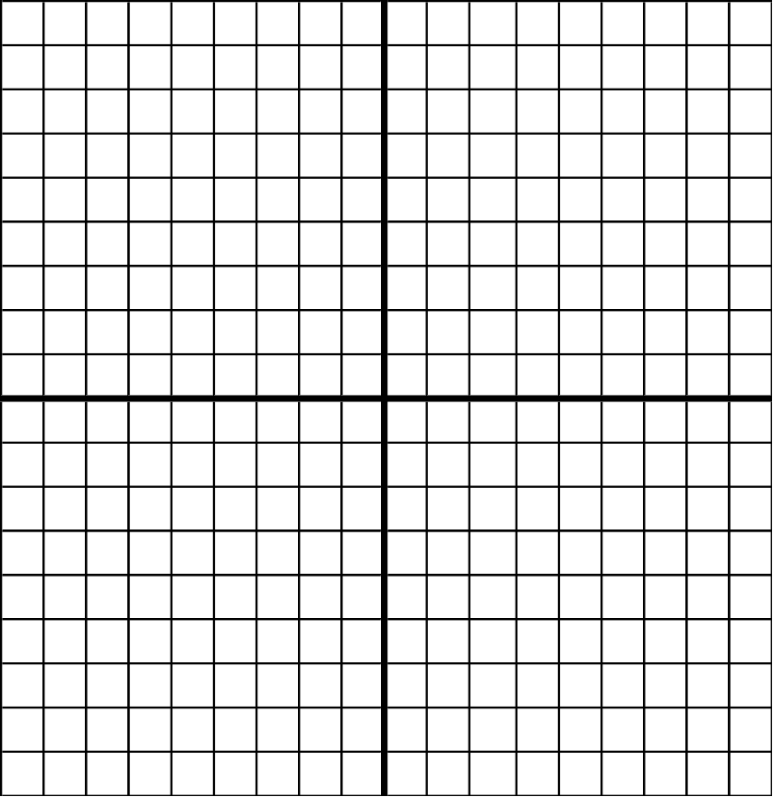
Point (3,5)

Slide 7
In order to graph a line, you need to know either:
A point and the Slope of the line
Two points on the line
OR

Slide 8
This powerpoint was kindly donated to www.worldofteaching.com
http://www.worldofteaching.com is home to over a thousand powerpoints submitted by teachers. This is a completely free site and requires no registration. Please visit and I hope it will help in your teaching.

