Slide 1
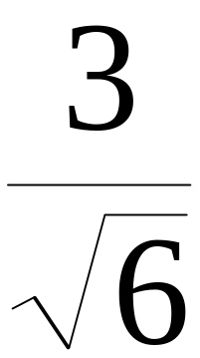
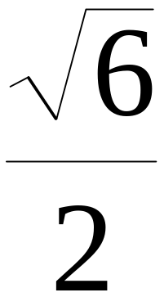
Rationalizing

Slide 2
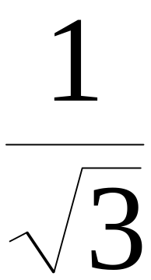
There is an agreement
in mathematics
that we don’t leave a radical
in the denominator
of a fraction.

Slide 3
So how do we change the denominator of a fraction?
(Without changing the value of the fraction, of course.)

Slide 4
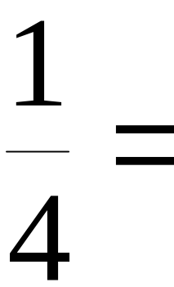
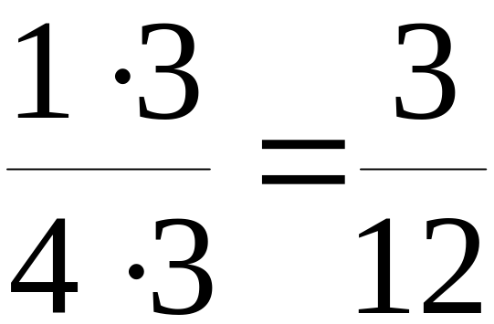
The same way we change the denominator of any fraction!
(Without changing the value of the fraction, of course.)

Slide 5
We multiply the denominator
and the numerator
by the same number.

Slide 6
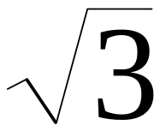
By what number
can we multiply
to change it
to a rational number?

Slide 7
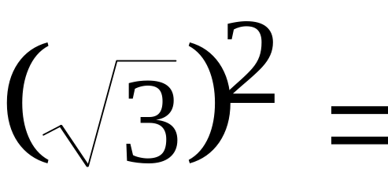
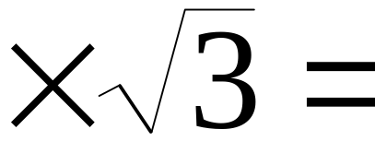

The answer is . . .
. . . by itself!

Slide 8
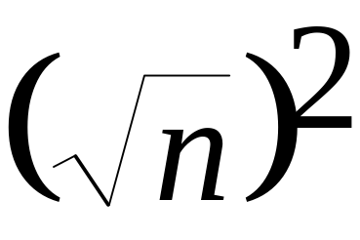
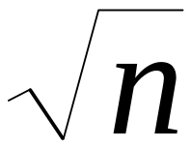

Remember,
is the number we square
to get n.
So when we square it,
we’d better get n.

Slide 9
In our fraction, to get the radical out of the denominator, we can multiply numerator and denominator by .

Slide 10
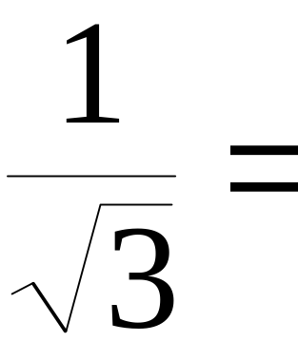
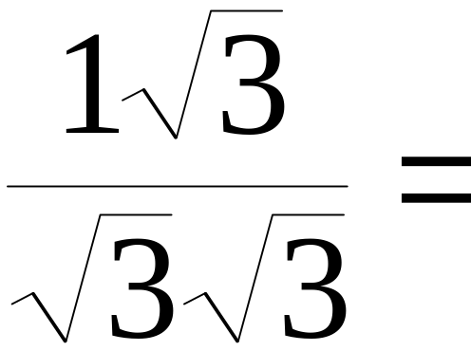
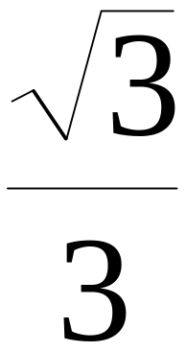
In our fraction, to get the radical out of the denominator, we can multiply numerator and denominator by .

Slide 11
Because we are changing the denominator
to a rational number,
we call this process rationalizing.

Slide 12

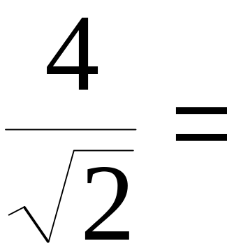
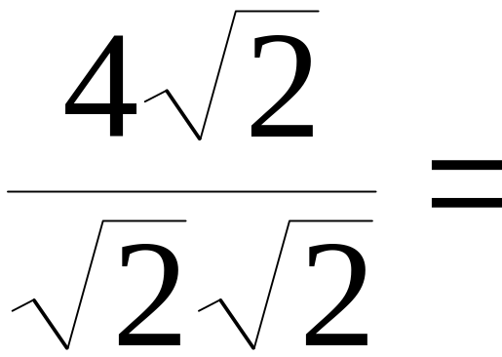
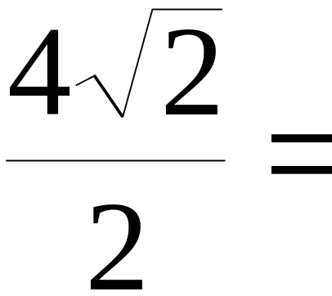
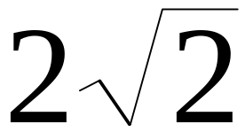
Rationalize the denominator:
(Don’t forget to simplify)

Slide 13
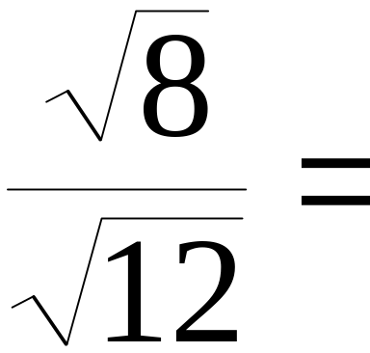
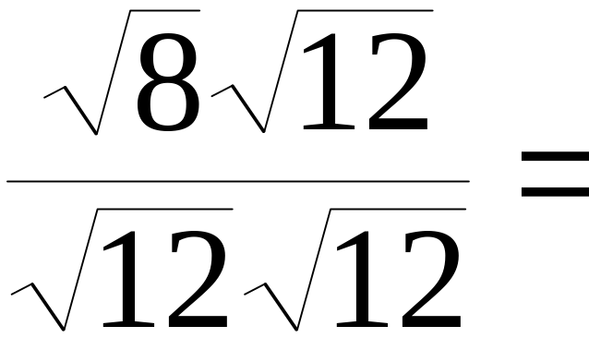
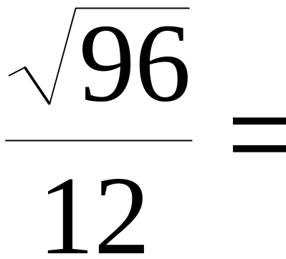
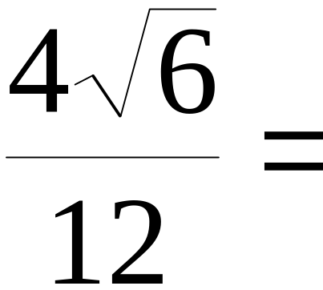
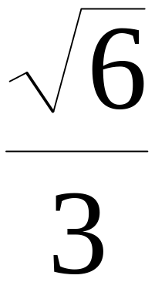
Rationalize the denominator:
(Don’t forget to simplify)
(Don’t forget to simplify)

Slide 14
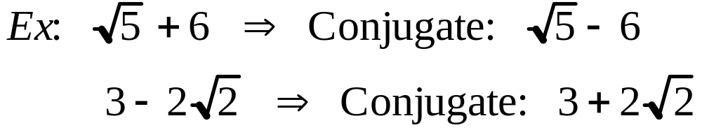
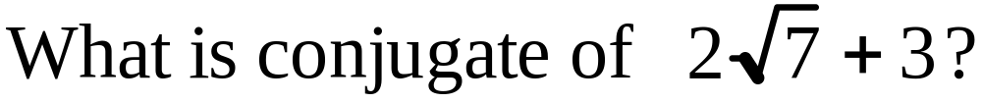
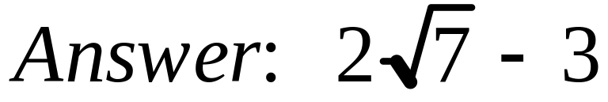
When there is a binomial with a radical in the denominator of a fraction, you find the conjugate and multiply. This gives a rational denominator.

Slide 15
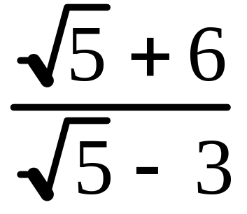
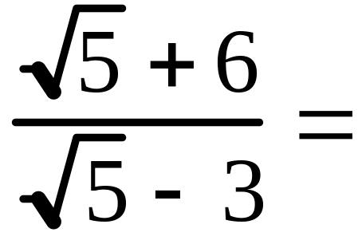
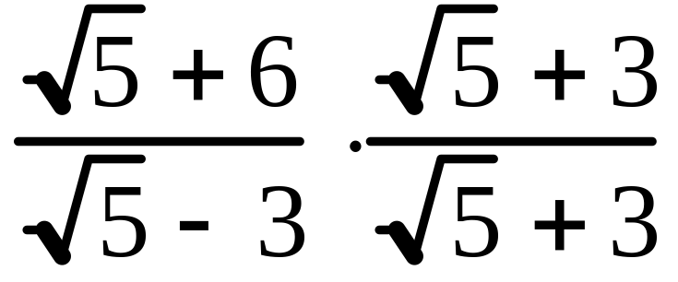
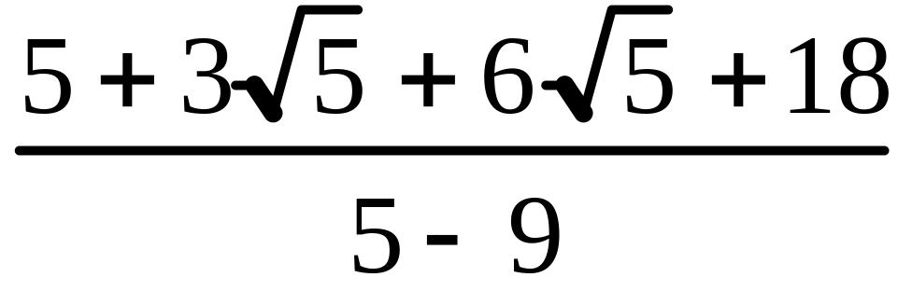
Simplify:
Multiply by the conjugate.
FOIL numerator and denominator.
Next

Slide 16
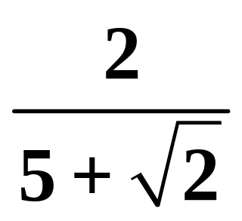
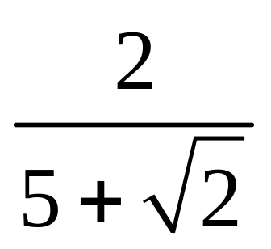
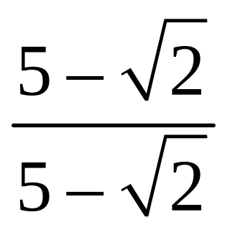
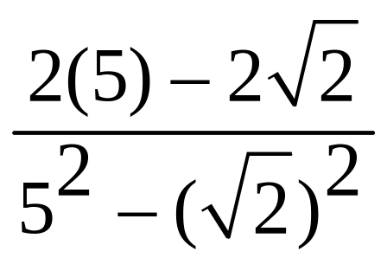
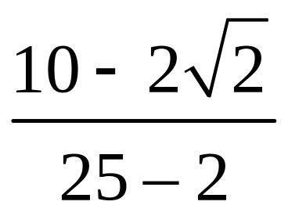
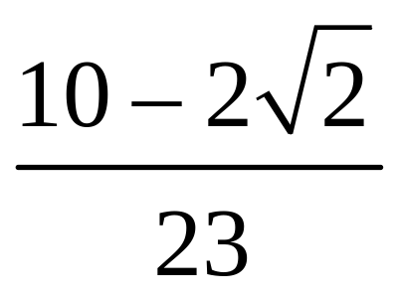
Simplify
·
=

Slide 17
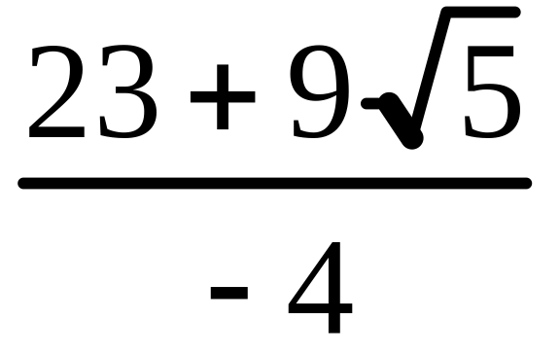
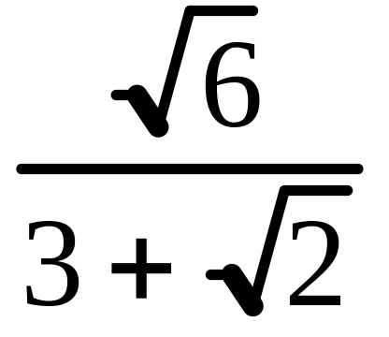
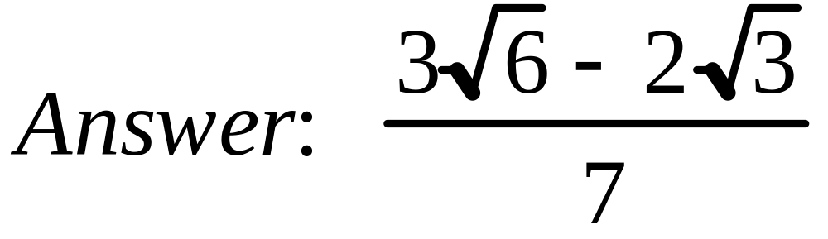
Combine like terms
Try this on your own:

Slide 18
This powerpoint was kindly donated to www.worldofteaching.com
http://www.worldofteaching.com is home to over a thousand powerpoints submitted by teachers. This is a completely free site and requires no registration. Please visit and I hope it will help in your teaching.

