Slide 1
1-2 Simplifying Expressions.

Slide 2
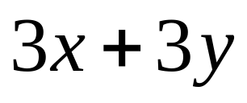
Expressions
A group of symbols used to represent a number
The number represented by the expression
Value

Slide 3
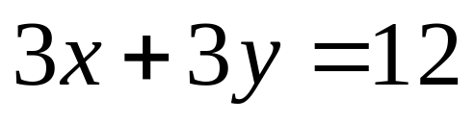
Equation
A combination of an expression and a value

Slide 4
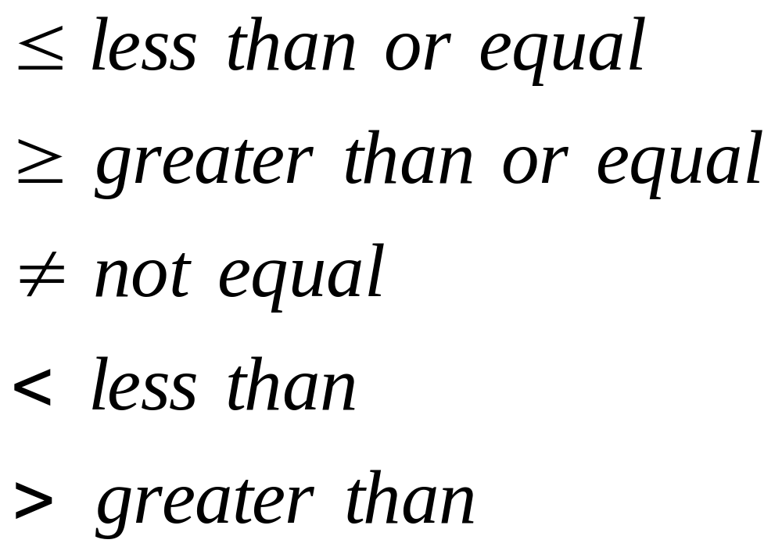
Inequality Symbols

Slide 5
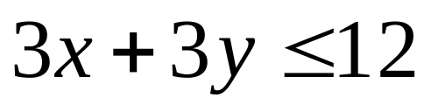
Inequalities
Made by placing an inequality symbol between an expression and a value

Slide 6
Results
Sum is the result of addition
Difference is the result of subtraction
Product is the result of multiplication
Quotient is the result of division.

Slide 7
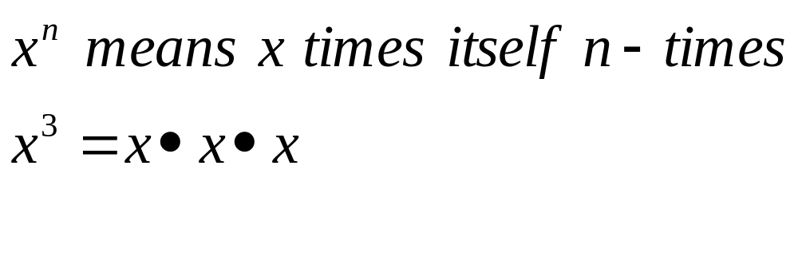
Powers

Slide 8
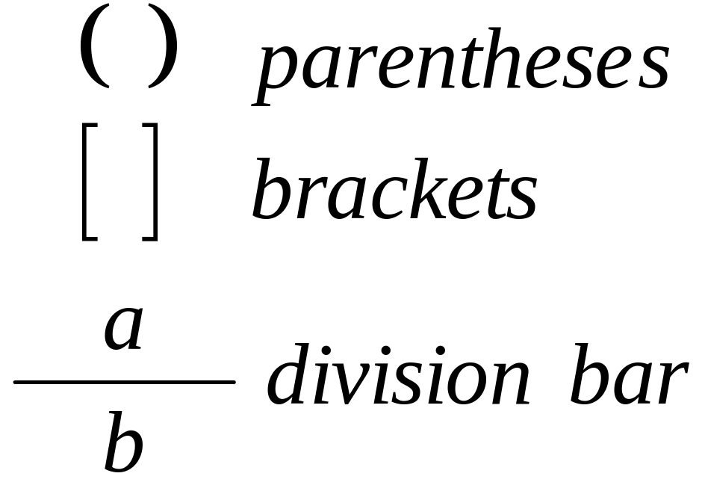
Grouping Symbols
Three main grouping symbols

Slide 9
Order of Operations
1st Grouping symbols
2nd Powers
3rd Multiplication & Division
4th Addition & Subtraction

Slide 10
Questions
Assignment: Pages 10 - 11 / 2 - 44 evens
No Calculators

Slide 11
This powerpoint was kindly donated to www.worldofteaching.com
http://www.worldofteaching.com is home to over a thousand powerpoints submitted by teachers. This is a completely free site and requires no registration. Please visit and I hope it will help in your teaching.

