Slide 1
MATHEMATICS
SQUARES
SQUARE ROOTS

Slide 2
TODAY’S MATH PREVIEW
AREA OF SQUARES
AREA OF RECTANGLES
AREA OF TRIANGLES
CONNECTIONS
  Exponents
  Pythagorean Theorem

Slide 3
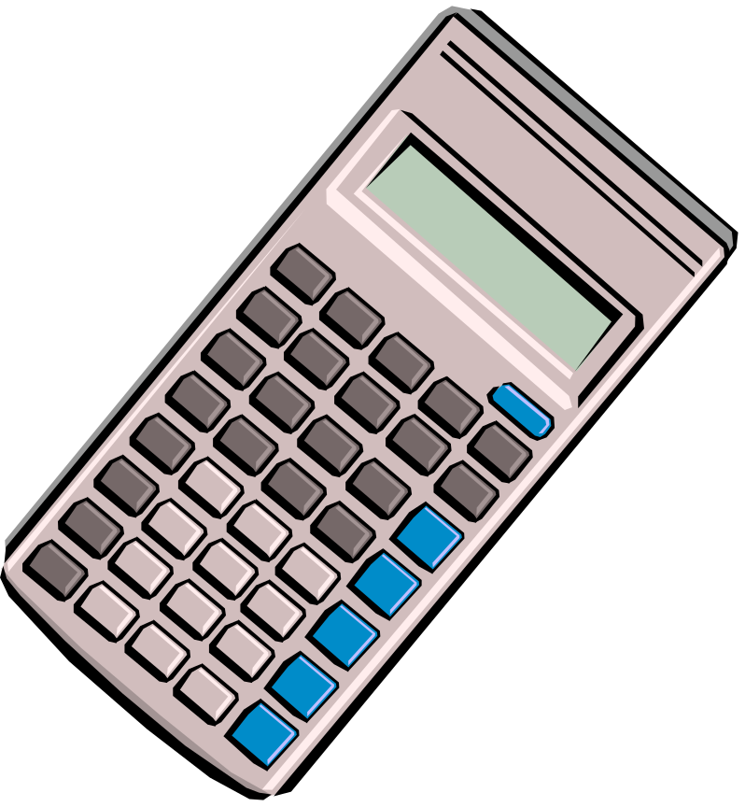
MATH RELATIONS
Square Roots
Scientific Calculators

Slide 4

Area of Squares
Area formula:
A=s² (A=area & s=side)
S²means sxs

Slide 5

Area of Rectangles
Area formula:
A = l x w
L = length
W = width

Slide 6

Area of Triangles
  Area formula:
  A = ½ bh
  B = base
  H = height or altitude

Slide 7
Types of Triangles
Acute: triangles with angles less than 90º
Obtuse: triangles with one angle greater than 90º but less than 180º
Right: triangles with one angle equaling 90º

Slide 8
CONNECTIONS
Exponents:
7² = 7 x 7
7² where 7 is the BASE and ² is the exponent.
Pythagorean Theorem:
A²+B²=C²
The square root of A & B are legs and the square root of C is the hypotenuse of the right triangle

Slide 9

Square Roots
One of the two equal factors of a number.
A square root of 144 is 12 since 12 squared = 144.

Slide 10

Scientific Calculator
Enter square root symbol before entering the number
Press enter or equal

Slide 11
This powerpoint was kindly donated to www.worldofteaching.com
http://www.worldofteaching.com is home to over a thousand powerpoints submitted by teachers. This is a completely free site and requires no registration. Please visit and I hope it will help in your teaching.

