Slide 1
Volume
is the amount of space occupied by any 3-dimensional object.
1cm
1cm
1cm
Volume = base area x height
= 1cm² x 1cm
= 1cm²

Slide 2
Cuboid
Top
Top
Back
Back
Side 2
Side 2
Side 1
Front
Side 1
Front
Height (H)
Bottom
Bottom
Breadth (B)
Length (L)

Slide 3
The net
L
H
H
L
H
B
B
B
B
L
H
H
H
L
B
B
L

Slide 4
Total surface Area
L
L
H
L
H
B
B
B
B
H
H
L
H
L
H
L
L
Total surface Area = L x H + B x H + L x H + B x H + L x B + L x B
= 2 LxB + 2BxH + 2LxH
= 2 ( LB + BH + LH )

Slide 6
Cube
L
L
L
Volume = Base area x height
= L x L x L
= L³
Total surface area = 2LxL + 2LxL + 2LxL
= 6L²

Slide 7
Name
Figure
Volume
Total surface area
Sample net
Cube
L³
6L²
Cuboid
LxBxH
2(LxB + BxH + LxH)

Slide 8
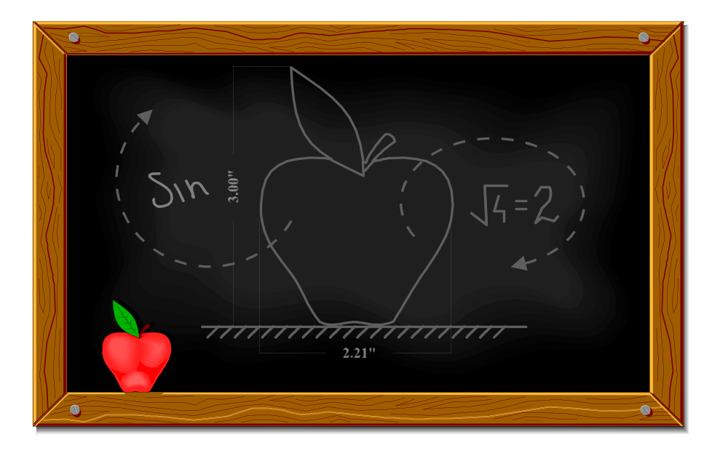
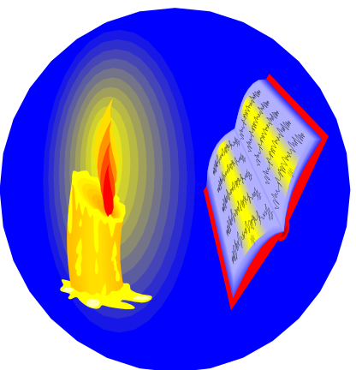
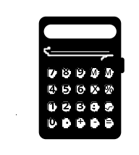
Show ends

Slide 9
This powerpoint was kindly donated to www.worldofteaching.com
http://www.worldofteaching.com is home to over a thousand powerpoints submitted by teachers. This is a completely free site and requires no registration. Please visit and I hope it will help in your teaching.

