Slide 1
The World Of Linear Equations
Writing Linear Equations
In Slope-Intercept Form
y = mx + b

Slide 2
If you are given:
The slope and y-intercept
Finding the equation of the line in y= mx + b form. Given: slope and y-intercept. Just substitute the “m” with the slope value and the “b” with the y-intercept value.
Slope = ½ and
y-intercept = -3
y= mx + b
½
-3
y= ½x – 3

Slide 3
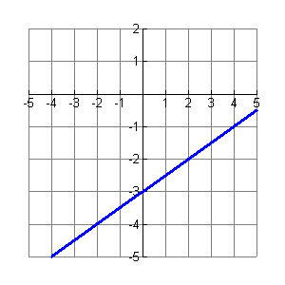
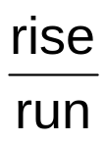
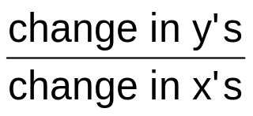
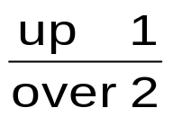
If you are given: A Graph
Find the:
y – intercept = b = the point where the line crosses the y axis.
Slope = = m =
y – intercept = b = -3
Slope = = m = ½
y= mx + b
-3
½
y= ½x – 3

Slide 4
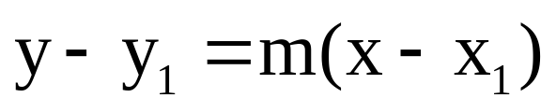
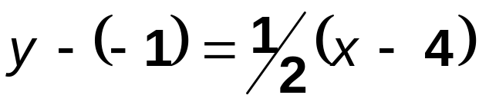
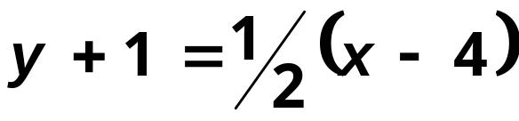
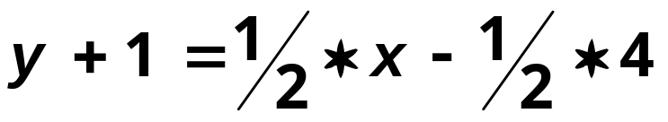
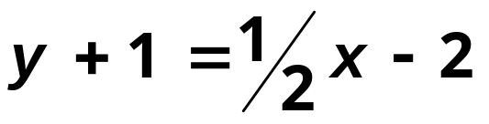
If you are given:
The slope and a point
Given: slope (m) and a point (x,y). To write equations given the slope and a point using Point-Slope Form.
½
Slope =½ and point (4,-1)
4
-1
Point-Slope Form
-1 -1
y= ½x – 3

Slide 5
If you are given:
The slope and a point
Given: slope (m) and a point (x,y). Substitute x, y, and m into y = mx+b and find the value of b (the y-intercept). Then write the equation substituting m and b values into y = mx + b.
½
Slope =½ and point (4,-1)
y = mx + b
4
-1
-1 = ½(4) + b
-1 = 2 + b
-2 -2
-3 = b So!
m = ½ and b = -3
y= ½x – 3

Slide 6
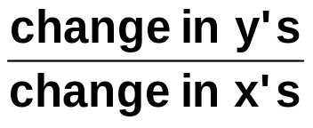
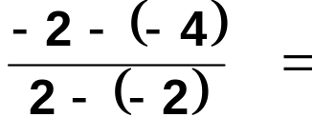
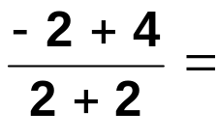
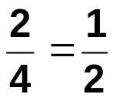
If you are given:
Two points
Finding the equation of the line in y= mx + b form. Given: Two points. First find the slope (m) and then substitute one of the points x and y values into y = mx+b along with the slope.
Find the:
Slope = = m =
½
Slope =½ and point (2, -2)
y = mx + b
2
-2
-2 = ½(2) + b
-2 = 1 + b
-1 -1
-3 = b So!
m = ½ and b = -3
Point (-2, -4) & Point (2, -2)
y= ½x – 3

Slide 7
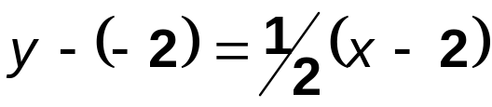
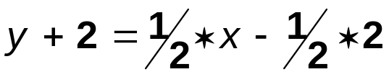
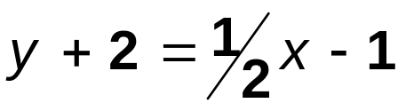
If you are given:
Two points
Finding the equation of the line in y= mx + b form. Given: Two points. First find the slope (m) and then substitute one of the points x and y values into Point-Slope Form.
Find the:
Slope = = m =
Slope =½ and point (2, -2)
½
2
-2
Point-Slope Form
Point (-2, -4) & Point (2, -2)
-2 -2
y= ½x – 3

Slide 8
This powerpoint was kindly donated to www.worldofteaching.com
http://www.worldofteaching.com is home to over a thousand powerpoints submitted by teachers. This is a completely free site and requires no registration. Please visit and I hope it will help in your teaching.

