Slide 1
Asexual Reproduction
World of Plants
Standard Grade Biology

Slide 2
 | Sexual Reproduction | Asexual Reproduction
Definition | Involves sex cells and fertilisation | Does not involve sex cells and fertilisation Only one parent plant
Advantages/ Disadvantages | Offspring are not genetically identical to one another There is variation in the offspring | Offspring have no variation Offspring are genetically identical to one another

Slide 3
Asexual reproduction
Also known as vegetative propagation
3 methods of vegetative propagtaion
-tubers
-bulbs
-runners

Slide 4
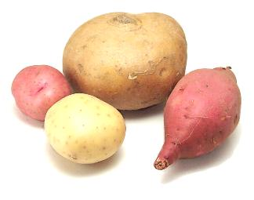
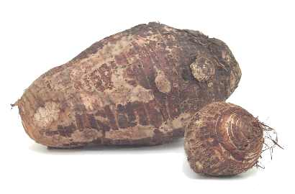
Tubers
Tubers are underground food stores which stores food over the winter and provides a new plant with food until it can make its own.
Examples: potato, artichoke, yam, cassava, water chestnut, arrowroot
Taro- Japanese potato
Food made by the new plant is sent to make new tubers. Thereby reproducing itself.
Notes:
Tuber info from http://www.foodsubs.com/Tubers.html

Slide 5
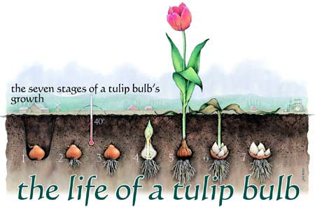
Bulbs
E.g. daffodils, lilies

Slide 6
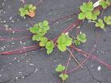
Runners
Runners are side shoots which grow out from the parent plant.
Buds form at points along the runner and eventually these buds form roots and grow into new plants.
Examples: spider plant (Anthericum), strawberry (Fragaria x ananassa)

Slide 7
Artificial Propagation
2 methods used to cultivate plants asexually
-taking cuttings
-grafting

Slide 8
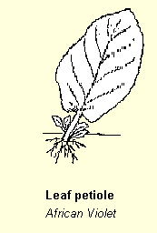
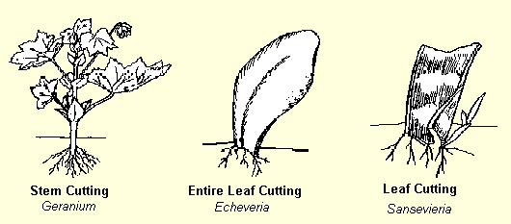
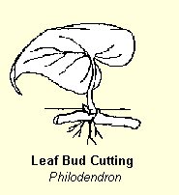
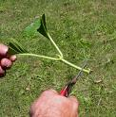
Cutting
Cuttings are small pieces of stem with some leaves attached, the new plant grows from this.
They can be placed in moist
soil or water (and sometimes
dipped in rooting
powder).
Notes:
SQA- Describe ways of propagating flowering plants artificially by cuttings and graftings
Source
counties.cce.cornell.edu/.../propagation.htm

Slide 9
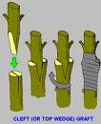
Grafting
A cut stem of one plant (with good flower or fruit growth) (the graft) is taken and firmly attached to the rootstock of another plant (which has a strong, established root system) (the stock).
Examples- roses, fruit trees

Slide 10
Commercial aspects
Artificial propagation has allowed us to adapt and improve plants for our own use.
Some of the benefits include:
Quick production of large numbers of genetically identical plants.
Specific varieties, desired features or consistent quality can be produced especially in fruit, flowers.
Notes:
ACTIVITY
WORKBOOK p42 Air Layering in clematis PS

Slide 11
This powerpoint was kindly donated to www.worldofteaching.com
http://www.worldofteaching.com is home to over a thousand powerpoints submitted by teachers. This is a completely free site and requires no registration. Please visit and I hope it will help in your teaching.

