Slide 1
Being Healthy
Breathing and the lungs

Slide 2
Objectives & Outcomes
Objective: Develop understanding of the structure of the lungs and gas exchange.
Outcomes:
All: Explain the process of breathing (4)
Most: Describe the difference between inhaled and exhaled air (5)
Some: Describe how alveoli are adapted for their purpose (6/7)
Extension: Describe how damaged alveoli can result in less gas exchange (7)

Slide 3
The Respiratory System
Gas exchange happens in the lungs.
You have 2 lungs, situated in your upper thorax / chest
Here, oxygen and carbon dioxide are exchanged – oxygen is needed for life and carbon dioxide is got rid of when we breathe out.

Slide 4
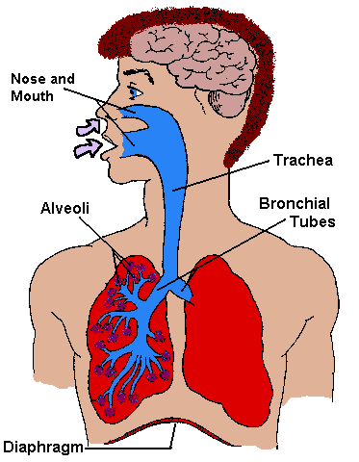
How do we breathe?
Mouth →
Windpipe/trachea →
bronchi →
bronchioles →
alveoli →
blood

Slide 5
Inhalation
(When we breathe in we inhale)

Slide 6
Exhalation
(When we breathe out we exhale)

Slide 7
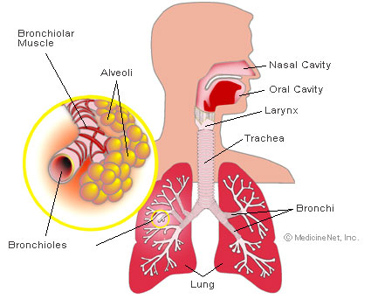
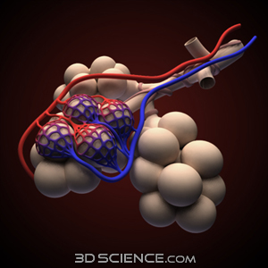
Exchanging gases

Slide 8
The Alveoli
Oxygen makes its way into thousands of special air sacs collectively called the ALVEOLI.
The outside of the alveoli is covered with tiny blood vessels.

Slide 9
The Alveolus
One of these alveoli is called the ALVEOLUS.
This is where the oxygen is transferred into the blood and carbon dioxide moves out of the blood.
If all these alveoli flattened and spread out onto the floor, they would cover an area the size of a tennis court!

Slide 10
Comparing inhaled and exhaled air
What are the big differences between inhaled and exhaled air?
How could you test for these?
Inhaled Air
Exhaled Air
Nitrogen (78%)
Oxygen (20.71%)
Carbon Dioxide (0.1%)
Other
Nitrogen (75.5%)
Oxygen (14.6%)
Carbon Dioxide (4%)
Other
…… water vapour.
There is another difference……

Slide 11
Lets take a closer look (avi)

Slide 12
Backup of as wmv file

Slide 13
avi

Slide 14
wmv

Slide 15
Task 1:
With a partner
Partner A – explain the process of breathing in and what gases exchange
Partner B – explain the process of breathing out and what gases exchange
Be prepared to share your answers with the class.

Slide 16
Task 2
Label diagram of lungs and indicate where oxygen and carbon dioxide exchange in the lungs.

Slide 17
Plenary
Objective: Develop understanding of the structure of the lungs and gas exchange.
Outcomes:
All: Explain the process of breathing (4)
Most: Describe the difference between inhaled and exhaled air (5)
Some: Describe how alveoli are adapted for their purpose (6/7)
Extension: Describe how damaged alveoli can result in less gas exchange (7)

Slide 18
This powerpoint was kindly donated to www.worldofteaching.com
http://www.worldofteaching.com is home to over a thousand powerpoints submitted by teachers. This is a completely free site and requires no registration. Please visit and I hope it will help in your teaching.

