Slide 1
A PRESENTATION REPORT ON
“BLOOD PATHOLOGY”
SUBMITTED TO :-
UNIVERSITY OF RAJASTHAN, JAIPUR
M.Sc. Final yr. (2010-11)
IN
BIOTECHNOLOGY
:- SUBMITTED BY:-
hanuman lal kumawat
M.Sc. Biotech.(int.)
Final year

Slide 2
About Hospital Lab
A Hospital Lab is a place where blood and other biological fluid is collected, tested and Resulted for pathology and diseses.

Slide 3
INTRODUCTION
A blood test is a lab analysis performed on a blood sample that is usually extracted from a vein in the arm using a needle, or via fingerprick.

Slide 4
Types of blood tests
Biochemical analysis
Molecular analysis
Cellular analysis

Slide 5
OBJECTIVE
To analysis blood compositions for prevention of blood dieses.

Slide 6
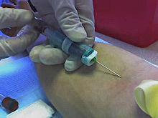
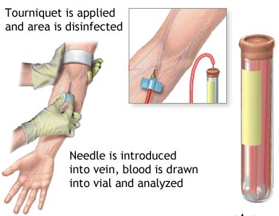
Process of blood sample collection
Blood sample collection performed using a vacationer
Blood is drawn from a vein (venipuncture), usually from the inside of the elbow or
the back of the hand.

Slide 7
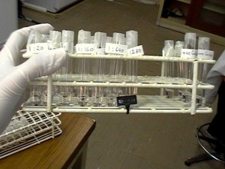
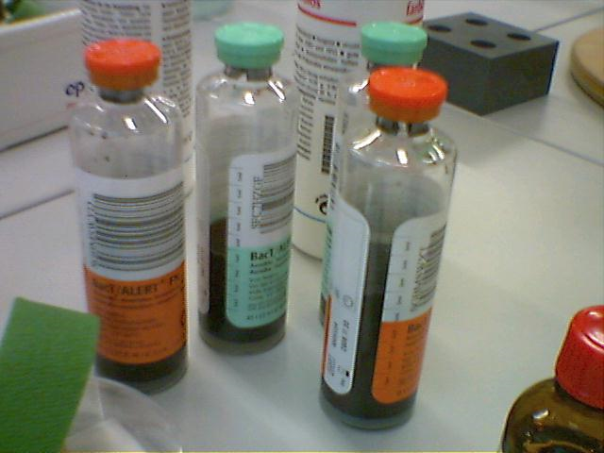
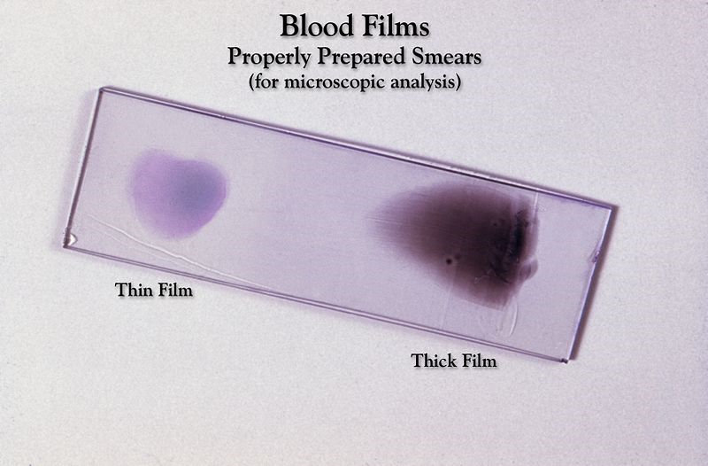
Involving Tests
Complete blood count
Blood culture
Blood film
Platelet count
Glucose test - blood
Widal Test
ELISA
Ammonium Ion

Slide 8
RESULTS of
Complete blood count:-
WBCs: 4,500–11,000 per microliter, RBCs: 4.2–5.0 million per microliter, Hemoglobin: 12–15 g/dL Hematocrit: 35–47% , Platelets: 150,000 per microliter.
Blood culture
Microbes not observed
Platelet count
150,000 to 400,000 platelets per microliter
Glucose test – blood
100 and 125 mg/dL

Slide 9
RESULTS for Normal Blood
Widal Test
IgM ratio 1: 160 IgG ratio 1:40
ELISA
Antigens not faund
Ammonium Ion
Not present

Slide 10
CONCLUSION
Any Abnormal Results Mean patient have a blood disorder.

Slide 11
Thank You For Sincerely Paying Attention…

