Slide 1
Cell And Tissue Culture
Mammalian Cells
Advanced Higher Biology

Slide 2
Why is it useful?
Gene manipulation
Culturing mammalian cells for cancer studies
Producing new plants through tissue culture

Slide 3
What do you need to do it?
Source of cell material
-freshly prepared
-stock of cell line
-bacterial culture

Slide 4
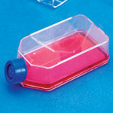
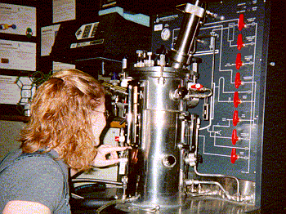
Suitable container
Simple flask
Sophisticated fermenter with computer-controlled monitoring

Slide 5
Growth medium
Glucose
Water
Amino acids
Salts

Slide 6
Opportunity for Gas Exchange
Oxygen
Carbon dioxide

Slide 7
Animal serum
Foetal Bovine Serum
Essential for animal cell proliferation
5% - 10% of growth media

Slide 8
Indicator
Waste products causes change in pH
Use indicator like phenol red
Changes from red to yellow

Slide 9
Control of Temperature and pH
37.5 ^{O}C
pH 7.5

Slide 10
Method for Measuring Cell Growth
Counting cell numbers in culture (haemocytometer)
Measure optical density in spectrophotometer

Slide 11
Sterilisation
Antibiotics
Sterilisation

Slide 12
Cells are either….
Anchorage – dependant
Anchorage - independant

Slide 13
Anchorage – independant cells
Cells associated with body fluid
-blood cells
Grown in suspension
Will eventually need subculturing

Slide 14
Anchorage – dependant cells
Most animal derived cells
Adhere to bottom of a flask and form a monolayer
Eventually cover entire surface of substratum (confluence)
Proliferation then stops
Need to subculture cells at this point (remove to fresh medium)
Proliferation can begin again

Slide 15
2 main categories of animal cell cultures….
Primary culture
Continuous cell line

Slide 16
Primary Cultures
Taken from fresh tissue
Limited life span in culture
Treated by proteolytic enzyme (Trypsin)
Separate into single cells
-epithelial cells
-fibroblasts

Slide 17
Continuous Cell Line
Derived from humans
Been transformed
-lose sensitivity to factors associated with growth control
Produce immortalised cell lines
Cell lines are neoplastic
Often lose their anchorage-dependence
-associated with an altered xsome pattern
More easily cultured

Slide 18
Cell line | Species of origin | Tissue of origin | Cell morphology | Growth in suspension?
3T3 | Mouse | Connective | Fibroblast | No
CHO | Chinese Hamster | Ovary | Epithelial | Yes
BHK21 | Syrian Hamster | Kidney | Fibroblast | Yes
HeLa | Human | Cervical Carcinoma | Epithelial | Yes

Slide 19
Why do it?
Particular cells can be isolated and cloned
-isolation of mutant cells
-investigate cell growth
-produce hybrid cells that have applications in biotechnology
Produce important pharmaceuticals
-vaccines
-hormones

Slide 20
This powerpoint was kindly donated to www.worldofteaching.com
http://www.worldofteaching.com is home to over a thousand powerpoints submitted by teachers. This is a completely free site and requires no registration. Please visit and I hope it will help in your teaching.

