Slide 1
AS Biology – Cell Cycle questions
Book Reference: p.28-32

Slide 2
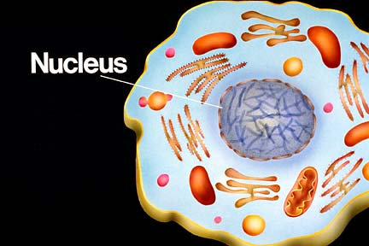
Where are the chromosomes located in eukaryotic cells?

Slide 3
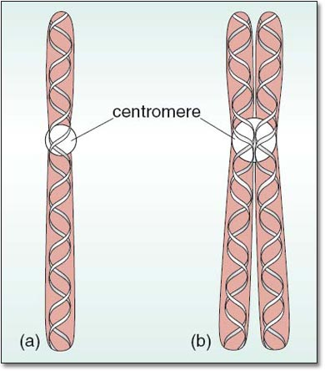
What does each chromosome contain?

Slide 4
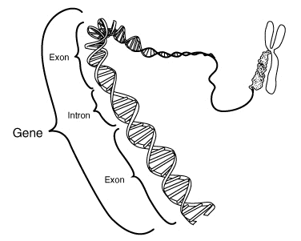
What is a gene?

Slide 5
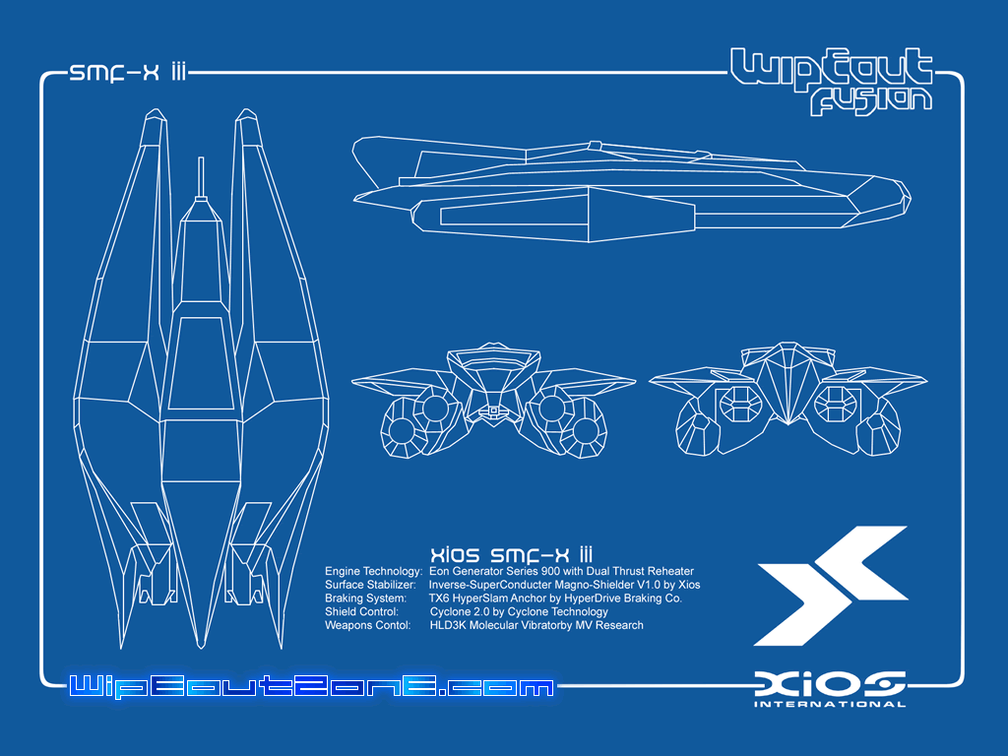
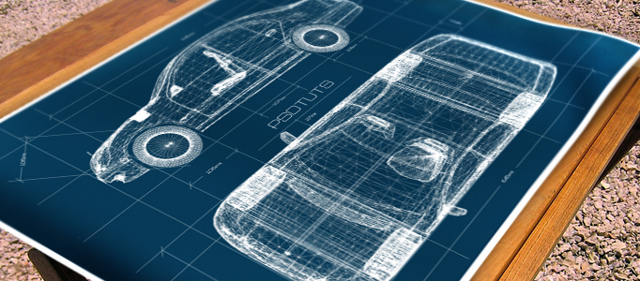
Is it the chromosomes, the genes or the DNA that hold the instructions for making new cells?

Slide 6
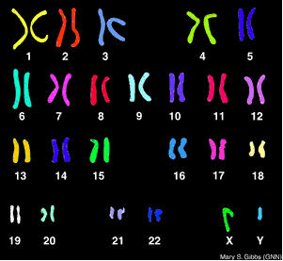
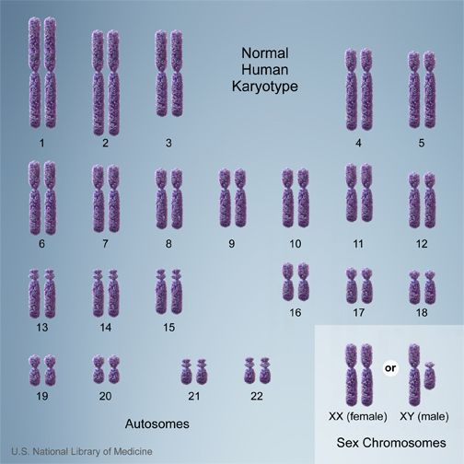
What is the human Karyotype made of?

Slide 7
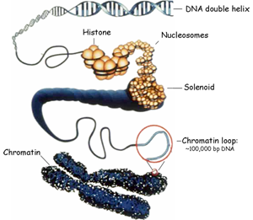
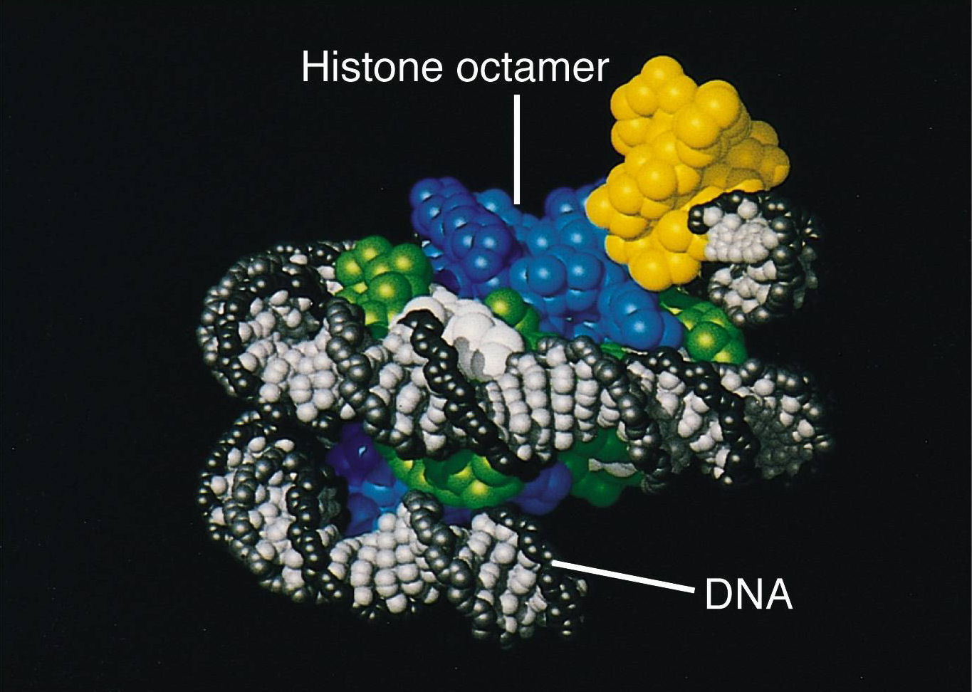
What is the difference between ‘histone’ and ‘chromatin’?

Slide 8
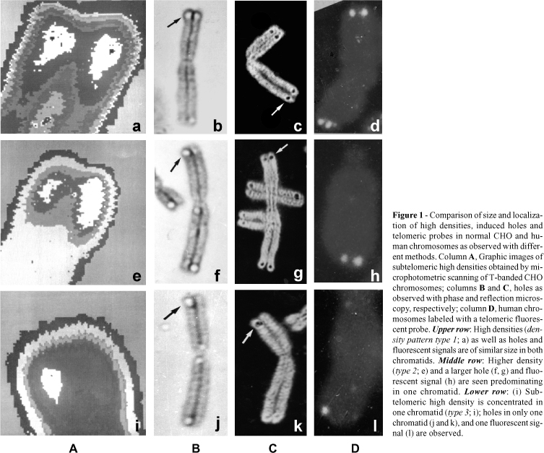
At what stage of the life cycle do the chromosomes became visible under a light microscope?

Slide 9
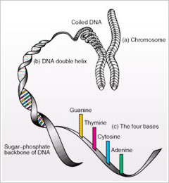
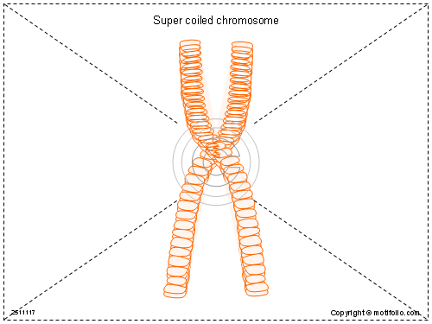
Why is it impossible for supercoiled chromosomes to perform their normal functions in the cell?

Slide 10
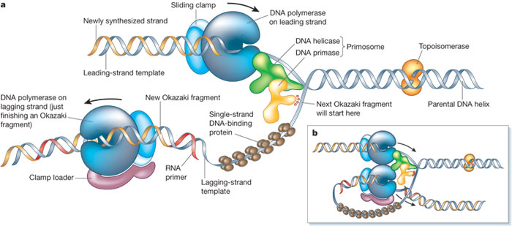
What checks that the DNA for the new daughter cells is without making any mistakes?

Slide 11
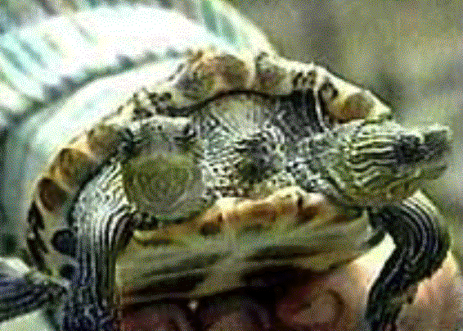
What is a mutation?

Slide 12
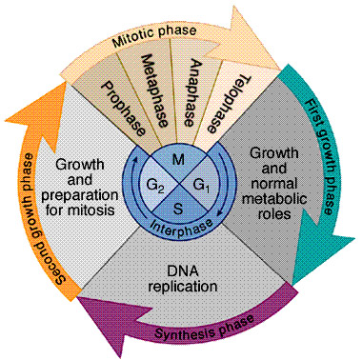
What are the phases of the cell cycle and what are the main events during each phase?

Slide 13
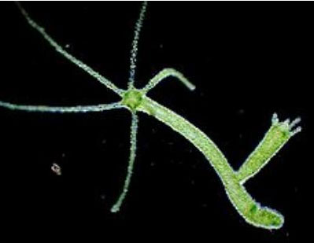
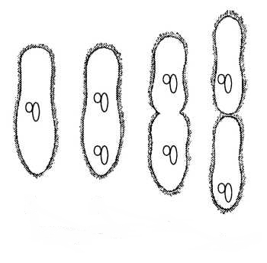
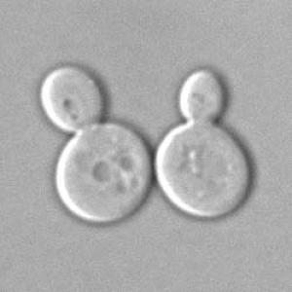
What is Asexual Reproduction?

Slide 14
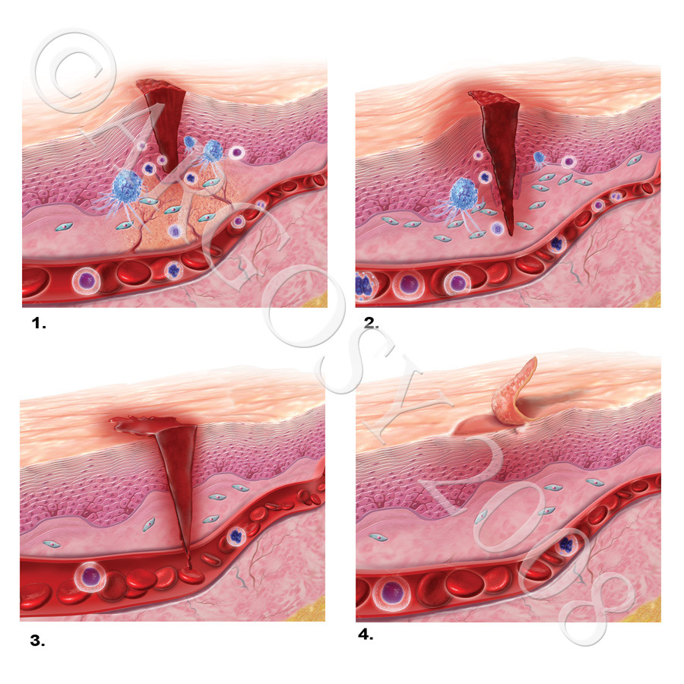
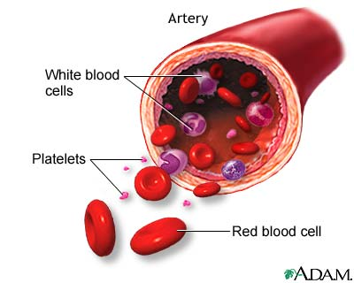
Why is it so important to make new cells?

Slide 15
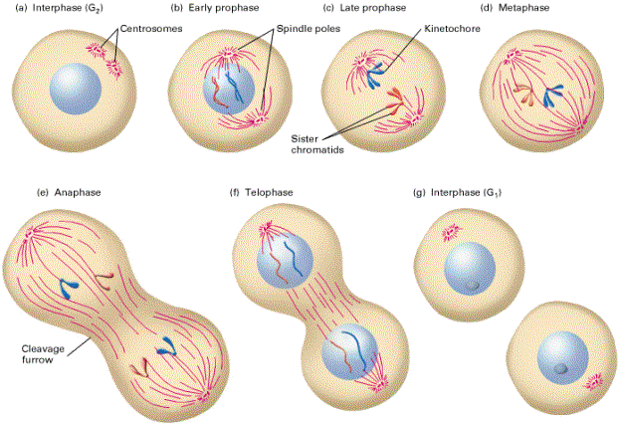
What are the 4 stages of mitosis?

Slide 16
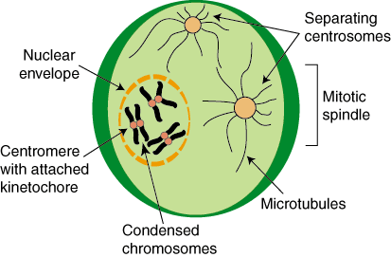
What happens at prophase?

Slide 17
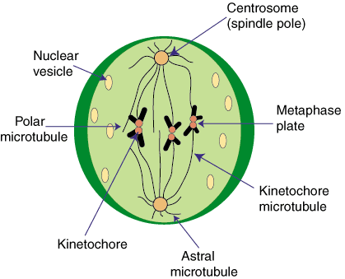
What happens at metaphase?

Slide 18
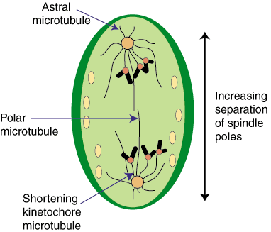
What happens at anaphase?

Slide 19
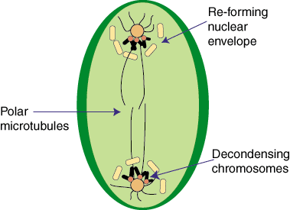
What happens at telophase?

Slide 20
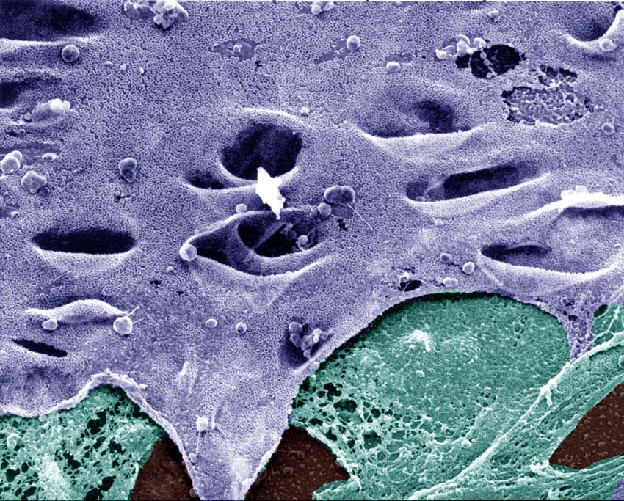
What happens to the nuclear envelope during prophase?

Slide 21
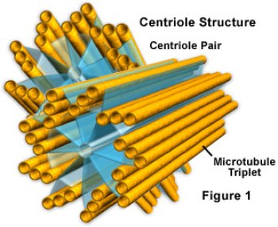
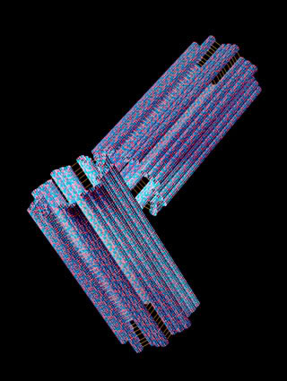
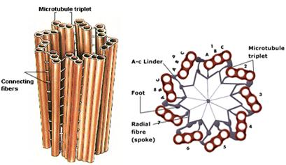
What is the role of centrioles in cell division?

Slide 22
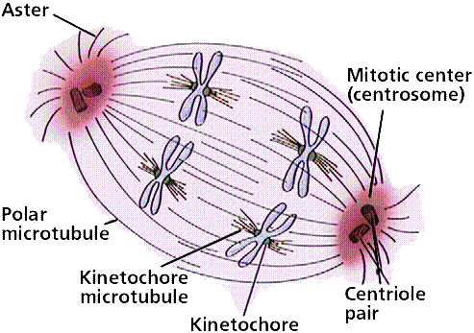
What is the spindle?

Slide 23
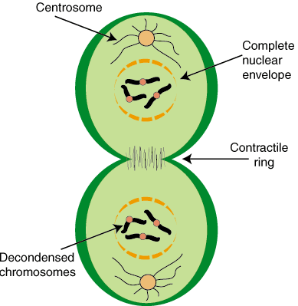
What is cytokinesis?

Slide 24
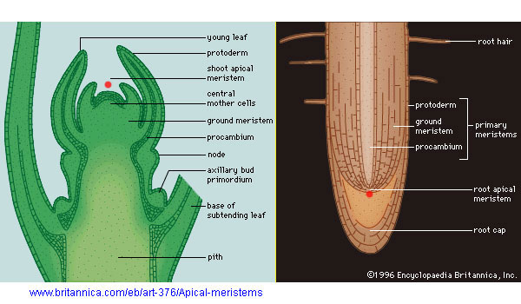
What makes the meristem cells so important for growth in plants?

Slide 25
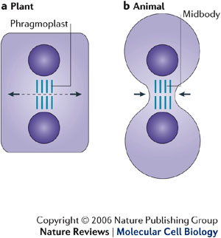
What is the difference between cytokinesis in plant and animal cells?

Slide 26
This powerpoint was kindly donated to
www.worldofteaching.com
http://www.worldofteaching.com
Is home to well over a thousand powerpoints submitted by teachers. This a free site. Please visit and I hope it will help in your teaching
Notes:
26

