Slide 1
Ch. 2 “Cells” Section 2: “Viewing Cells” Pages 47 - 51
LESSON 3

Slide 2
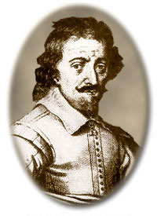
EARLY MICROSCOPES
Zacharias Janssen - made 1st compound microscope
a Dutch maker of reading glasses (late 1500’s)

Slide 3
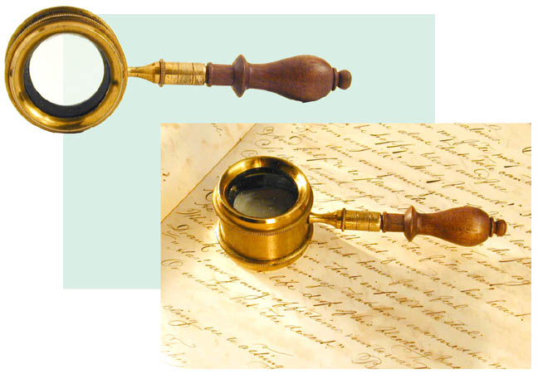
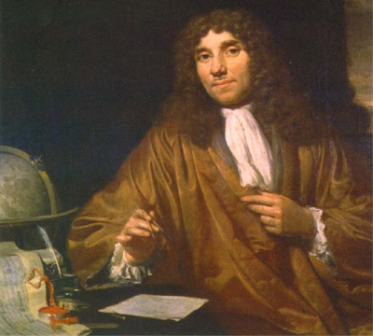
Leeuwenhoek
made a simple microscope (mid 1600’s)
magnified 270X
Early microscope lenses made images larger but the image was not clear

Slide 4
Leeuwenhoek's microscope
A) a screw for adjusting the height of the object being examined
B) a metal plate serving as the body
C) a skewer to impale the object and rotate it
D) the lens itself, which was spherical

Slide 5
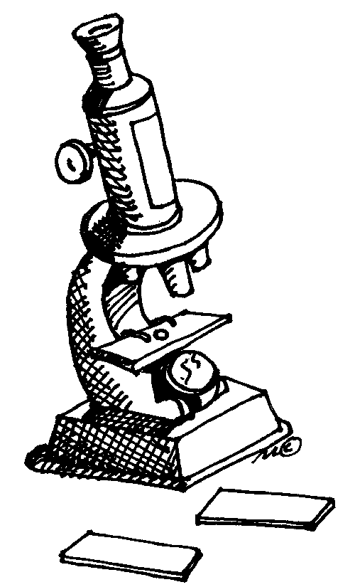
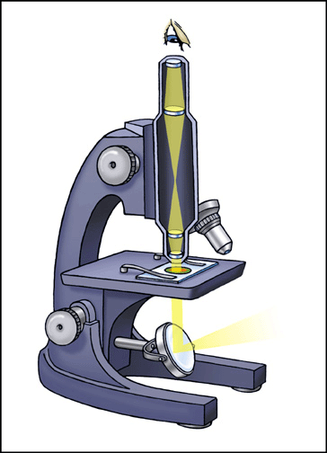
MODERN MICROSCOPES
A microscope is simple or compound depending on how many lenses it contains
A lens makes an enlarged image & directs light towards you eye

Slide 6
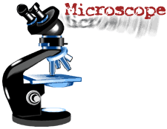
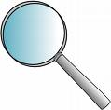
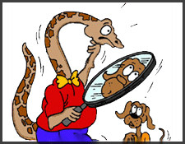
A simple microscope has one lens
Similar to a magnifying glass
Magnification is the change in apparent size produced by a microscope

Slide 7
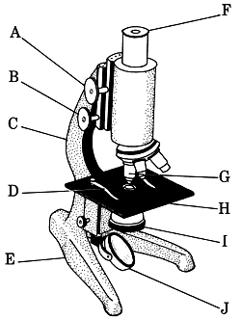
COMPOUND MICROSCOPE
A compound microscope has multiple lenses
(eyepiece & objective lenses)

Slide 8
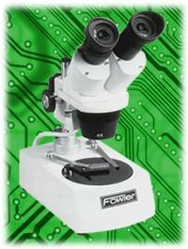
STEREOMICROSCOPE
creates a 3D image

Slide 9
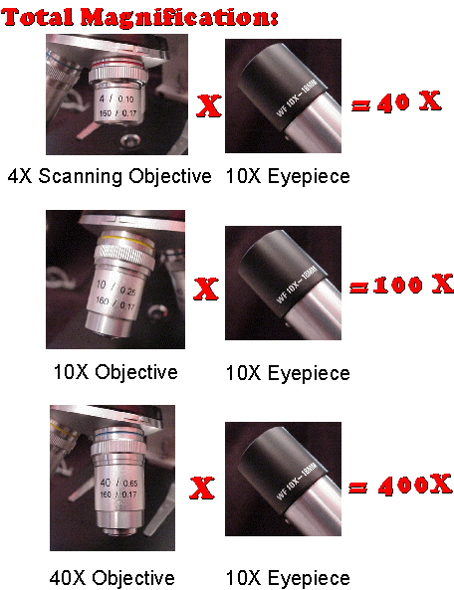
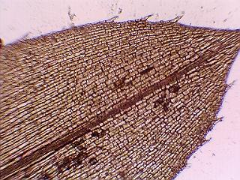
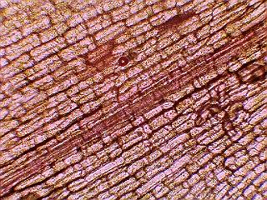
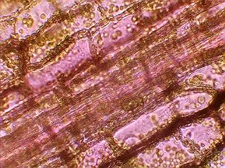
TOTAL MAGNIFICATION
Powers of the eyepiece (10X) multiplied by objective lenses determine total magnification.

Slide 10
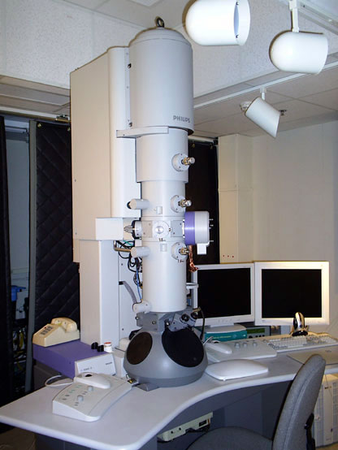
ELECTRON MICROSCOPES
More powerful; some can magnify up to 1,000,000X
Use a magnetic field in a vacuum to bend beams of electrons
Images must be photographed or produced electronically

Slide 11
Scanning Electron Microscope (SEM)
Electron microscope image of a spider
produces realistic 3D image
only the surface of specimen can be observed
Electron microscope image of a fly foot

Slide 12
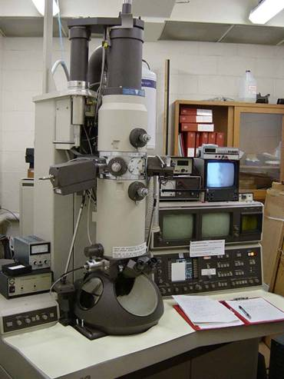
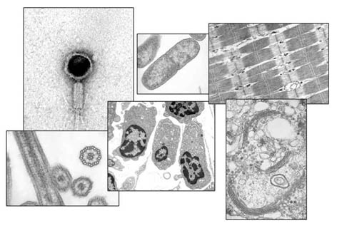
Transmission Electron Microscope (TEM)
produces 2D image of thinly sliced specimen
detailed cell parts (only inside a cell) can be observed

Slide 13
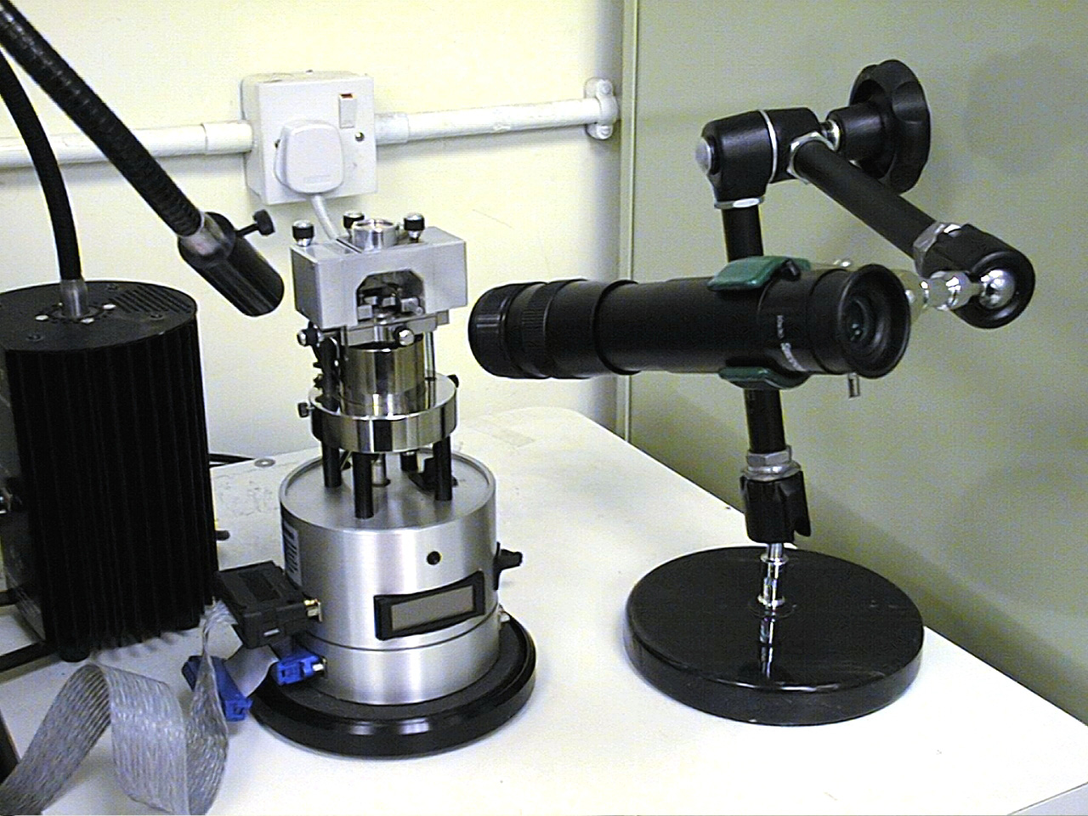
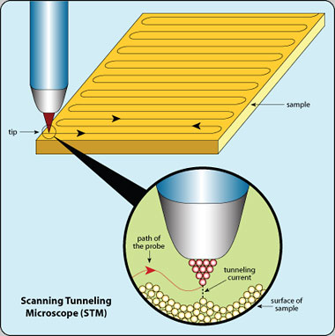
Scanning Tunneling Microscope (STM)
able to show arrangement of atoms

Slide 14
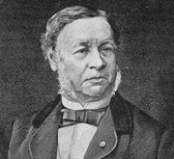
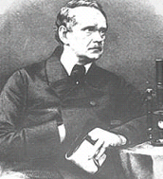
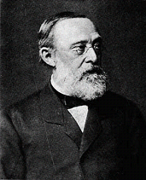
CELL THEORY
Schwann | Schleiden | Virchow
A theory resulting from many scientists’ observations & conclusions

Slide 15
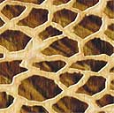
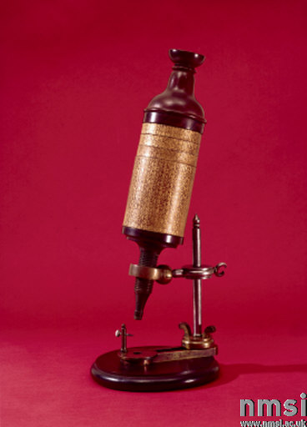
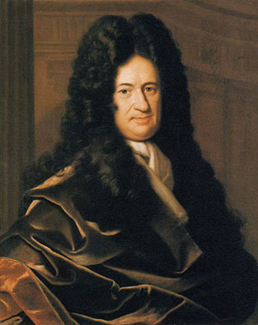
CELL THEORY 1. The basic unit of life is the cell. (Hooke)
In 1665, an English scientist named Robert Hooke made an improved microscope and viewed thin slices of cork viewing plant cell walls
Hooke named what he saw "cells"

Slide 16
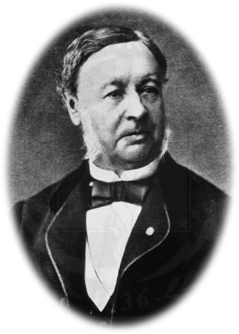
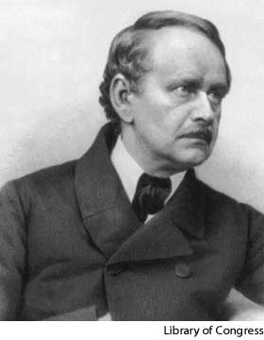
CELL THEORY 2. All living things are made of 1 or more cells.
Matthias Schleiden (botanist studying plants)
Theodore Schwann (zoologist studying animals) stated that all living things were made of cells
Schwann
Schleiden

Slide 17
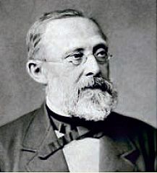
CELL THEORY 3. All cells divide & come from old cells. (Virchow)
Virchow

Slide 18
This powerpoint was kindly donated to www.worldofteaching.com
http://www.worldofteaching.com is home to over a thousand powerpoints submitted by teachers. This is a completely free site and requires no registration. Please visit and I hope it will help in your teaching.

