Slide 1
ORDER + A
The Scientific Rules for being considered Living

Slide 2
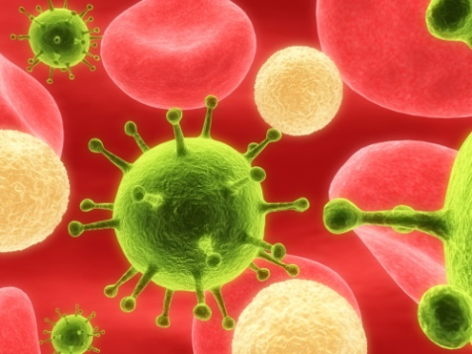
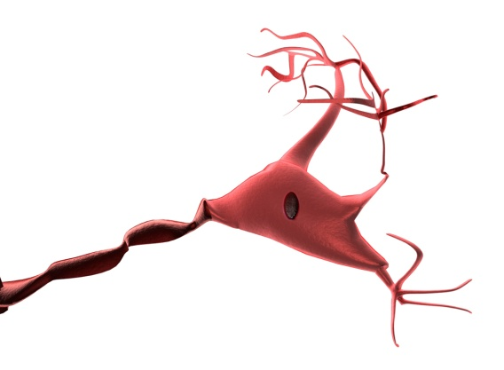
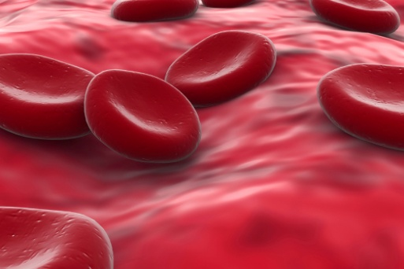
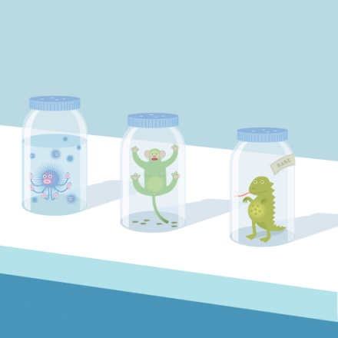
O – Organized by Cells
If you are living you are made of one or more cells.

Slide 3
R – Responds to Stimuli
If you are living you have to react to the outside world

Slide 4
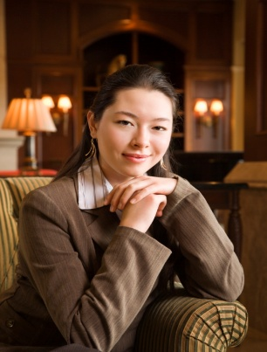
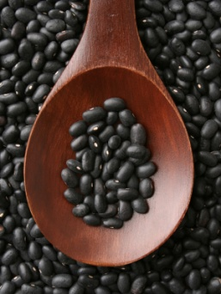
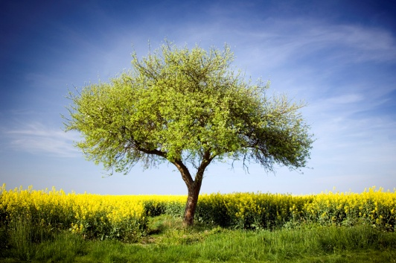
D – Develop and Grow
If you are living you have to get bigger and develop into a more complex being

Slide 5
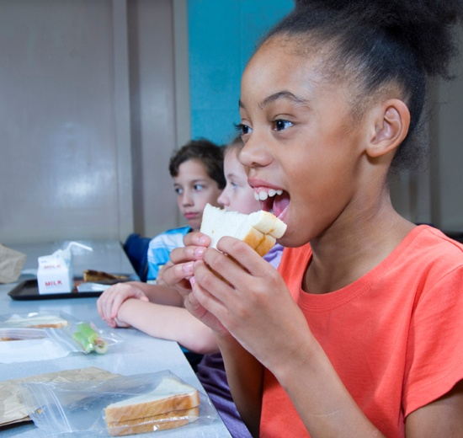
E – Energy /Eat
If you are a living animal you get your energy from eating
If you are a living plant you make your energy from a process called photosynthesis

Slide 6
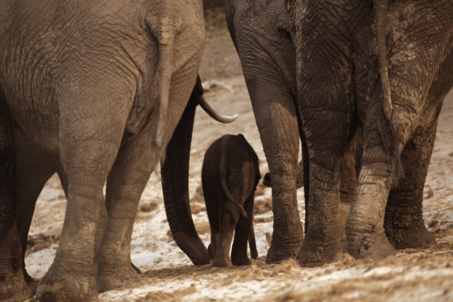
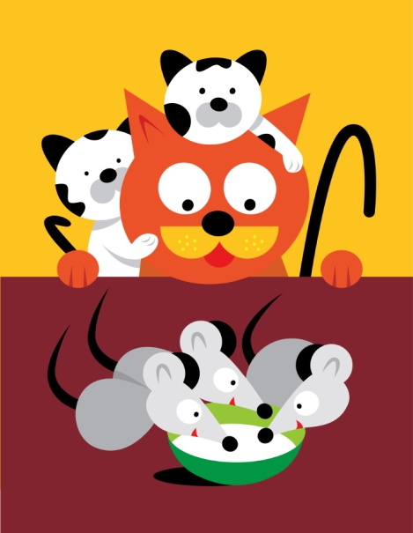
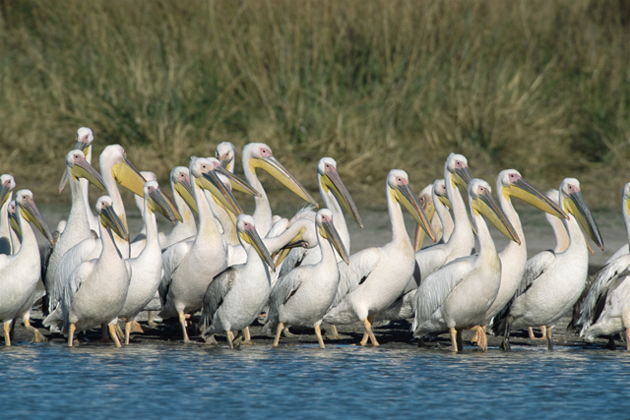
R – Reproduce
If you are living you have to be able to make copies of yourself

Slide 7
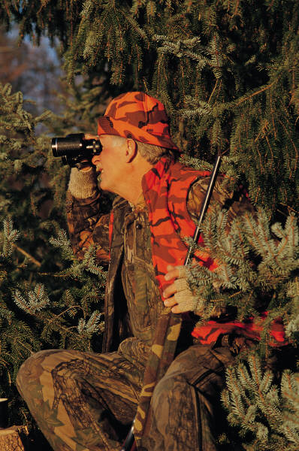
+A – Adapt to Environment
If you are living you must be able to change to the outside world

Slide 8
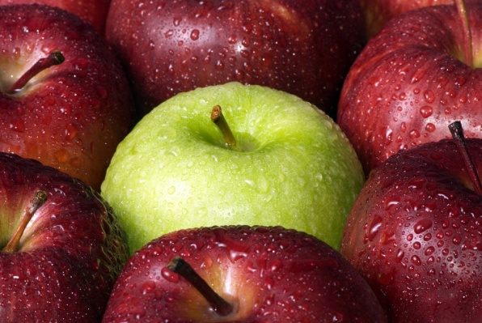
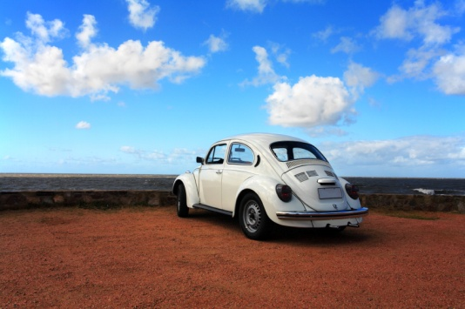
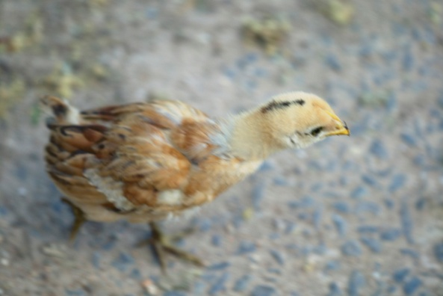
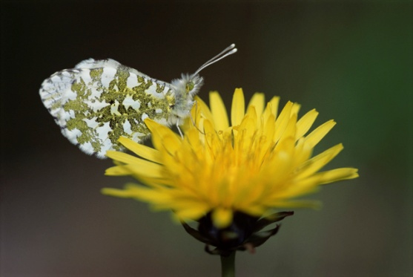
ORDER +A
To be living you must be able to do all of these things by yourself. If you don’t do all those things you are not alive according to science.
Are the following things ALIVE:

Slide 9
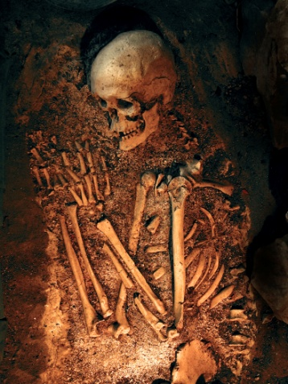
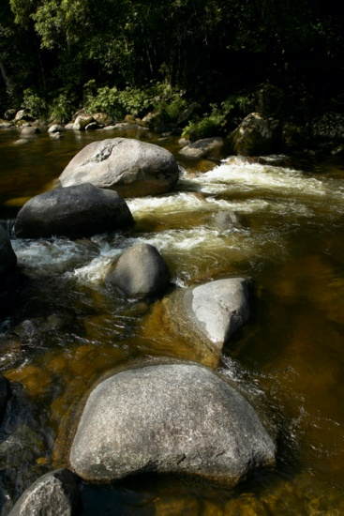
Living vs. Non-Living
Living –
You can perform all of the activities of ORDER +A at the current time.
Non-Living –
Dead – you were once able to perform all the activities of ORDER+A but can not now.
Man-Made – you were made by man and could never do ORDER+A.
Never Alive – you were made by nature and could never do ORDER+A

Slide 10
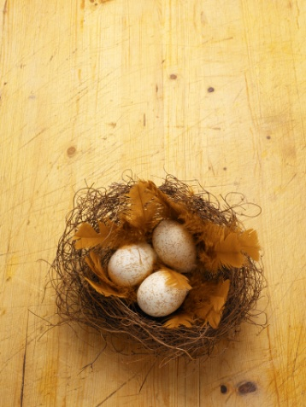
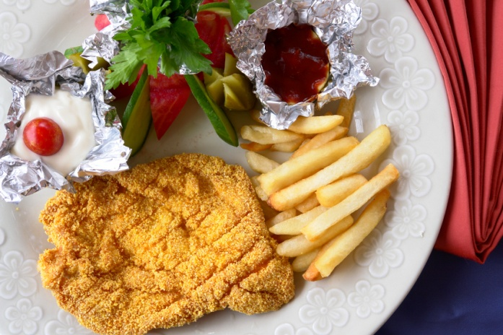
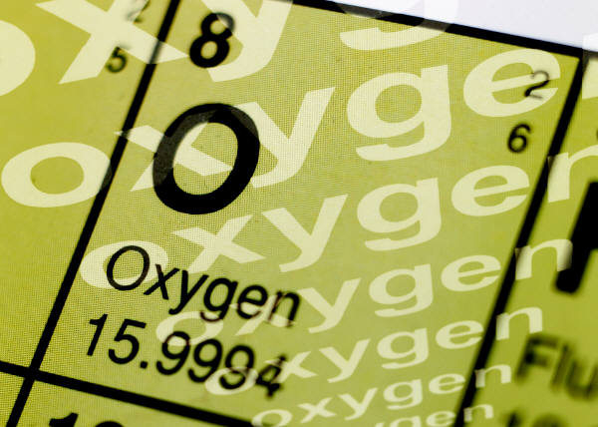
All living things Need
Shelter – a place to live
Food – whether they eat or make it themselves
Water – H2O without hydration you will die
Air – O2 whether you breath or get it out of water you will die without it.

Slide 11
This powerpoint was kindly donated to
www.worldofteaching.com
http://www.worldofteaching.com
Is home to over a thousand powerpoints submitted by teachers. This a free site. Please visit and I hope it will help in your teaching
Notes:
11

