Slide 1
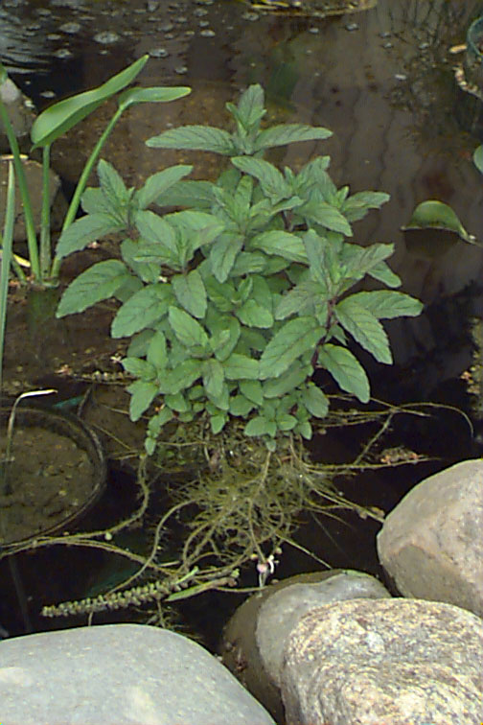
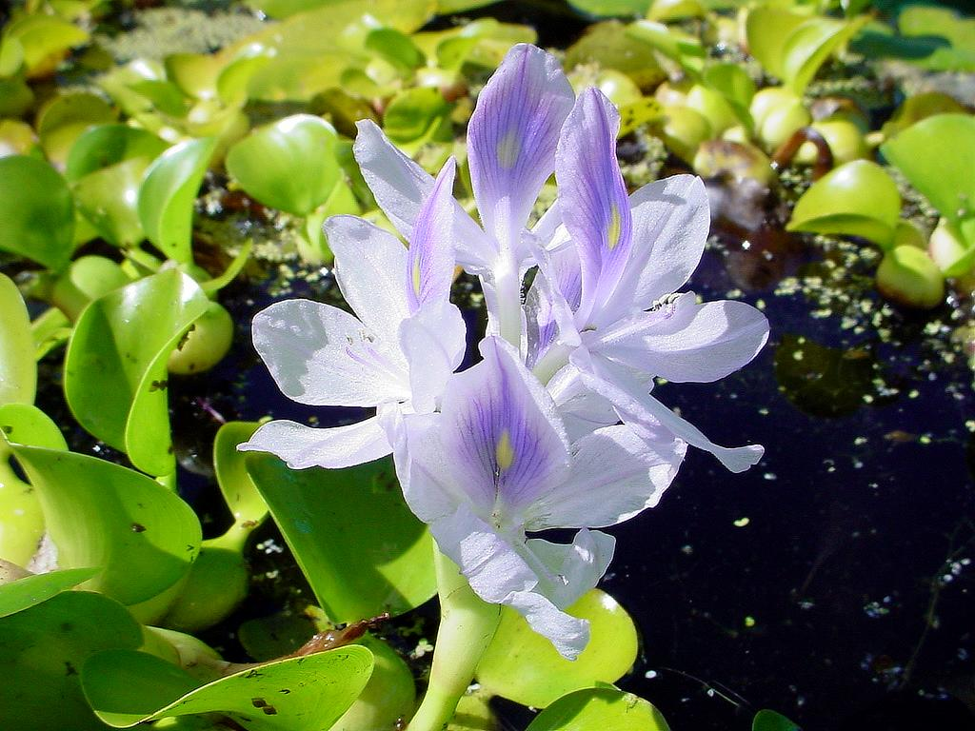
Classification
Grouping plants

Slide 2
Plants Groups
There are four plant groups:
Mosses
Ferns
Conifers
Flowering plants

Slide 3
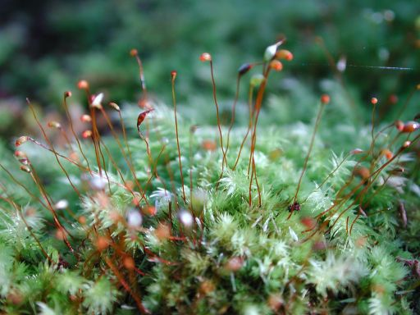
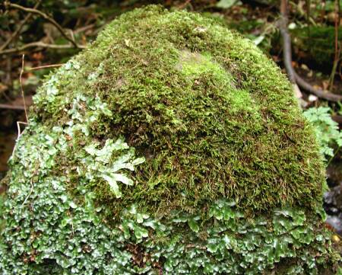
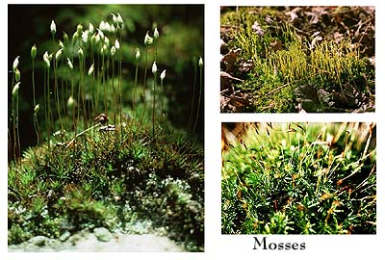
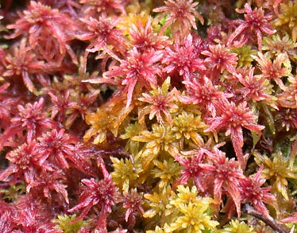
Mosses
Reproduce by spores
Thin Leaves
No roots or xylem vessels

Slide 4
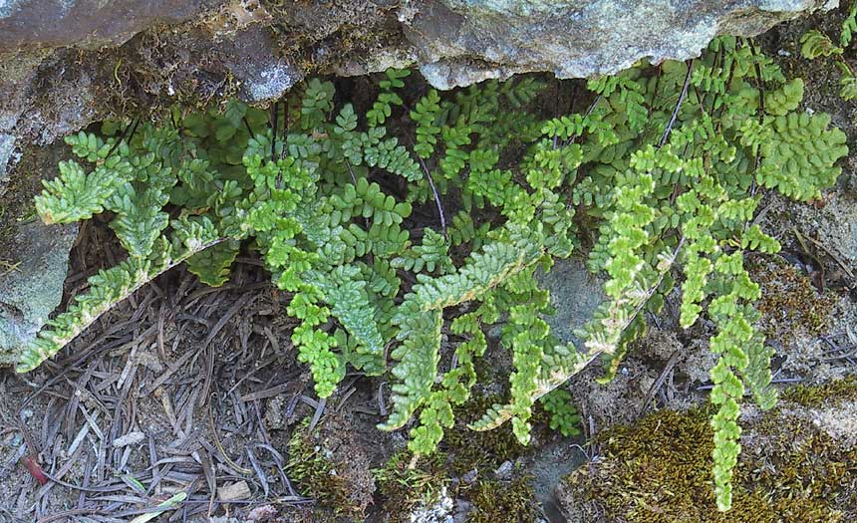
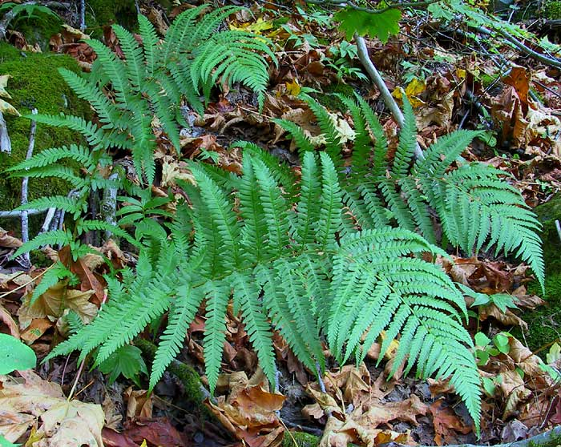
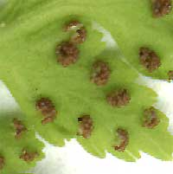
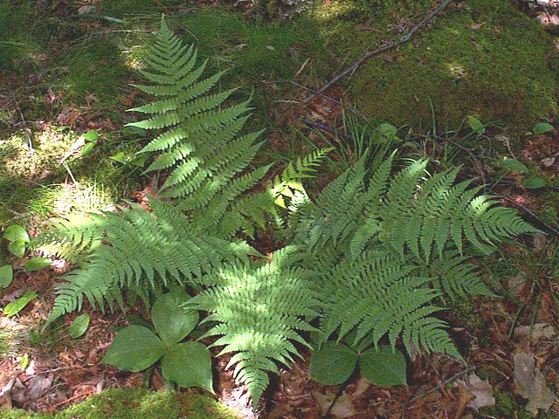
Ferns
Reproduce by spores

Slide 5
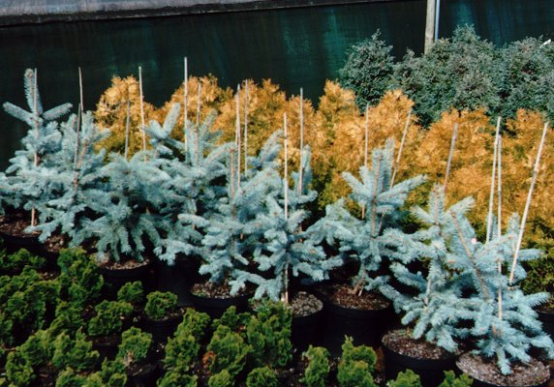
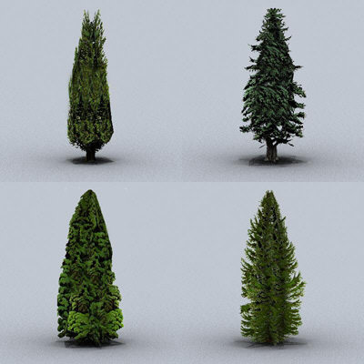
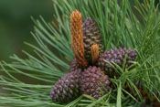
Conifers
Reproduce using seeds found in cones
Needle-shaped leaves

Slide 6
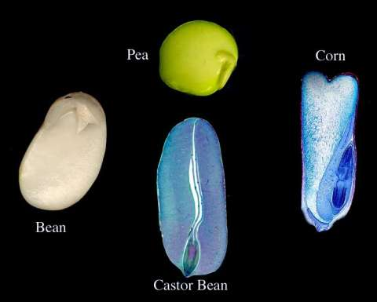
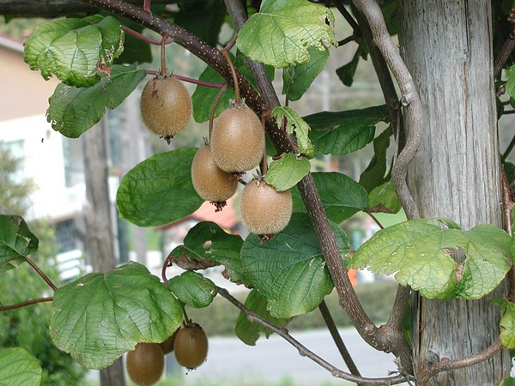
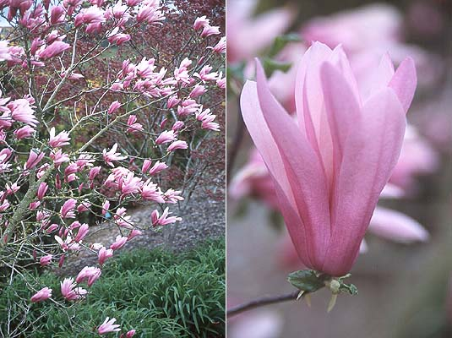
Flowering Plants
Reproduce using seeds found in fruits
Large flat leaves
Have flowers

Slide 7
Summary
________ and _________ ________
both use seeds for reproduction.
Mosses and ________ both use _________ for reproduction.
______ contain seeds in flowering plants.
______ have no xylem vessels.
Xylem vessels carry ________ around the plant.
water/flowering plants/fruits/spores/conifers/mosses
ferns

Slide 8
This powerpoint was kindly donated to www.worldofteaching.com
http://www.worldofteaching.com is home to over a thousand powerpoints submitted by teachers. This is a completely free site and requires no registration. Please visit and I hope it will help in your teaching.

