Slide 1
Chemical Reactions in the Drug World
Synthesis and Biological Actions of Cocaine

Slide 2
Overview
Cocaine Synthesis and Extraction
Affects of Cocaine on the human body
Cocaine in the media

Slide 3
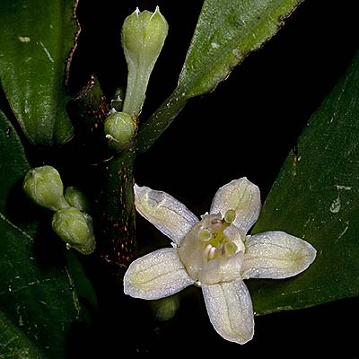
Cocaine Extraction
Coca leaves are stripped from the plant and crushed, chopped, and/or pounded
mixed with a solution of alcohol, gasoline, kerosene, or some other solvent that will remove the cocaine from the leaves.

Slide 4
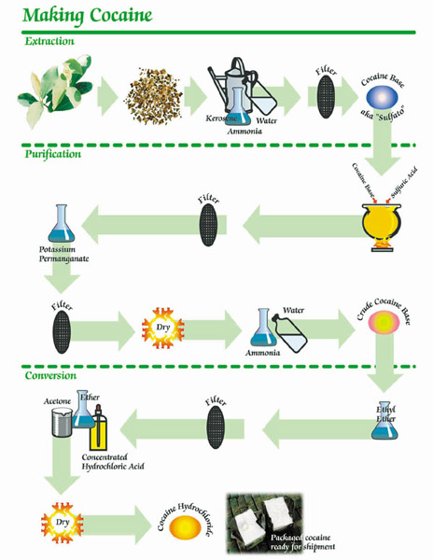
Extraction and Purification
1. Dissolve using solvents
3. Oxidation to ↑ purity colour Δ indicates end rxn
2. Acid-Base Neutralization

Slide 5
Cocaine Purification
The resulting liquid contains unpurified cocaine alkaloids and waxy material from the leaves. The waxy material is removed by heating and cooling the mixture, which solidifies the unwanted wax.
cocaine alkaloids are isolated from the liquid using acid and base mixtures. The removed alkaloids are then treated with kerosene.
The kerosene is removed and crystals of crude cocaine are left at the bottom of the tank. The crystals are dissolved in methyl alcohol.

Slide 6
Purification and Conversion
Cont’d
4. Removes precipitate from last rxn
5. acid-base neutralization
6. Dissolve in solvent
7. Dissolve in solvent crystallizes

Slide 7
Cocaine Purification
They are then recrystallized and dissolved in sulfuric acid, which results in cocaine that is about 60% pure.
cocaine at this point is freebase cocaine (crack). When a person freebases cocaine, or makes crack, they are reversing what is done in the next process.

Slide 9
Cocaine Conversion
freebase is converted cocaine hydrochloride (a salt). The reasons for the conversion
1) left in this form for long it would lose its potency
2) To purify it to about 99% cocaine purity
3) To make it water soluble. Coke in this form can't be injected or snorted into the bloodstream. Any drug which is injected into the human body must be dissolvable in water, if it is not, it will remain in a non dissolved clump. Clumps cause strokes or heart attacks
cocaine is further treated with oxidizing agents to become water-soluble . Further washing, oxidation and separation procedures with potassium permanganate, benzole, and sodium carbonate.
The result is an odorless, white crystalline powder. With a bitter, numbing taste.

Slide 10
Crack Cocaine
Freebase/crack cocaine. Freebase/crack is derived from cocaine hydrochloride which has been chemically treated with ammonia (freebase) or baking-powder (crack) to free the potent base material from the salt.
Free-base was originally produced by a dangerous four-or-five step process in which the hydrochloride salt was heated with water and a volatile liquid such as ether.
Base cocaine in the form of 'crack' is safer to produce; Crack/free-base is indissoluble in water, so it can't easily be injected or sniffed.  it is smoked in pipes; burnt on tin foil; or mixed with tobacco and weed in a joint.

Slide 11
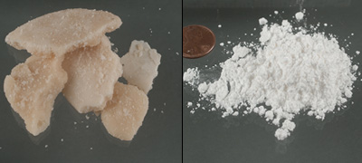
Crack and Cocaine Powder
Photo courtesy U.S. Drug Enforcement Administration

Slide 12
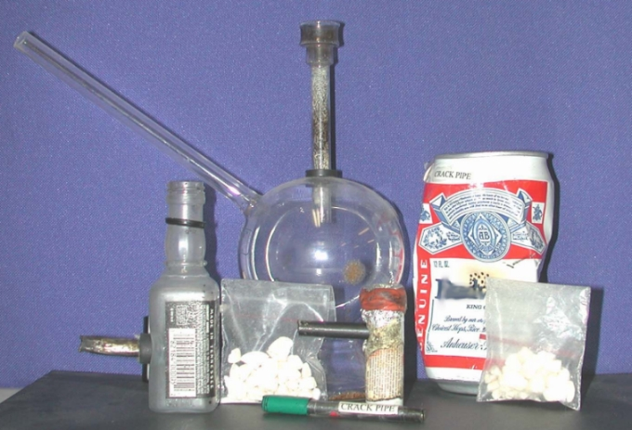
Cocaine Paraphernalia
www.sccja.org/images/ csid_crackpara.jpg

Slide 13
Cocaine Methods of Use
causes such pleasurable effects as reduced fatigue, increased mental clarity, and a rush of energy
the more one takes cocaine, the less one feels its pleasurable effect
which causes the addict to take higher and higher doses of cocaine in an attempt to recapture the intensity of that initial high

Slide 14
Cocaine Methods of Use
average high a user gets from snorting cocaine only lasts for 15-30 minutes
smoking high, although more intense due to the rapidity in which the drug is absorbed into the bloodstream, lasts for an even shorter period of only about five to ten minutes
crashing low, in which the addict craves more of the drug and in larger doses

Slide 15
Cocaine’s effects on the nervous system
one of the most potent, addictive recreational drugs
Can cause irreversible damage to the nervous system

Slide 16
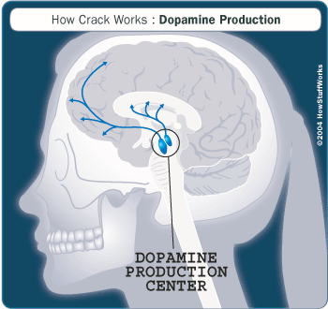
Cocaine and the brain
http://health.howstuffworks.com/crack6.htm

Slide 17
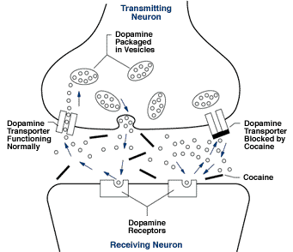
Cocaine’s Effects on the Brain
produces its pleasurable high by interfering with the brains pleasure centers where such chemicals as dopamine are produced
drug traps an excess amount of dopamine in the brain, causing an elevated sense of well being

Slide 18
This is your brain on drugs
By inhibiting the brains release of dopamine and other neurochemicals, cocaine can cause serious and often irreversible damage to neurons within the brain
cocaine users had a reduced number of dopamine neurons
When flooded with the excess of dopamine created during a cocaine high, the brain reacts by making less dopamine, getting rid of this excess, and shutting down the dopamine neurotransmitters, sometimes permanently

Slide 19
This is your brain on drugs
the drug cause blood vessels to restrict, increases the body temperature, heart rate, and blood pressure, and cause the pupils to dilate
increases ones breathing rate
serious long-term effects to the central nervous system, including an increased chance of heart attack, stroke, and convulsions, combined with a higher likelihood of brain seizures, respiratory failures, and, ultimately, death

Slide 20
Cocaine Overdose
serious long-term effects to the central nervous system, including an increased chance of heart attack, stroke, and convulsions, combined with a higher likelihood of brain seizures, respiratory failures, and, ultimately, death
overdose of cocaine raises blood pressure to unsafe heights resulting in permanent brain damage

Slide 21
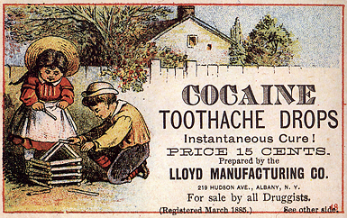
Cocaine as medicine
www.stopcocaineaddiction.com/ pictures.htm

Slide 22
Coca-Cola
“Coca-Cola, the globally recognized soft drink manufacturer, buys 115 tonnes of coca leaf from Peru and 105 tonnes from Bolivia per year, with which it produces, without alkaloids, 500 million bottles of soda per day
www.stopcocaineaddiction.com/ pictures.htm

Slide 23
Coca-Cola Commercials
http://www.hollywoodcg.com/projects/cocacola/cola.htm

Slide 24
Cocaine as wine
www.stopcocaineaddiction.com/ pictures.htm

Slide 25
Cocaine in Commercials
http://www.bluehaze.com.au/humour/2005_11_18.html

Slide 26
Cocaine on Film

Slide 27
Credits
http://serendip.brynmawr.edu/bb/neuro/neuro03/web1/edamore.html
http://www.a1b2c3.com/drugs/coc08.htm
http://www.erowid.org/archive/rhodium/chemistry/cocaine.illicit.production.html
http://www.horton-szar.net/clipart/

Slide 28
This powerpoint was kindly donated to www.worldofteaching.com
http://www.worldofteaching.com is home to over a thousand powerpoints submitted by teachers. This is a completely free site and requires no registration. Please visit and I hope it will help in your teaching.

