Slide 1
Crossing Membranes 1 – Passive Processes
Book Reference: p.22-23

Slide 2
Diffusion
The After Shave Man

Slide 3
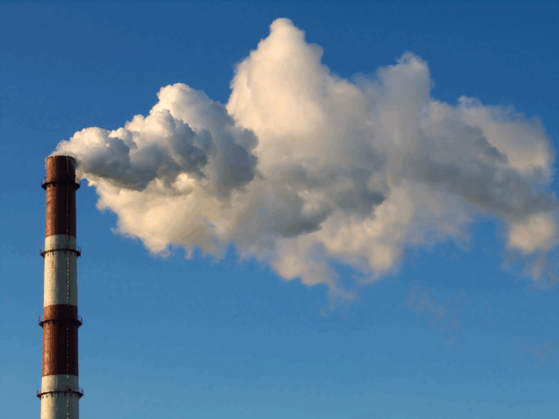
Diffusion in Air

Slide 4
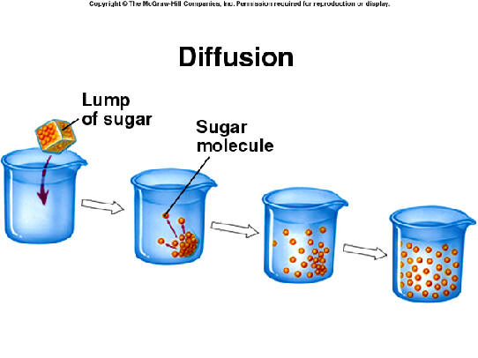
Diffusion in water

Slide 5
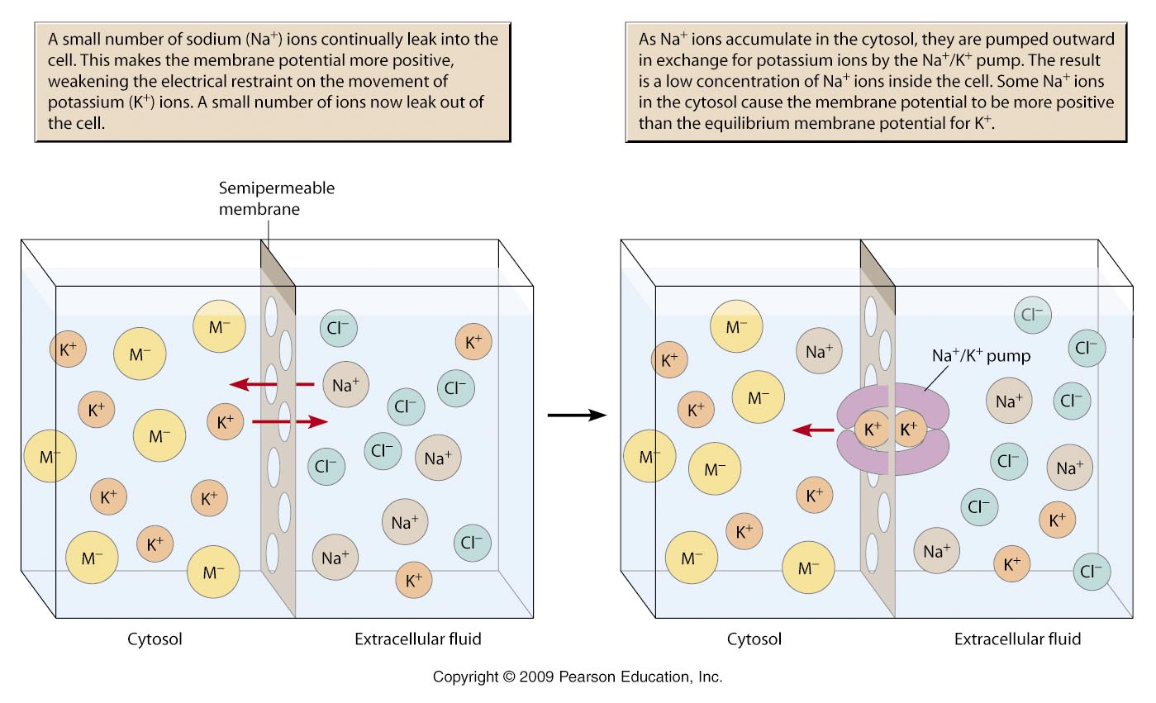
What is diffusion? (definition)
Diffusion is the movement of molecules (or ions) from a region of high concentration to a region of lower concentration until they are spread out evenly

Slide 6
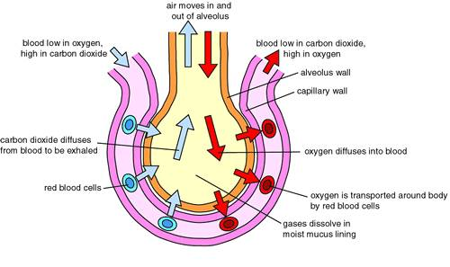
Example 1:Diffusion in the Alveoli: O₂ diffusing into the blood and CO₂ diffusing out of the blood

Slide 7
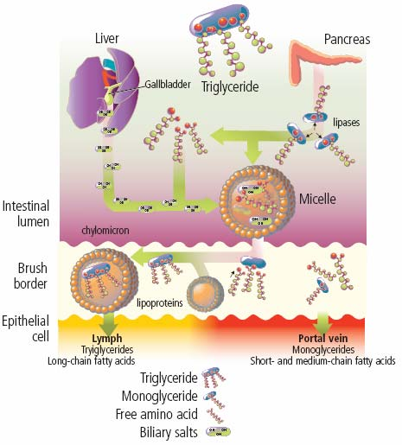
Example 2: Some digested food diffuses across the gut wall into the blood

Slide 8
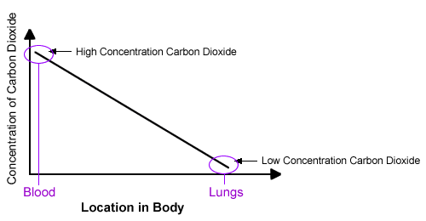
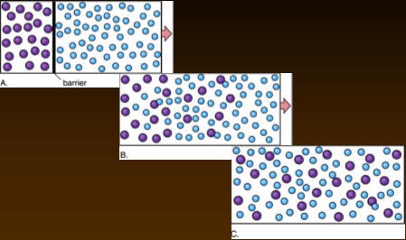
What affects the rate of diffusion?
Concentration gradient: The greater the difference in the concentration of a substance in two areas, the faster the rate of diffusion
The rate of diffusion is directly proportional to the concentration gradient

Slide 9
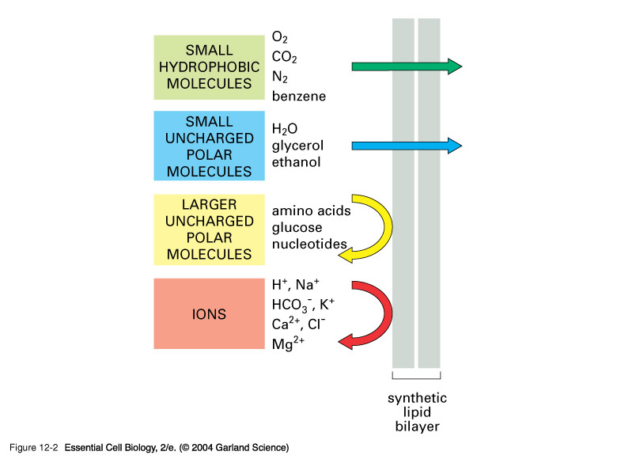
What affects the rate of diffusion?

Slide 10
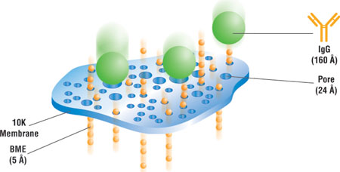
Small particles tend to diffuse faster than larger ones

Slide 11
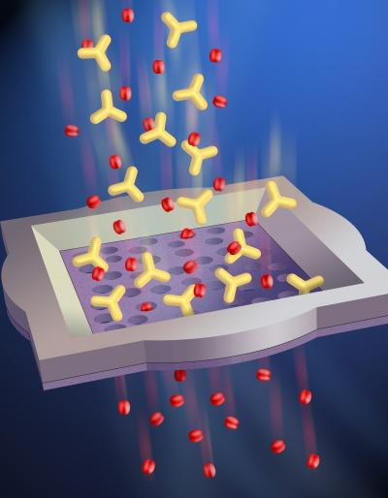
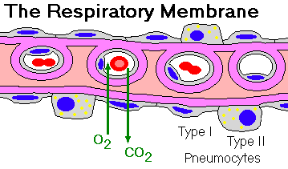
Diffusion takes place more quickly through thin membranes (e.g. exchange of gases through the alveolar wall)

Slide 12
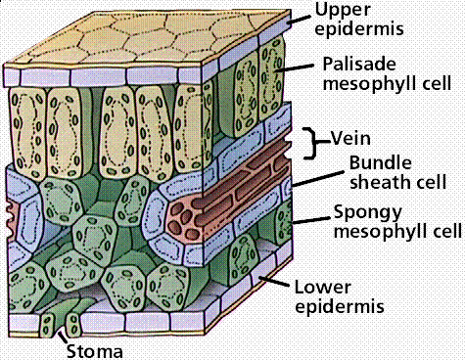
The larger the surface area the higher the rate of diffusion (e.g. in gases diffusing into/out of leaves)

Slide 13
The shorter the distance, the faster the rate of diffusion
An increase in temperature
increases the rate of diffusion

Slide 14
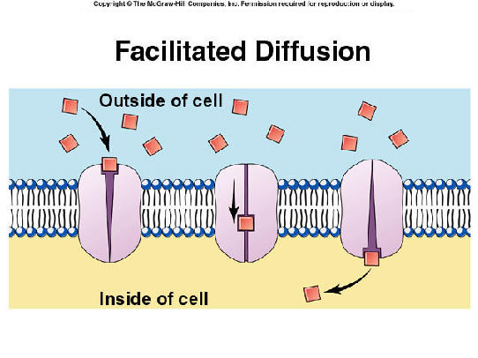
Facilitated Diffusion
Faster movement
Cell membrane proteins used
Channel proteins
Carrier proteins

Slide 15
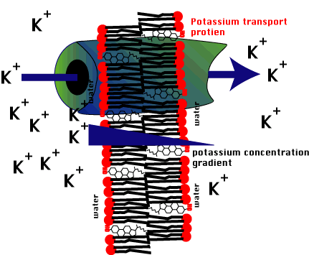
Channel Proteins facilitate the diffusion of Ions
Na⁺
K⁺
Ca²⁺
Cl⁻
Why can ions not diffuse freely across the membrane?
Usually each channel protein is specific to one type of ion

Slide 16
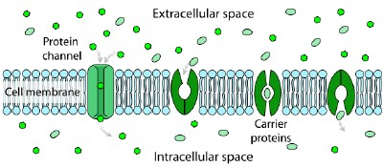
Channel proteins can open or close their pores acting like gates depending upon the cell’s needs

Slide 17
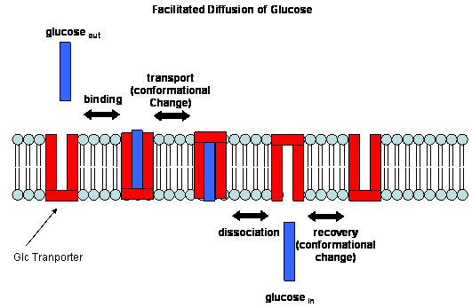
Carrier proteins are more sophisticated in the way they work
They allow the diffusion across the membrane of larger polar molecules, such as sugars and amino acids

Slide 18
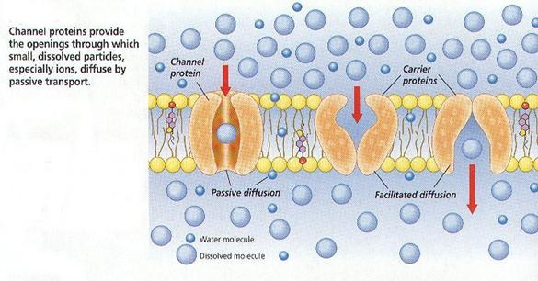
Once a particular molecule attaches to the carrier protein at it binding site, the carrier protein changes its shape to ‘deliver’ the molecule through the membrane

Slide 19
This powerpoint was kindly donated to
www.worldofteaching.com
http://www.worldofteaching.com
Is home to well over a thousand powerpoints submitted by teachers. This a free site. Please visit and I hope it will help in your teaching
Notes:
19

