Slide 1
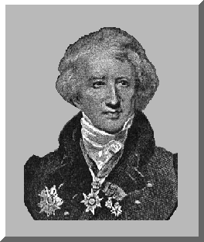
Jean-Leopold-Nicolas-Frederic Cuvier “Georges” Cuvier

Slide 2
Brief Bio
Born: August 23, 1769 in Montbeliard, France.
Attended Carolinian Academy of Stuttgart from 1784-88
- Studied Dissection
- Studied Comparative Anatomy

Slide 3
Bio (Cont.)
After graduation, Cuvier served as a tutor for a Noble family in Normandy from 1788-95.
While working as a tutor, he Composed 2 works on marine invertebrates.

Slide 4
Beginning of a Career
Geoffroy Saint-Hilaire- professor of zoology at the Museum of Natural History in Paris
- Read some of Cuvier’s Studies
- Invited Cuvier to join the museum staff
- Cuvier accepted the offer and eventually became a professor of animal anatomy at the museum

Slide 5
Work At The Museum
Cuvier collaborated with Hilaire for a short time until it became clear that they held opposing views concerning origin of and relationships between species.
Cuvier devoted most of his time at the museum to the continued study of comparative anatomy.

Slide 6
Comparative Anatomy
Cuvier’s work with comparative anatomy led him to reject the organic evolution theories of his time.
Cuvier had a theory called “Correlation of parts” – Each body structure is functionally related to and dependent on all other body structures(every part of an organism resembles signs of the whole); Therefore, any major change in the anatomy of an organism would render it unable to survive; **This thinking totally went against the evolutionary ideas of Lamarck and Saint-Hilaire**

Slide 7
Cuvier’s Other Involvements
In addition to his scientific studies, Cuvier was appointed, by Napoleon, to be the Inspector-General of public education in France as well as State Councillor.
- Cuvier was instrumental in starting many French universities.
** At the same time that Cuvier held these governmental positions, he became active in the excavation & study of fossils**

Slide 8
Fossil Studies
Discovered many unknown organisms
This raised serious evidence that entire past species had become extinct in some way.
This evidence for extinction may be the “most crucial and longest-lasting contribution to evolutionary biology” on Cuvier’s part.

Slide 9
Fossils (Cont.)
Cuvier extensively studied the distinct species’ differences between fossilized mammoths and the living elephants of his day
He published many studies documenting the past existence of huge mammals: (Giant Ground Sloth, Irish Elk, and the American Mastadon, among others
**These studies laid the foundation for the scientific field of vertebrate paleontology!!
- So, Cuvier is responsible for the Jurassic Park movies in a round-about way!

Slide 10
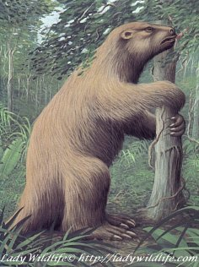
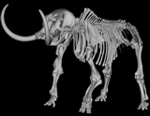
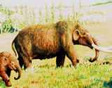
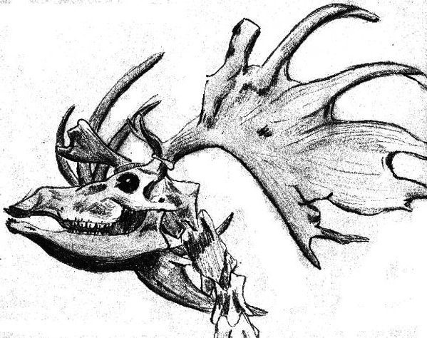

Slide 11
Catastrophism
Cuvier’s work with fossils made him wonder why entire species had become extinct.
He believed that vast changes had occurred at some point in Earth history in the form of sudden land upheavals and floods, which destroyed entire animal species & carved out the present features of the Earth.
Sound Familiar?? – THE GENESIS FLOOD!!!

Slide 12
More Accomplishments
In the midst of his scientific studies, Cuvier remained on the political scene: 1817: became Vice President of the ministry of the Interior.
1817- He published his system of animal classification.
Grouped animals into 4 categories based on anatomical structure: Vertebrates, Mollusks, Articulates(arthropods & segmented worms), and Radiates(cnidarians and echinoderms)
*This Classification system was a significant step up from Linnaeus’ system

Slide 13
Cuvier & His Contemporaries
There was strong tension between Cuvier & some of his contemporaries such as Lamarck and Hilaire
Cuvier successfully discredited Lamarck’s evolutionary Theory of the Inheritance of Acquired Characteristics, which said, traits developed by parents are passed on directly to offspring.

Slide 14
Cuvier/Contemporaries(Cont.)
In addition, Cuvier also disagreed with Hilaire’s claim that all animals were “representatives of only one type” (This is the idea of common ancestry)
Cuvier believed that each species was distinct and created for its own special purpose.
He also held that “any similarities between organisms were due to common functions, not common ancestry”

Slide 15
Cuvier/Contemporaries(Cont.)
Cuvier/Hilaire differences culminated in a public debate in 1830
Cuvier won the debate, but his anti-evolutionary thinking never took hold due to the impending shift into Darwinian evolution shortly after.
Cuvier died on May 13, 1832, due to the 1st ever cholera epidemic to hit Paris.

Slide 16
Ironic Conclusions
All of his life, Cuvier stood firm against the early theories of evolution and common ancestry, yet many of his ideas and discoveries served as the framework for the Darwinian evolution theories, such as:
**Cuvier pointed out the key issue of “why were animals anatomically different?”
**His study of fossils led to the extensive study of the fossil record in search of transitional forms and examination of the different stratification layers.
**His establishment of the existence of extinction led to the theory of Natural Selection, which says, entire species would die off due to a particular weakness or deficiency.
**And as we know, Natural Selection is the benchmark of Darwinian Evolution**

Slide 17
Final Conclusions
Cuvier was a man who devoted his entire life to his country and scientific advancement. In a relatively short period of time he laid the groundwork for a new field of scientific study and unknowingly developed the platform for the most dynamic & maybe even the most controversial scientific theory in history, among many other accomplishments and discoveries.

Slide 18
This powerpoint was kindly donated to www.worldofteaching.com
http://www.worldofteaching.com is home to over a thousand powerpoints submitted by teachers. This is a completely free site and requires no registration. Please visit and I hope it will help in your teaching.

