Slide 1
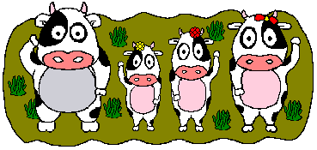
Digestion in Ruminants & Rodents

Slide 2
Ruminants
Herbivore mammals
Eg. Cow, goat, giraffe, deer
Feed on plant - cellulose

Slide 3
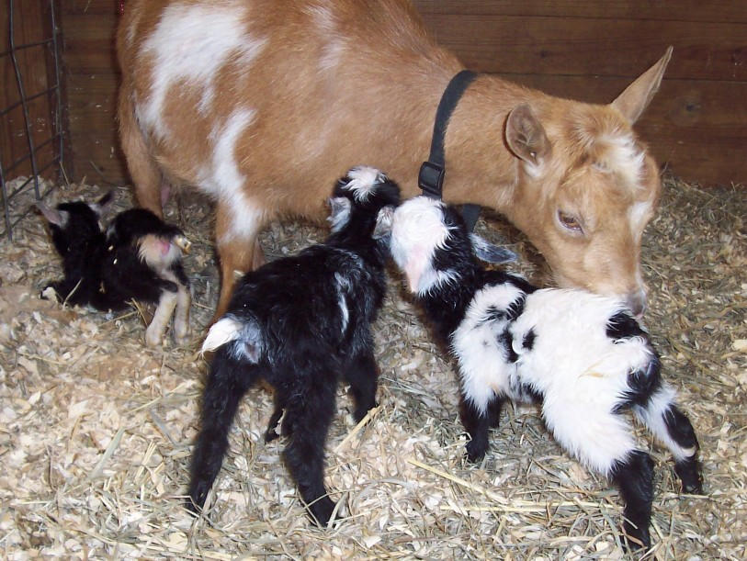

Slide 4
Rodents..
Rabbits and rats family

Slide 5
Digestive System of Ruminants
Feed on plant – cellulose
Need cellulase to digest it
But ruminants do not produce cellulase
However their digestive system are specially adapted to carry out cellulose digestion

Slide 6
Ruminants..
Has a stomach with 4 chambers:
1. rumen
2. reticulum
3. omasum
4. abomasum
Carry out rumination – process of regurgitating food and rechewing it

Slide 7
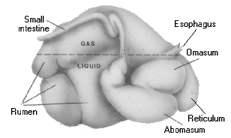

Slide 8
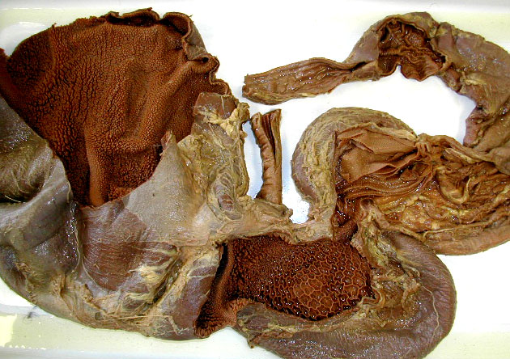

Slide 9
Ruminants..
the saliva of a cow contains no salivary amylase
To digest the plant material, herbivores need to depend on the cellulase-secreting microorganism in its digestive system

Slide 10
Ruminants..
Rumen
- first & largest compartment
- contain bacteria that produced cellulase for the cellulose digestion
- function as the fermentation chamber

Slide 11
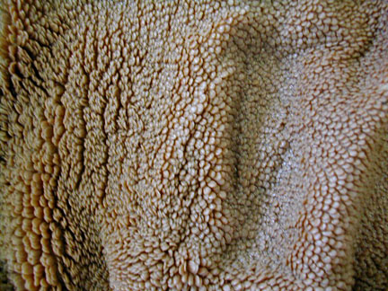

Slide 12
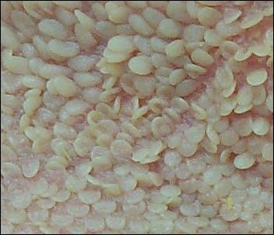

Slide 13
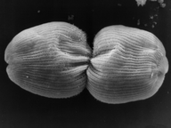
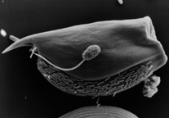
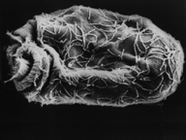
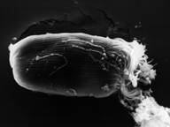
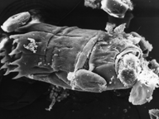
Organisms in rumen

Slide 14
Ruminants..
Reticulum
- also contains bacteria for digestion
- content of reticulum called cud
- regurgitation occurs
- has a ‘honeycomb’ wall

Slide 15
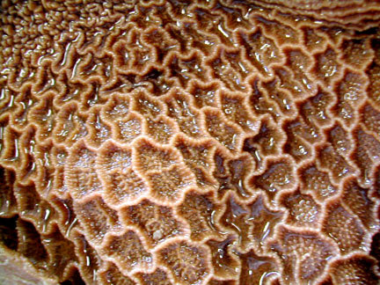

Slide 16
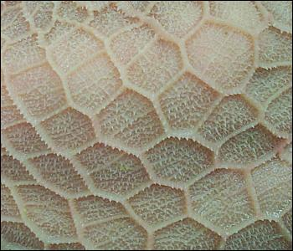

Slide 17
Ruminants..
Omasum
- reswallowed cud will be sent here
- large particle are broken down by peristalsis
- water is removed

Slide 18
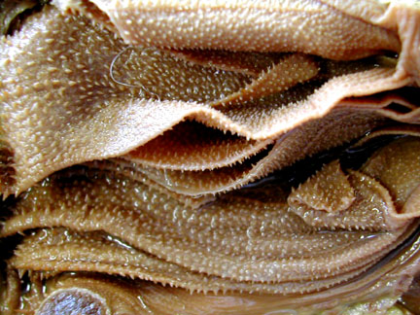

Slide 19
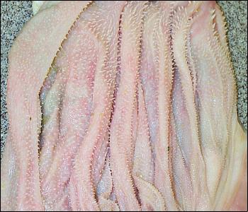

Slide 20
Ruminants..
Abomasum
- true stomach of the ruminants
- gastric juice containing digestive enzymes
- HCl and pepsin

Slide 21
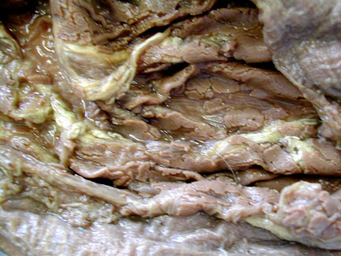

Slide 22
Flow of food in ruminant
chyme
mouth
abomasum
swallow
- H₂O
oesophagus
omasum
swallow
curd
rumen
reticulum
mouth
fermentation
regurgitation

Slide 23
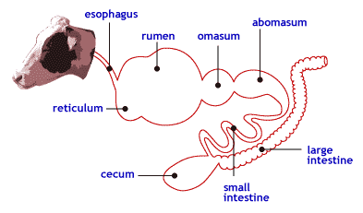

Slide 24
reticulum
omasum
rumen
abomasum

Slide 26
Digestive System of Rodents
Their caecum and appendix are enlarged to store the cellulase producing bacteria
Food pass the alimentary canal twice
- first as food
- then as soft faeces

Slide 27
Soft and watery faeces usually produced at night
Eaten again
Pass out as hard and dry faeces during the day

Slide 28
Rat digestive system

Slide 29
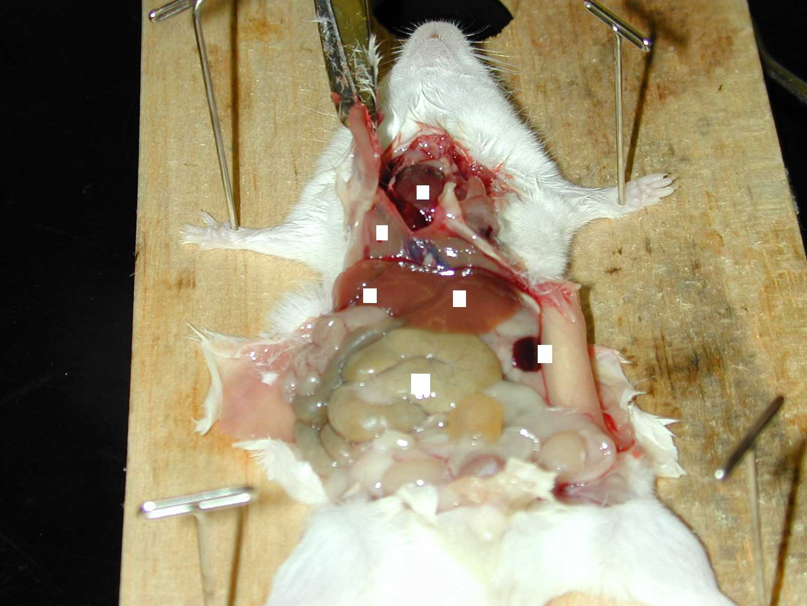

Slide 30
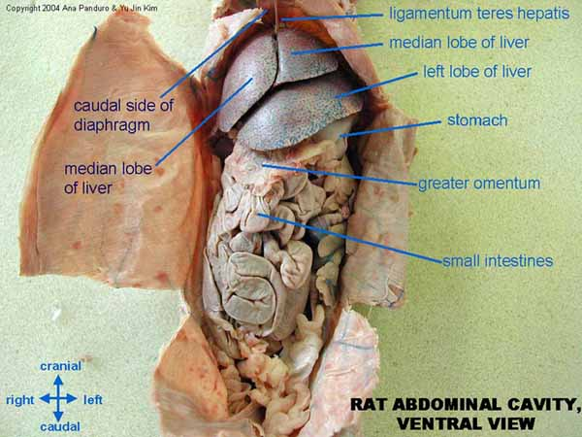

Slide 31
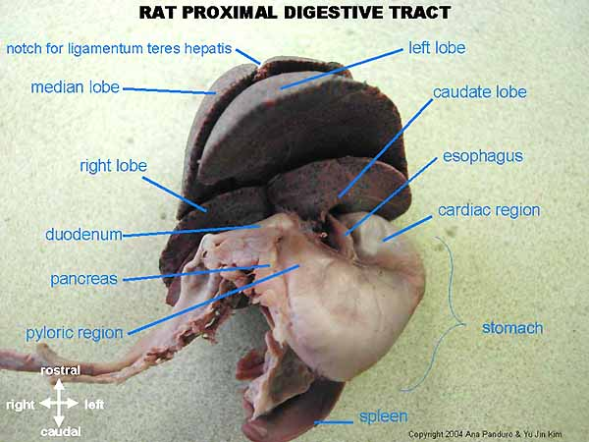

Slide 32
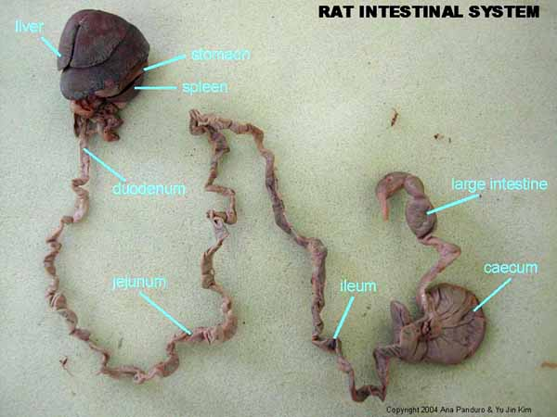

Slide 33
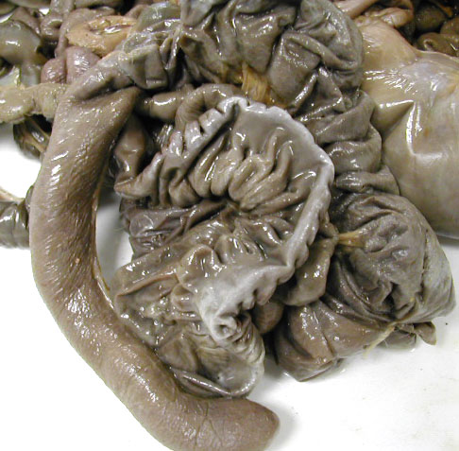
Rat’s caecum

Slide 34
Flow of food in rodents
Re-eat the faeces to absorb more nutrient
mouth
swallow
oesophagus
anus
stomach
Small intestine
caecum
Digest cellulose

Slide 35
Eaten again? Why??
to enable the animals to absorb the products of bacterial breakdown
allow rodent to recover the nutrients initially lost with the faeces

Slide 36
Eaten again? Why??
nutrient is absorb in the small intestine
but in rats, the microorganism that help to digest cellulose is in the caecum, the food must pass the small intestine before entering the caecum
So the faeces eliminate is actually soft and rich in nutrient
That’s why they have to re-eat the faeces in order to absorb all the nutrients

Slide 38
This powerpoint was kindly donated to www.worldofteaching.com
http://www.worldofteaching.com is home to over a thousand powerpoints submitted by teachers. This is a completely free site and requires no registration. Please visit and I hope it will help in your teaching.

