Slide 1
Diseases
How they affect us

Slide 2
Disease are acquired by:
Genetic causes – inherited from parents
Microbes – infection from a virus, bacteria or fungus
Parasites - catch an organism that causes disease condition – e.g. malaria

Slide 3
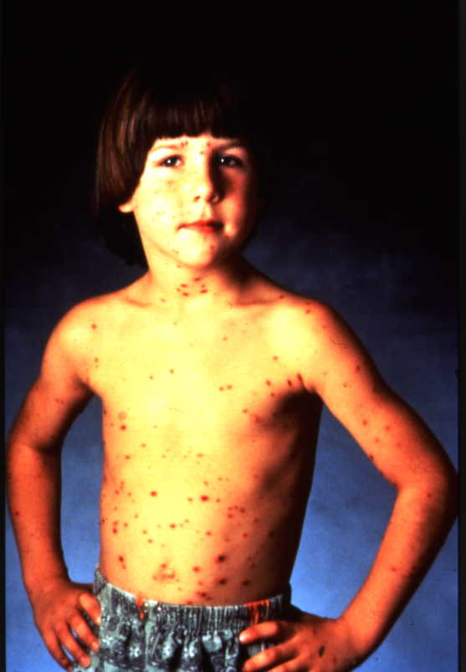
Chicken pox

Slide 4
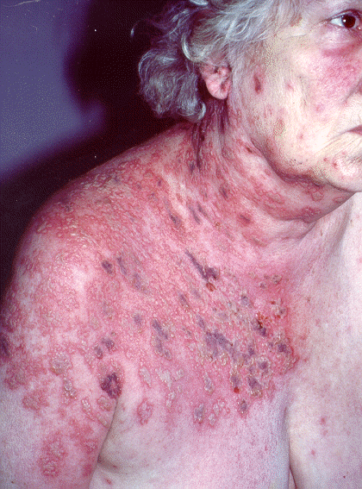
Shingles

Slide 5
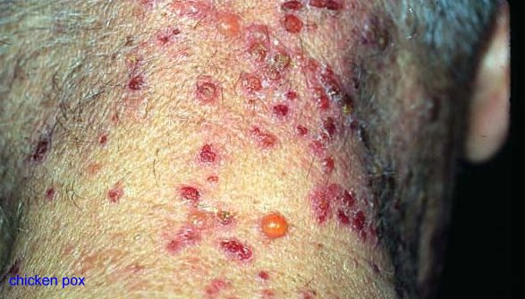
shingles

Slide 6
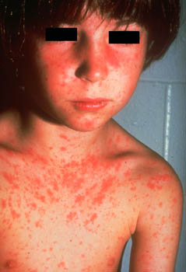
Rubella or German measles

Slide 7
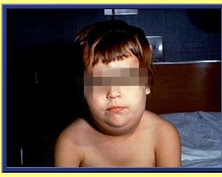
Mumps

Slide 8
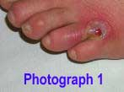
Athletes foot

Slide 9
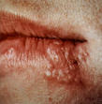
Cold sore

Slide 10
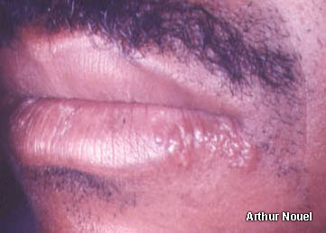
Herpes

Slide 11
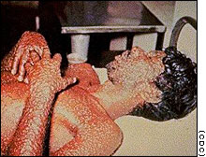
Small pox – a killer

Slide 12
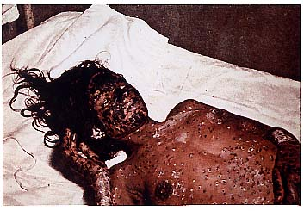
Small pox

Slide 13
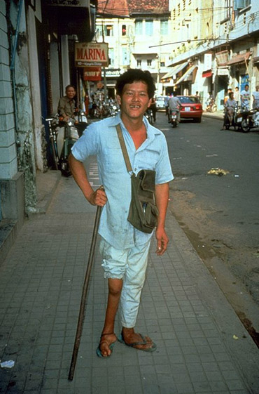
Polio

Slide 14
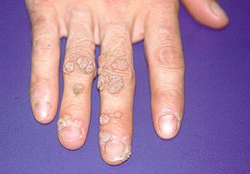
Warts

Slide 15
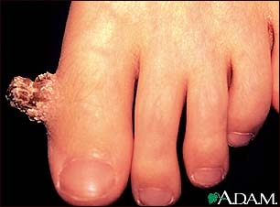
Verruca

Slide 16
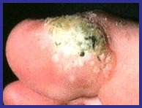
verruca

Slide 17
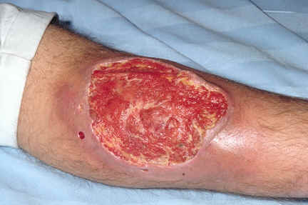
Ulcers

Slide 18
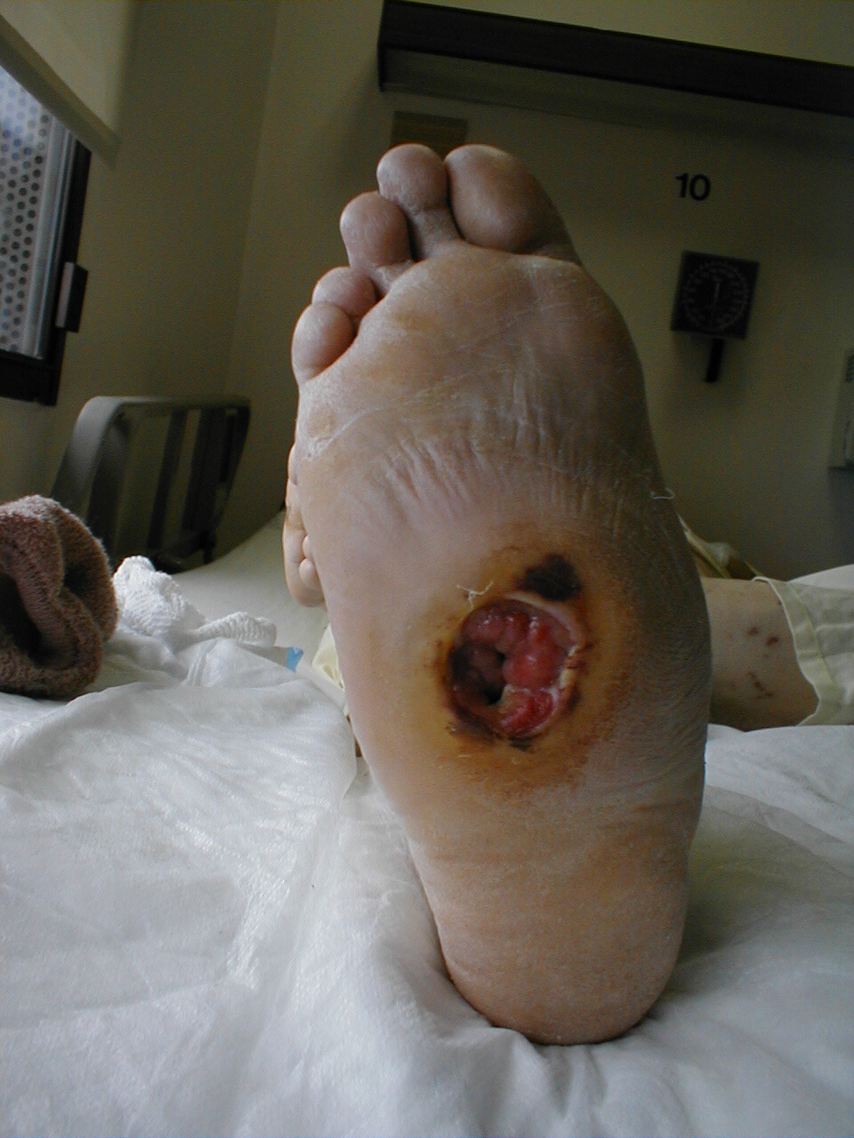
Ulcer

Slide 19
Bed ulcers - Ouch!!!!!!!

Slide 20
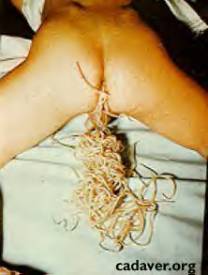
These are parasitic worms – passes from the intestine after treatment with drugs

Slide 21
This powerpoint was kindly donated to www.worldofteaching.com
http://www.worldofteaching.com is home to over a thousand powerpoints submitted by teachers. This is a completely free site and requires no registration. Please visit and I hope it will help in your teaching.

