Slide 1
EARTH WORM
Surendran. K
Surendranaduthila@gmail.com

Slide 2
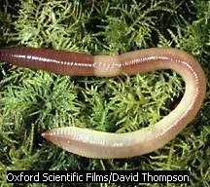
EARTH WORM

Slide 3
EARTH WORM
Phylum : Annelida
Class : Oligochaeta
Genus : Megascolex
Species : mauritii

Slide 4
HABIT
NEGATIVELY PHOTOTACTIC
NOCTURNAL
LOCOMOTION
BURROWING
FEEDING
BREEDING
REGENERATION

Slide 5
Earthworms are terrestrial animals inhabiting the moist soil. They are usually found in the upper layer of soil to a depth of 30-40cm. They are nocturnal and in day time they live in the burrows.During rainy season they come out and crawl on the ground. During winter they close the burrows by leaves and debris. This is to warm the burrows. Their presence is marked by the occurrence of worm cast, the faecal deposit of earthworm.
There are about 500 species of earthworm. Of which 13 are found in India. Common varieties are Pheretima and Lumbricus

Slide 6
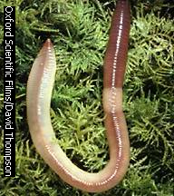
EXTERNAL MORPHOLOGY
A fully grown earthworm measures about 150mm in length and 3-5mm width The body is cylindrical and elongated. The anterior end is pointed , while the posterior end is rounded.

Slide 7
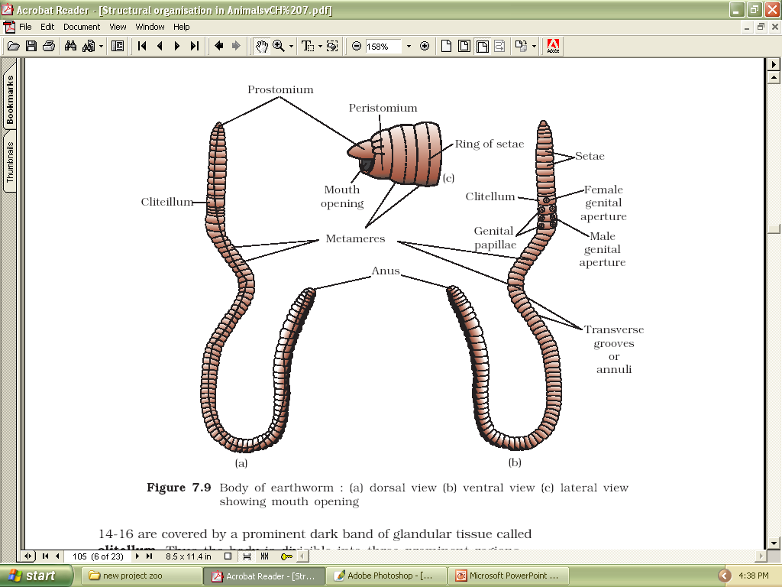
EARTHWORM
Body Segments
Prostomium
Peristomium
14-16 segments: Clitellum Glandular tissue covering
Metameres 100-120
Dorsal side- dark mid dorsal line
Ventral side- genital openings
Ant. End- Mouth, Prostomium, Peristomium

Slide 8
Body apertures
Spermathecal Pores
Female genital Pores
Male genital pores
Nephridiopores
Dorsal pores
Anus

Slide 9
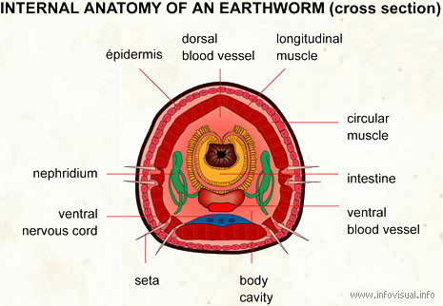
INTERNAL MORPHOLOGY
Cuticle, Epidermis, Two muscle layers, Coelomic Epithelium
The body wall is covered externally by a thin non-cellular cuticle. It is followed by two muscle layers and an inner most coelomic epithelium.The epidermis consists of single layer of columnar cells.Secretory gland cells are also found among the columnar cells

Slide 10
All segments except first and last bear a ring of microscopic S-shaped chitinous setae ,help in locomotion.by gripping on the soil
T.S. of bodywall showing Setae

Slide 11
Digestive system
It is a straight tube and runs from the first to the last segments. It consists of mouth(peristomium),buccal cavity , pharynx, oesophagus,a muscular gizzard, stomach, intestine and anus

Slide 12
Circulatory system
In earthworm ,the circulation is closed type.The circulatory system consists of heart, blood vessels, capillaries and blood glands

Slide 13
Excretory system
Nephridia
Segmentally arranged nephridia are the excretory organs.
There are three types of nephridia
septal,
integumentary and
pharyngeal.

Slide 14
NERVOUS SYSTEM
The nervous system consists of segmentally arranged ganglia and a ventral nerve cord. A ganglion is a mass of nerve cells.
Nerve ring
Ventral Nerve cord
Sense Organs

Slide 15
Reproductive system
Earthworm is hermaphrodite or bisexual .
Male reprodutive organs
Testis
Seminal vesicles
Semimal funnels
Vasa differentia
Prostate glands

Slide 16
Female reproductive system
Ovaries
Oviduccal funnels
Oviducts
Spermatheca
surendranaduthila@gmail.com

Slide 17
INTERACTION WITH MANKIND
WORM CAST
VERMI COMPOSTING
FOOD
MEDICINE

Slide 18
thanks
SURENDRAN. K

Slide 19
This powerpoint was kindly donated to www.worldofteaching.com
http://www.worldofteaching.com is home to over a thousand powerpoints submitted by teachers. This is a completely free site and requires no registration. Please visit and I hope it will help in your teaching.

