Slide 1
Ecology

Slide 2
The study of the interactions that take place among organisms and their environment

Slide 3
Biosphere
The part of Earth that supports life
Top portion of Earth's crust
All the waters that cover Earth's surface
Atmosphere that surrounds Earth.

Slide 4
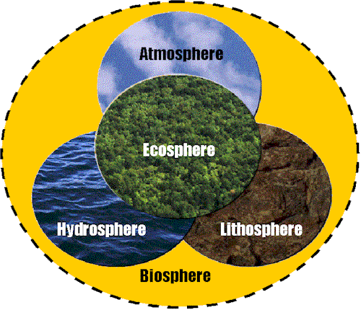

Slide 5
Ecosystem
All the organisms living in an area and the nonliving features of their environment

Slide 6
Population
All the organisms in an ecosystem that belong to the same species

Slide 7
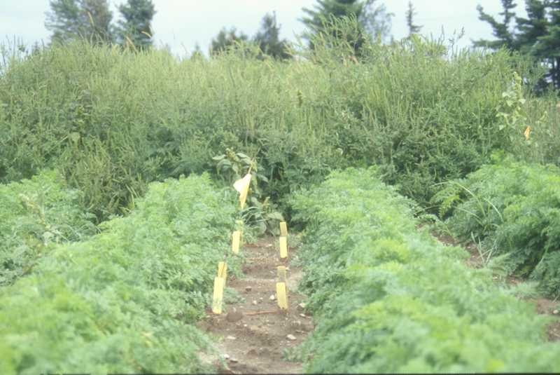

Slide 8
Community
All the populations in an ecosystem

Slide 9
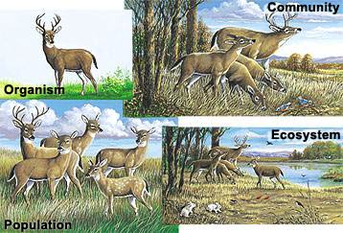

Slide 10
Habitat
The place in which an organism lives
provides the kinds of food and shelter, the temperature, and the amount of moisture the organism needs to survive

Slide 11
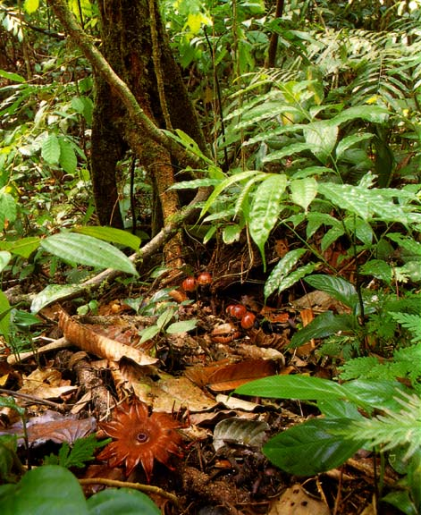

Slide 12
Competition
Food
Space

Slide 13
Competition
Competition caused by population growth affects many organisms, including humans
Limits population size

Slide 14
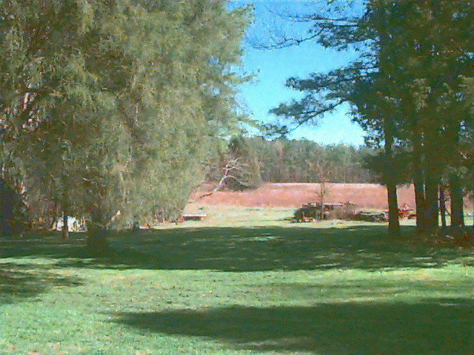

Slide 15
Limiting Factor
Anything that restricts the number of individuals in a population.
Includes living and nonliving features of the ecosystem

Slide 16
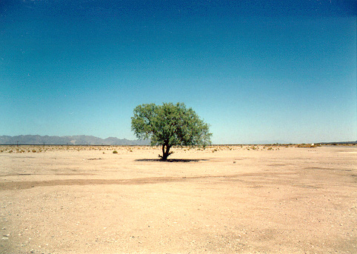

Slide 17
Succession
Natural, gradual changes in the types of species that live in an area; can be primary or secondary.
Primary – begins in a place without soil
Secondary – where soil already exists

Slide 18
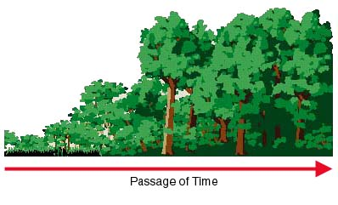

Slide 19
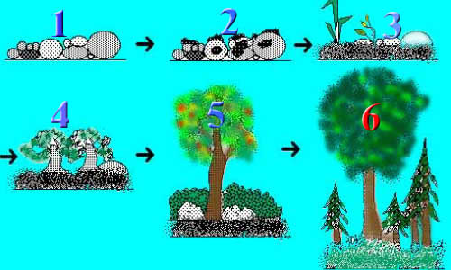

Slide 20
Primary Succession

Slide 21
Secondary Succession

Slide 22
Pioneer species
A group of organisms, such as lichens, found in the primary stage of succession and that begin an area's soil-building process

Slide 24
Climax community
A community that has reached a stable stage of ecological succession

Slide 25
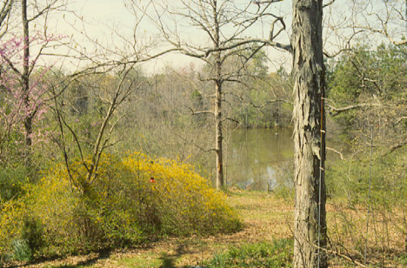

Slide 26
Biome
Large geographic areas with similar climates and ecosystems

Slide 27
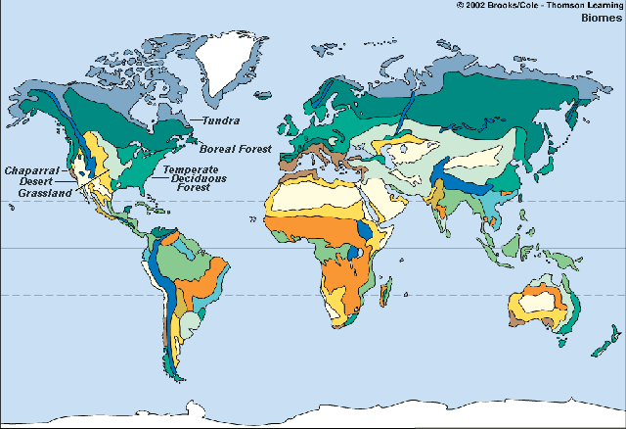

Slide 28
Includes
Tundra
Taiga
Desert
Temperate deciduous forest
Temperate rain forest
Tropical rain forest, and grassland

Slide 29
This powerpoint was kindly donated to www.worldofteaching.com
http://www.worldofteaching.com is home to over a thousand powerpoints submitted by teachers. This is a completely free site and requires no registration. Please visit and I hope it will help in your teaching.

Slide 30
This powerpoint was kindly donated to www.worldofteaching.com
http://www.worldofteaching.com is home to over a thousand powerpoints submitted by teachers. This is a completely free site and requires no registration. Please visit and I hope it will help in your teaching.

