Slide 1
Electrical Circuits
Bobbi Martin, Las Vegas, NV

Slide 2
What is electricity?
It is a form of energy that is created from the movement of electrons of atoms. When the electrons move from one atom to the next, energy is created. The word electricity comes from the same root word as electron.

Slide 3
Voltage
The electron travels around the atom at a very high rate of speed. When the electrons move from one atom to the next, the energy created is called voltage.

Slide 4
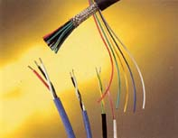
Moving Electrons
The moving electrons make a fast flowing river of energy called a current.
The current travels through a material like a wire made from aluminum or copper called a conductor.

Slide 5
Types of Currents
Direct Current (DC)
Alternating Current (AC)

Slide 6
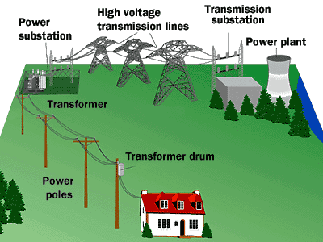
Alternating Current
The power that comes from a power plant is called alternating current (AC). The direction of the current reverses, or alternates, 60 times per second (in the U.S.) or 50 times per second (in Europe, for example). The power that is available at a wall socket in the United States is 120-volt, 60-cycle AC power.

Slide 7
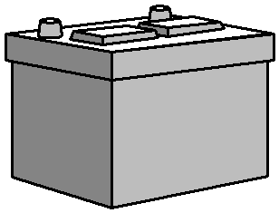
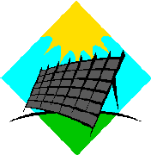
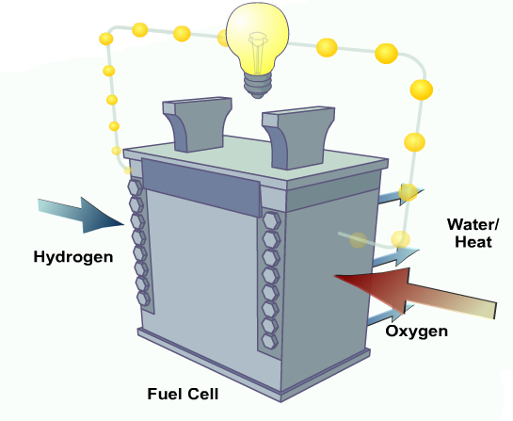
Direct Current
Batteries, fuel cells and solar cells all produce something called direct current (DC). The positive and negative terminals of a battery are always positive and negative. The electron current always flows in the same direction between those two terminals.
Car Battery
Solar Cell
Fuel Cell

Slide 8
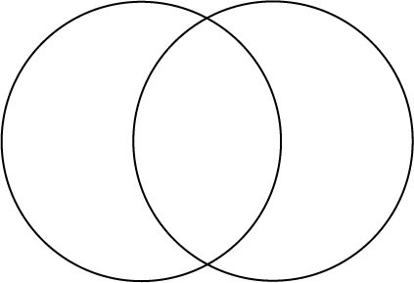
AC DC
Direction of electrons reverses
Electricity is generated by coal, water, fossil fuels, or nuclear reaction at a generating station
Electrons flow in one direction
Electricity is generated by stored chemicals, radiation, wind, or fuel
Can be portable
Electrical Power Sources

Slide 9
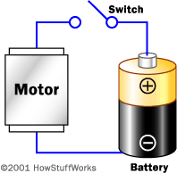
Batteries
Batteries are not little packages of energy.
Batteries collect electrons in the negative (-) terminal.
Chemicals inside the battery rapidly push the electrons out the positive (+) terminal creating electricity.

Slide 10
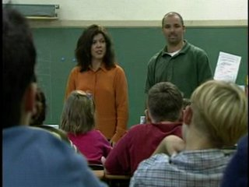
Components of a Circuit
Click on picture for video stream

Slide 11
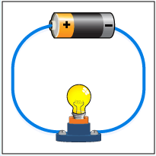
Components of a Circuit
Power Source
Conductor
Load

Slide 12
Types of Circuits

Slide 13
Series Circuit
A circuit that only has one path for current to flow through is called a series circuit. If the path is broken, no current flows through the circuit.

Slide 14
Parallel Circuit
A type of circuit that has more than one path for current is called a parallel circuit. If the path is broken, the current continues to flow through the circuit.

Slide 15
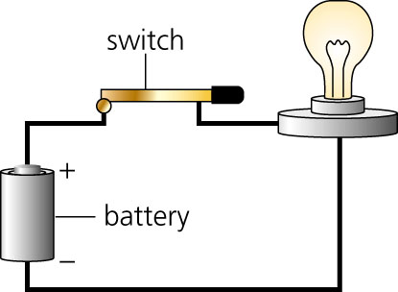
Open and Closed Circuits
What will happen if the switch is lifted?

Slide 16
Combination Circuit
What will happen to the circuit if one of the motors fails to function?
What will happen if one of the bulbs fails to function?

Slide 17
Work with your partner or group to use a Venn diagram to compare and contrast series and parallel circuits
Series Circuit Parallel Circuit

