Slide 1
Electricity
April 23, 2007

Slide 2
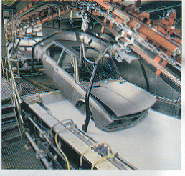
Applications of Electrostatics

Slide 3
Electric Charge
Measured in COULOMBS
Six million trillion electrons is about - 1 C.
Six million trillion protons is about + 1 C.

Slide 4
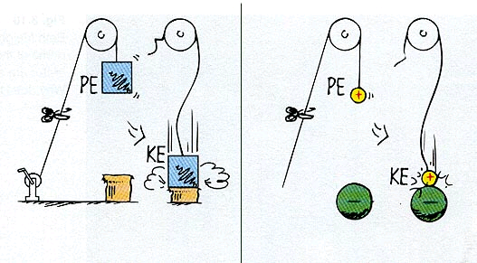
Electric Potential Energy

Slide 5
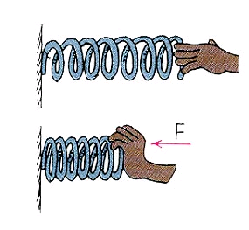
Electric Potential Energy
This spring has more SPE when it is compressed

Slide 6
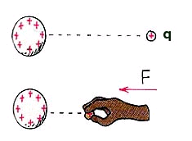
Electric Potential Energy
This spring has more SPE when it is compressed
Likewise, these charges will have more potential energy when they are pushed closer

Slide 7
Electric Potential Energy
PE equals the amount of work done to move a charge from one place to another.

Slide 8
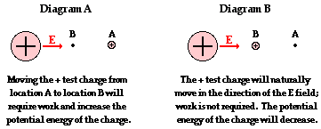

Slide 9
Electric Potential Energy
Which will have the larger electric potential energy?

Slide 10
Electric Potential Energy
A – because it requires work to move it away from the negative charge.

Slide 11
Electric Potential (volts)
EP = work/charge

Slide 12
Electric Potential (volts)
Example: 1000 joules of work is done to move the charge q from far away to the place indicated. If q = 10 C, what is the electric potential at the new location?

Slide 13
Electric Potential (volts)
Example: 1000 joules of work is done to move the charge q from far away to the place indicated. If q = 10 C, what is the electric potential at the new location?
Voltage = work/charge
V = 1000 J/10C = 100 Volts

Slide 14
Electric Potential (volts)
What if the charge in the previous problem were now 100 C instead of 10? What would happen to the EP?

Slide 15
Electric Potential (volts)
What if the charge in the previous problem were now 100 C instead of 10? What would happen to the EP?
IT WOULD BE THE SAME!!!
Work would also increase

Slide 16
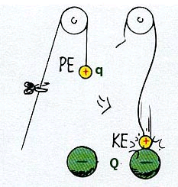
Electric Potential (volts)
Electric potential is associated with LOCATION, not CHARGE

Slide 17
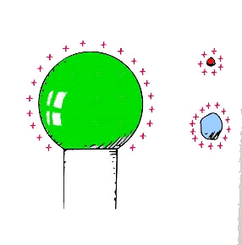
Electric Potential vs Potential Energy
Which charge has more electric potential?
Which has more potential energy?

Slide 18
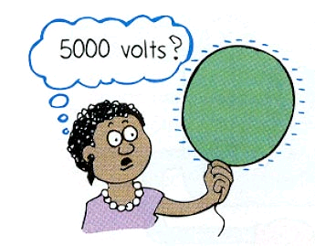
Is 5000 Volts Dangerous?

Slide 19
Is 5000 Volts Dangerous?
NOPE!
When 1 million electrons are added to a neutral balloon, it has an electric potential of 5000 volts

Slide 20
Potential Difference (voltage)
Difference in electric potential between two points.

Slide 21
Potential Difference (voltage)
Difference in electric potential between two points.
Potential difference between A and B is 0
A
B

Slide 22
Potential Difference (voltage)
Difference in electric potential between two points.
Now there is a potential difference
A
B

Slide 23
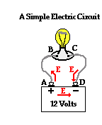
Potential Difference
Batteries provide potential difference between one end of the circuit and the other

Slide 24
Potential Difference
Batteries provide potential difference between one end of the circuit and the other
Charges flow from high to low electric potential

Slide 25
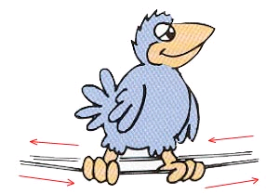
Potential Difference (voltage)
Why aren’t birds on power lines shocked?

Slide 26
Potential Difference (voltage)
Why aren’t birds on power lines shocked?
The Potential Difference between their feet is zero! (0 voltage)

Slide 27
Current (I)
Net flow of electrons

