Slide 1
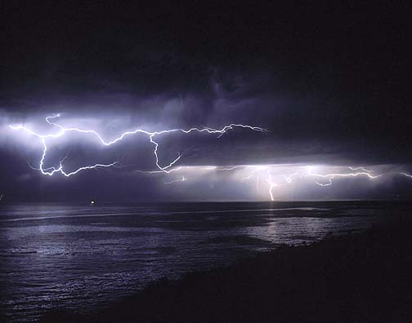
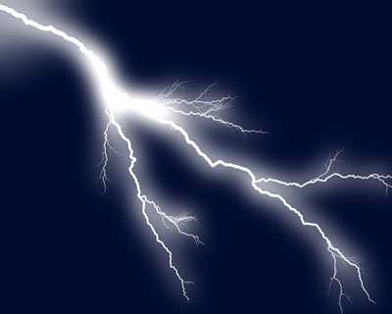
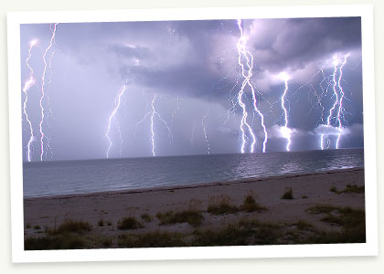
Electricity

Slide 2
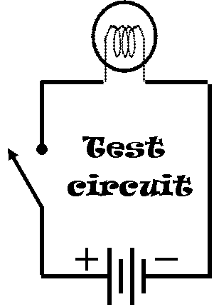
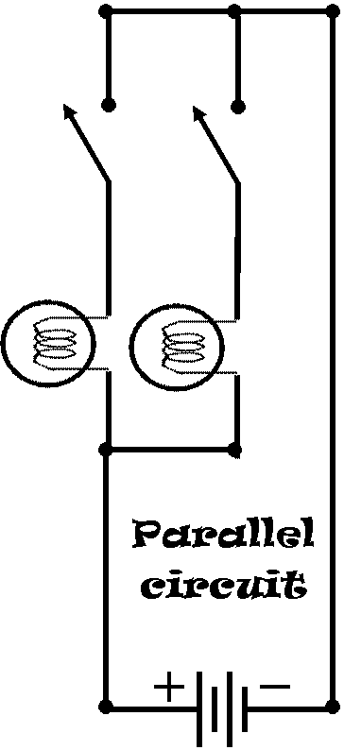
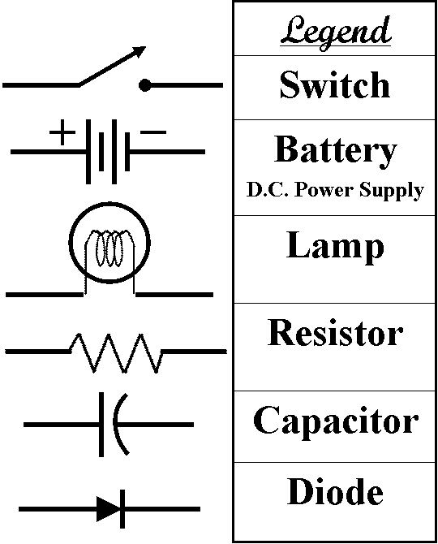
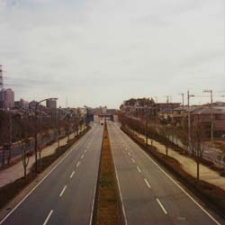
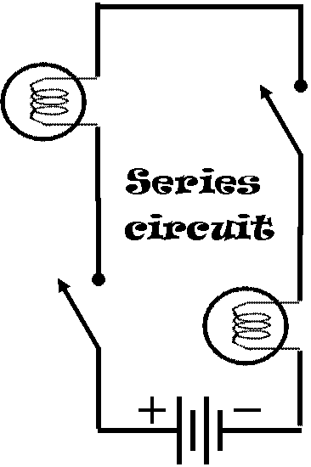
Parallel & Series
Circuit Lab
Read Me
Build the test circuit.
Build the series circuit & fill out the table.
Build the Parallel circuit & fill out the table.
Switch 1
Switch 2
Lamp 1
Lamp 2
Lamp 1
Switch 2
Switch 1 | Switch 2 | Lamp1 | Lamp 2
Off | Off
On | Off
Off | On
On | On
Switch 1 | Switch 2 | Lamp1 | Lamp 2
Off | Off
On | Off
Off | On
On | On
Switch 1
Lamp 2

Slide 3
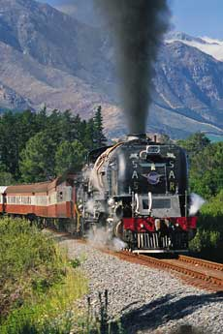

Slide 4

Switch 1
Switch 2
Lamp 1
Lamp 2

Slide 5

‘
El Motor
Cardboard tube
Wire coil (covered with glue)
Wood shtick
Wire ends (stripped)
Foil (glued onto bottom half of stick)

Slide 6
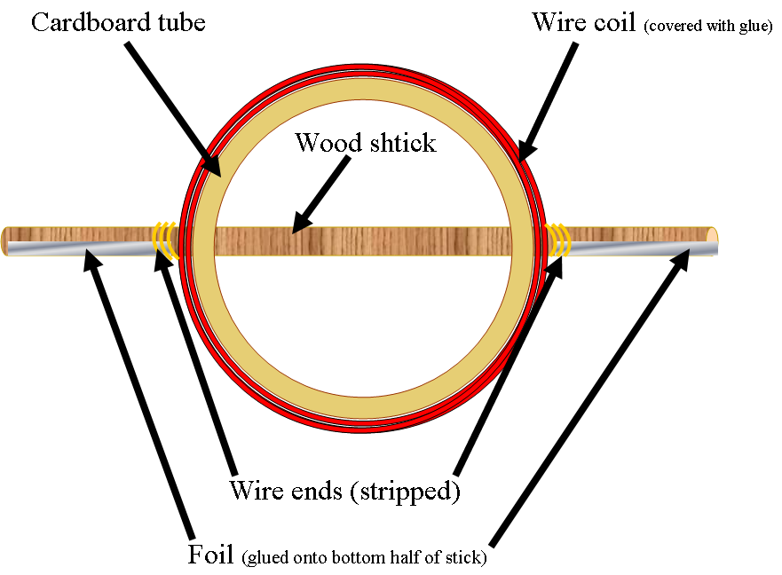
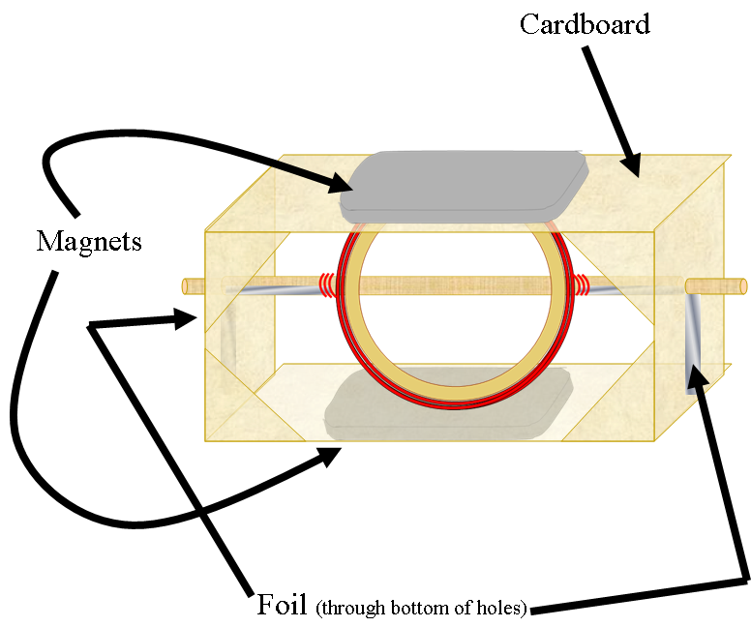
‘
El Motor

Slide 7
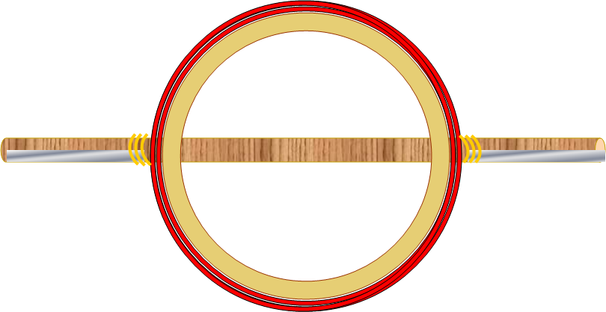

Slide 8
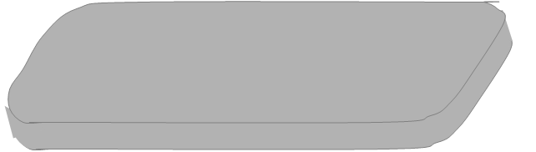

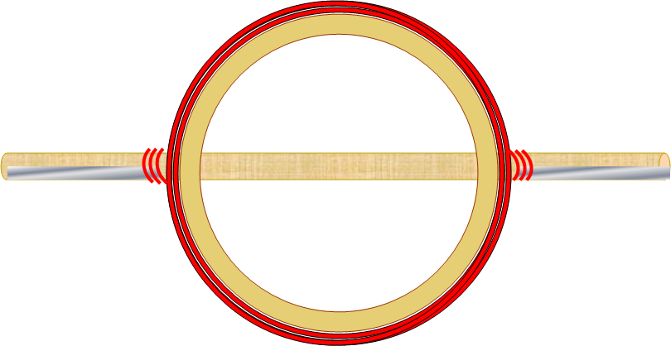

Cardboard
Magnets
Foil (through bottom of holes)

Slide 9
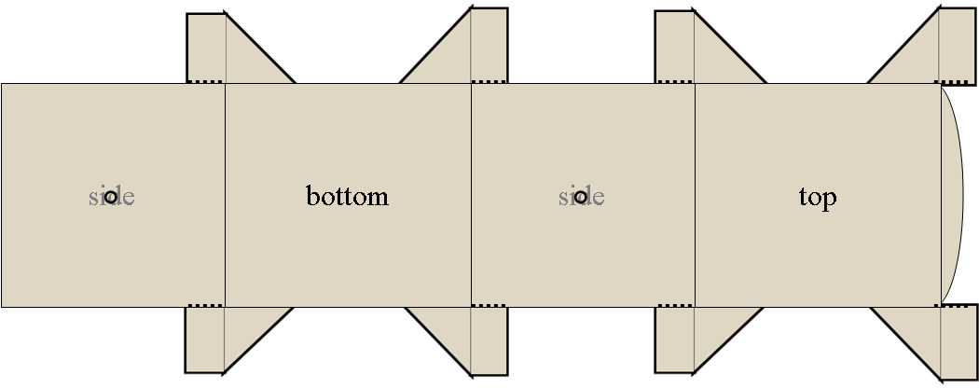

Slide 10
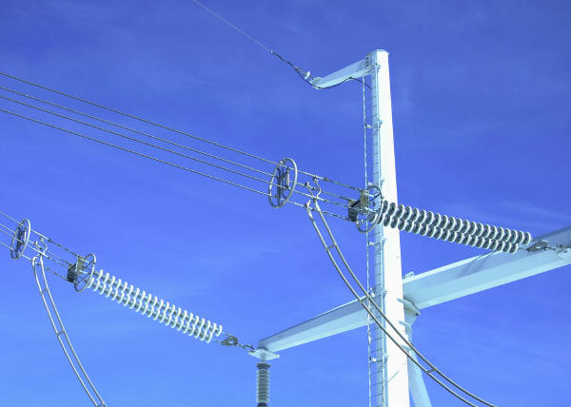
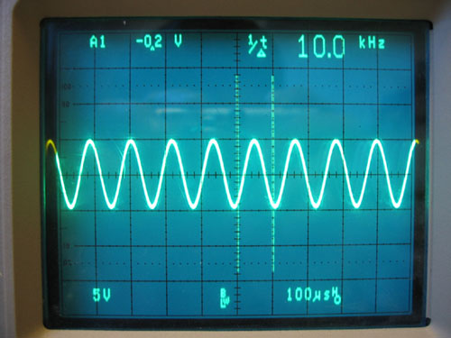
Vibration/Wave
mechanical oscillations about an equilibrium point.
Earthquake
Sound
Trampoline
Pendulum
Spring (car)
guitar string
Ocean
Wave
a disturbance that propagates through space and time,
usually with transferrance of energy.
Potential
Wave
Vibration

Slide 11

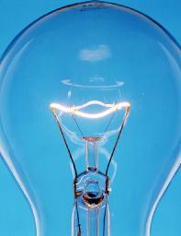





Electricity
filament

Slide 12
Electricity
D.C.
Direct Current
A.C.
Alternating Current

Slide 13

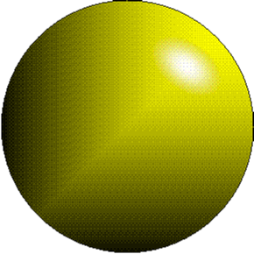
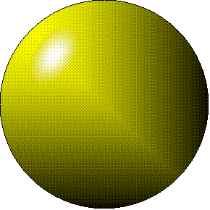
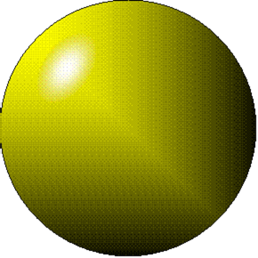
Electricity - electrons moving through a metal wire.

Slide 14
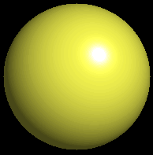
Atomic Absorption

Slide 15

Atomic Emission
Magic is technology that is not understood.

Slide 16
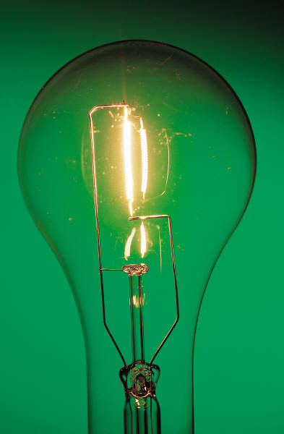
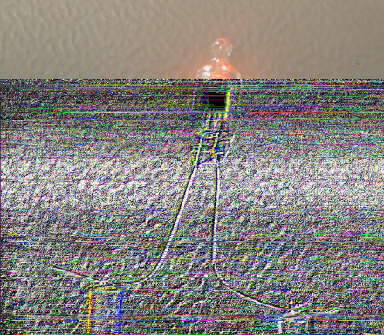
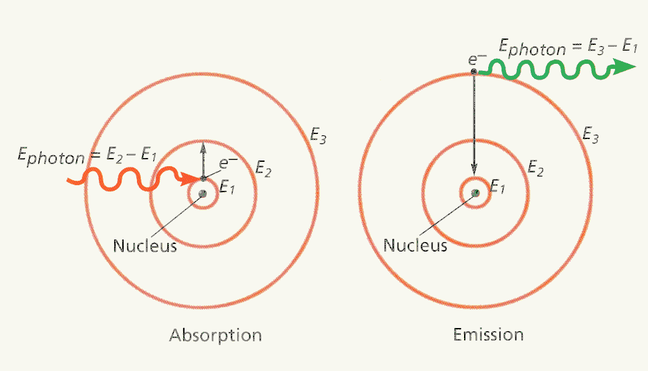


Slide 17
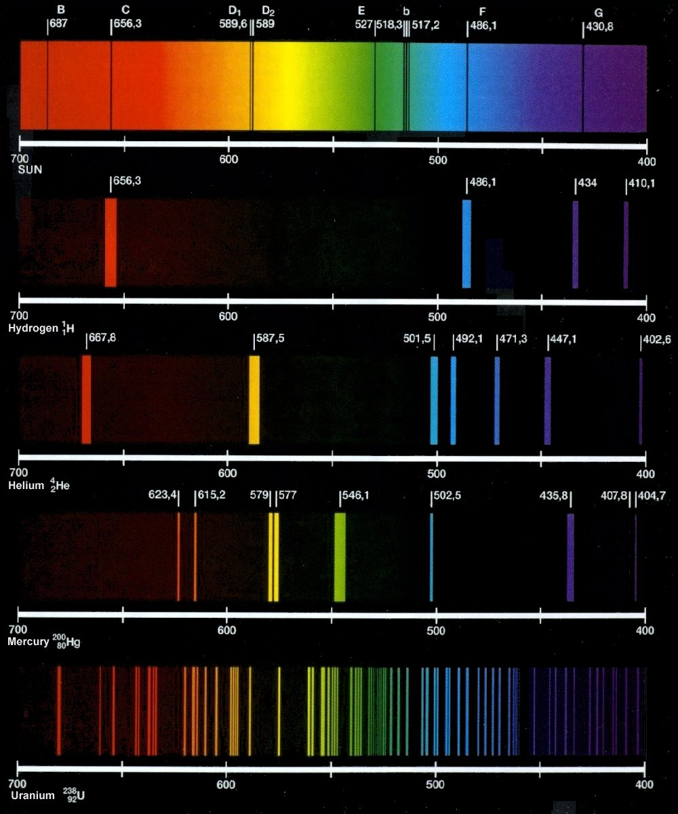

Slide 18
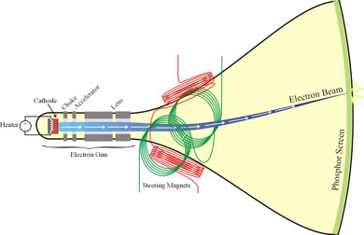
A television is an Electron Gun

Slide 19
Generating an Electric Field
with dc voltage
+
-
+
-
9V
Notes:
Voltage creates field, field is a force (push ions)

Slide 20
Generating an Electric Field
dc voltage
+
-
e⁻¹
e⁻¹
e⁻¹
e⁻¹
e⁻¹
e⁻¹
e⁻¹
e⁻¹
+
-
9V
Notes:
Voltage creates field, field is a force (push ions)

Slide 21
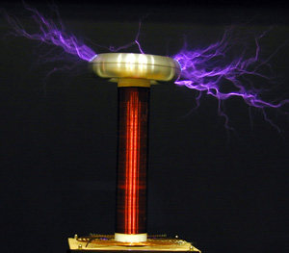
Static electricity

Slide 22


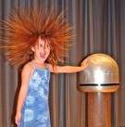
Static Electricity when a material has an excess or a lack of electrons.

Slide 23
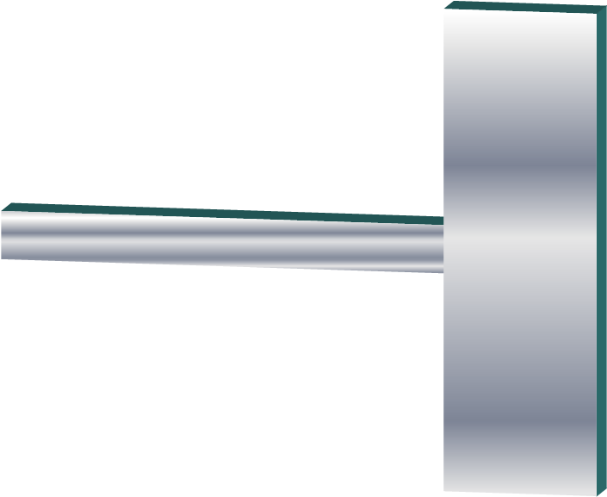
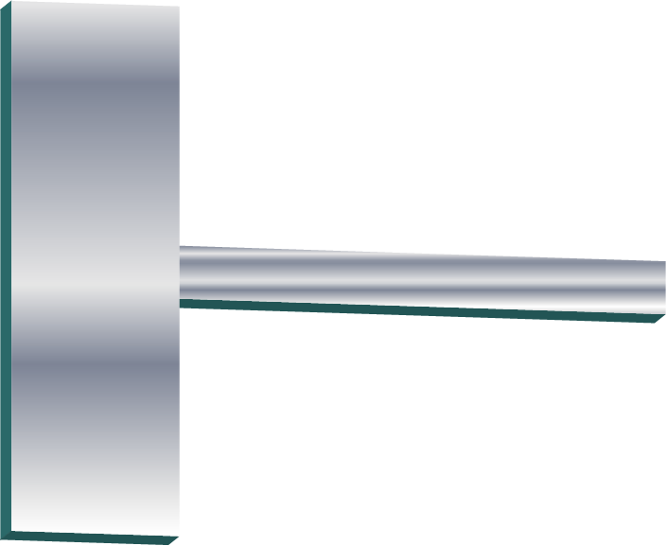
A Capacitor holds a charge on its plates.

Slide 24


Conductor
Something that allows thermal energy to pass easily
Metal
Water

Slide 25
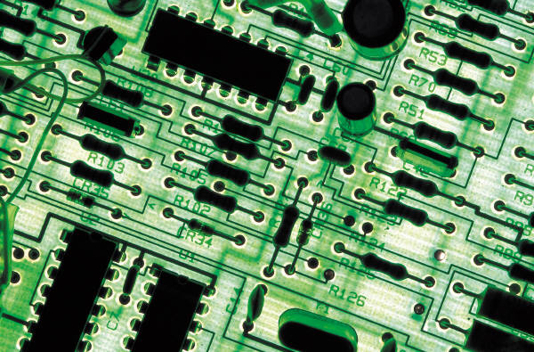
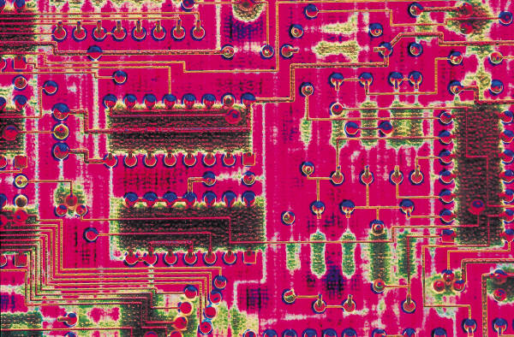
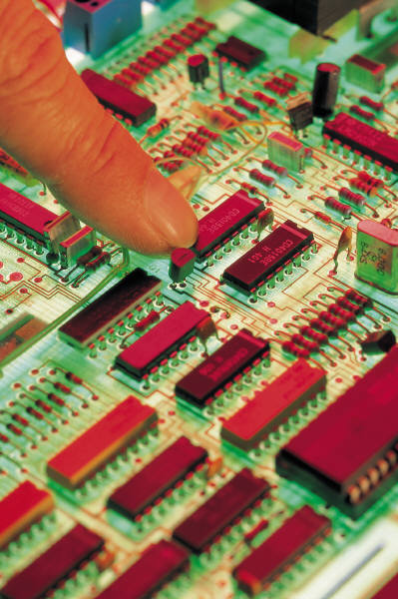
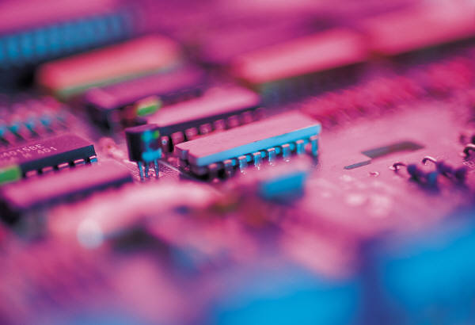
semi-Conductor

Slide 26
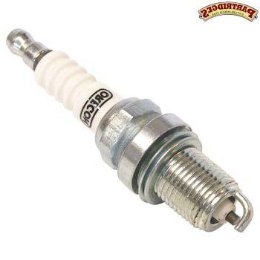
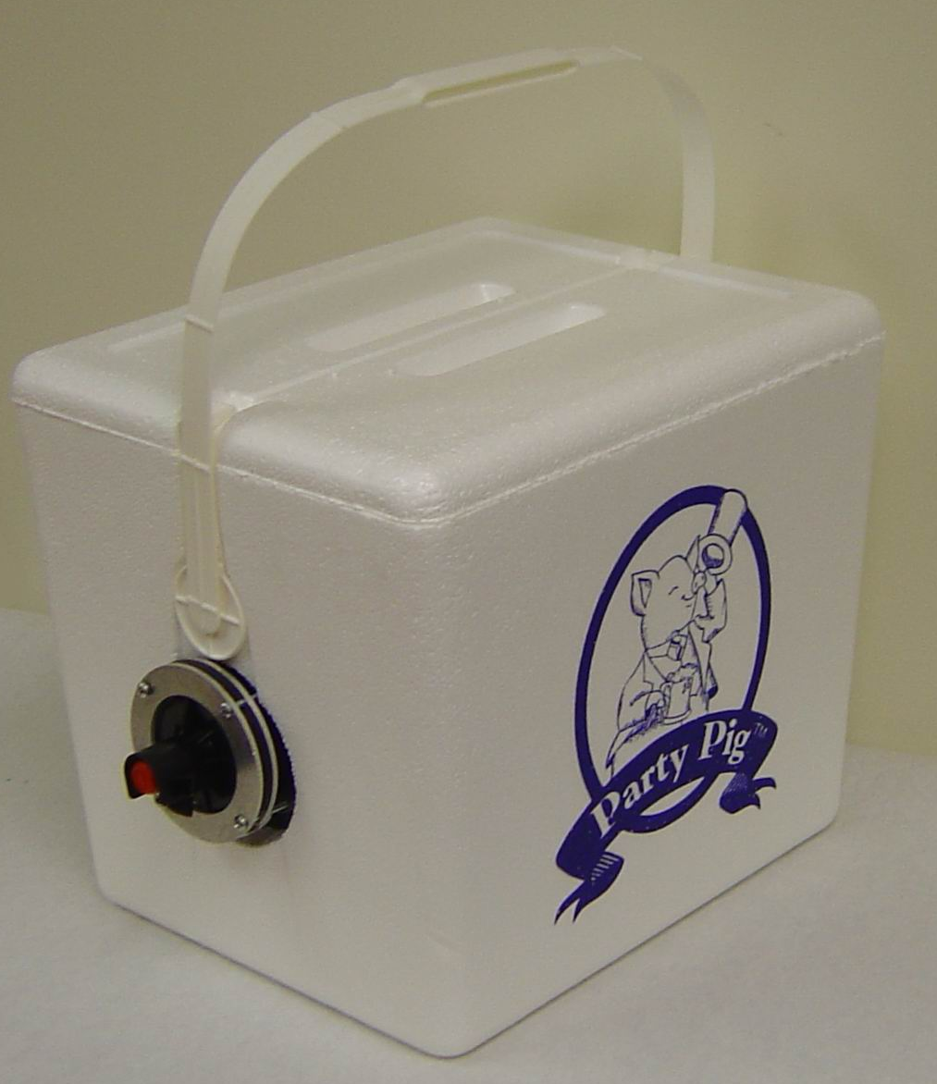


Insulator
Something that does NOT allow
thermal energy
to pass easily

Slide 27


Electrical Energy - is energy resulting from the force between two objects having different voltages.

Slide 28
Electrical Energy - is the force of moving electrons.

Slide 29


Electrical Energy
Voltage
Current
Resistance
Thermocouple (copper & nickel or copper & iron)

Slide 30




Circuits
Series Parallel

Slide 31
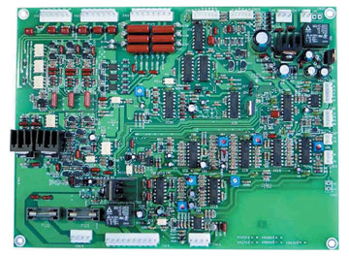
Circuit Board

Slide 32
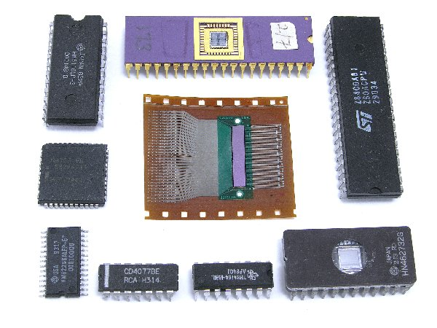
Integrated circuit

Slide 33
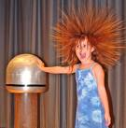
Static electricity

Slide 34
Static electricity

Slide 35
Electricity
filament

Slide 36

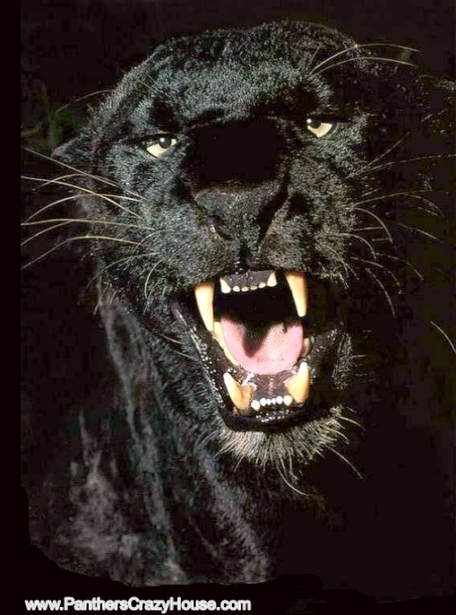
The End
Produced by Jake Israel
Directed by Jake Israel
Original Story by Jake Israel
Screenplay Jake Israel
Engineer Jake Israel
Photo enhancement Jake Israel
Casting Jake Israel
Editor Jake Israel
Custom animation Jake Israel
Location manager Jake Israel
Special Effects Jake Israel
Field research Jake Israel
© 2008
Jacob (Cowboy) Israel
All rights reserved
Panther Productions

Slide 37
This powerpoint was kindly donated to www.worldofteaching.com
http://www.worldofteaching.com is home to over a thousand powerpoints submitted by teachers. This is a completely free site and requires no registration. Please visit and I hope it will help in your teaching.

