Slide 1
Electricity
What is it and where does it come from?

Slide 2
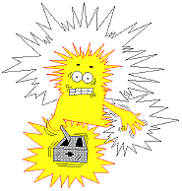
Be safe around electricity
Electricity can be very dangerous. You should never put anything into electric sockets, except plugs.
Never touch appliances, wires or electrical switches with wet hands or feet.

Slide 3
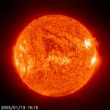
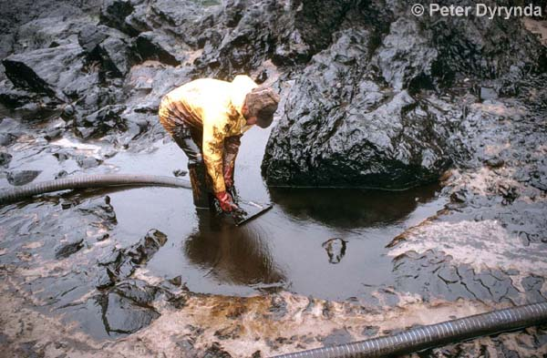
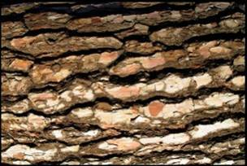
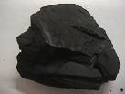
Sources of electricity
There are many sources of electricity such as:
Fossil fuels: coal, oil and wood.

Slide 4
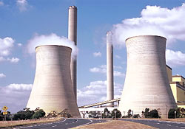
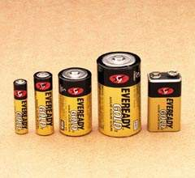
What is electricity and how is it made?
Electricity is a kind of energy. It is made in power stations.
Electricity is also made in batteries.
How do you think electricity is connected to our homes?

Slide 5
How mains electricity works
The electricity produced in power stations is carried through wires into buildings.
This is called mains electricity
and we can connect to it by using a plug.

Slide 6
How batteries work
Inside a battery are two different chemicals. When you put a battery into an appliance a circuit is made.
The two chemicals begin to change into new chemicals. As they change an electrical current flows along the circuit making the appliance work.

Slide 7
Why do we need electricity?
In the modern world we rely on electricity for nearly everything.
We need it for important things like:
lighting
refrigerators
heating
What type of electricity do these appliances use?

Slide 8
Things that use battery power
Can you think of appliances that use batteries?

Slide 9
Things that use mains electricity
What can you see in this classroom that uses mains electricity?
What things do you have at home that use mains electricity?

Slide 10
Independent activity
Mains | Battery
heat | sound, movement
Cut out and sort the pictures under the correct columns. Label the effects of the electricity.
Blue and green tables write a sentence describing the effect. E.g. The mains electricity causes the iron to heat up so it can iron the wrinkles out of clothes.

