Slide 1
Aims of the session:
Learn about fertilisers and their effects on the environment.
Be able to answer exam questions on the effects.
Learn about Pesticides and their effects
Summarise the key points about pesticides

Slide 2
Fertilisers and Pesticides

Slide 3
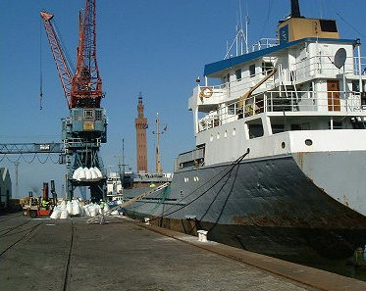
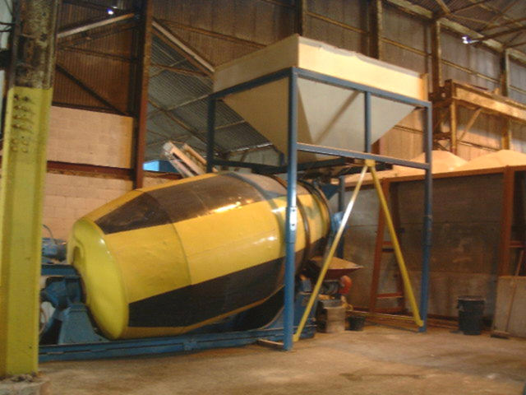
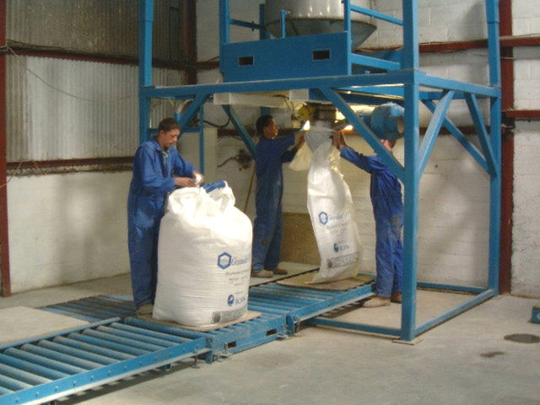
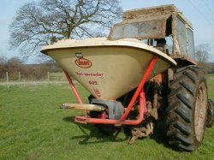
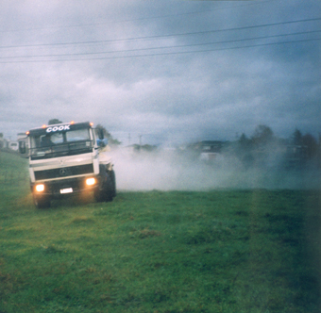
Fertilisers

Slide 4
The process of
Eutrophication

Slide 5
The process of Eutrophication cont.

Slide 6
Biochemical Oxygen Demand (BOD).
This measures the rate of oxygen consumption by a sample of water, and therefore gives a good indication of eutrophication. A high BOD means lots of organic material and aerobic microbes, i.e. eutrophication

Slide 7
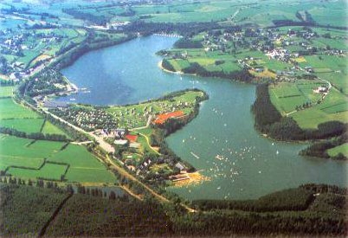

Slide 8
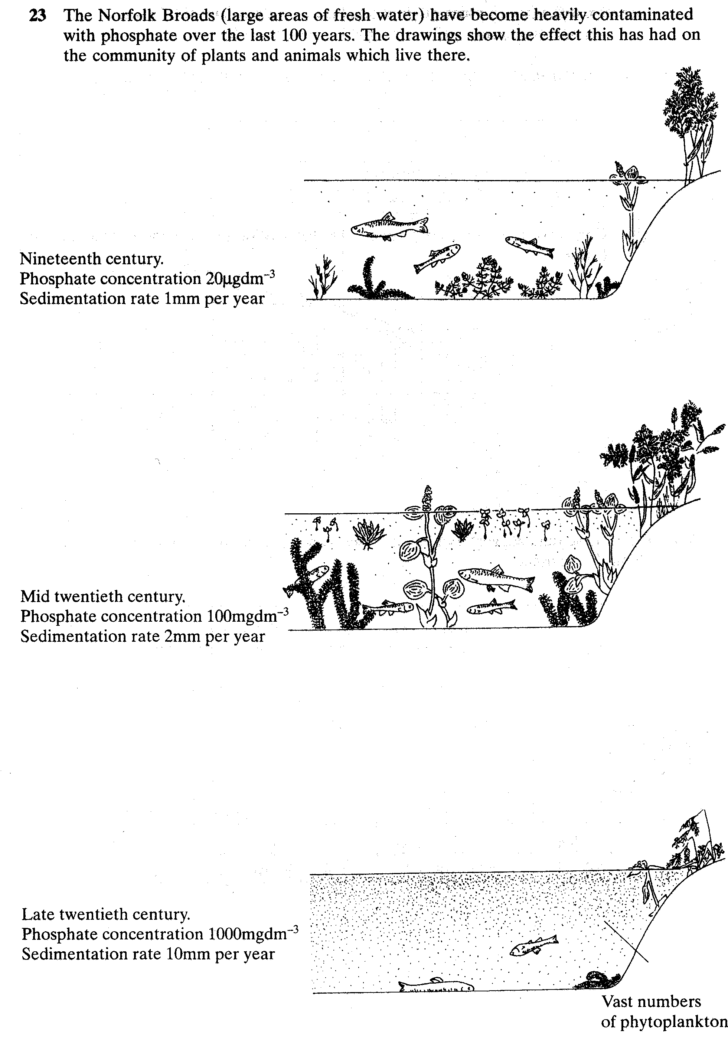

Slide 11
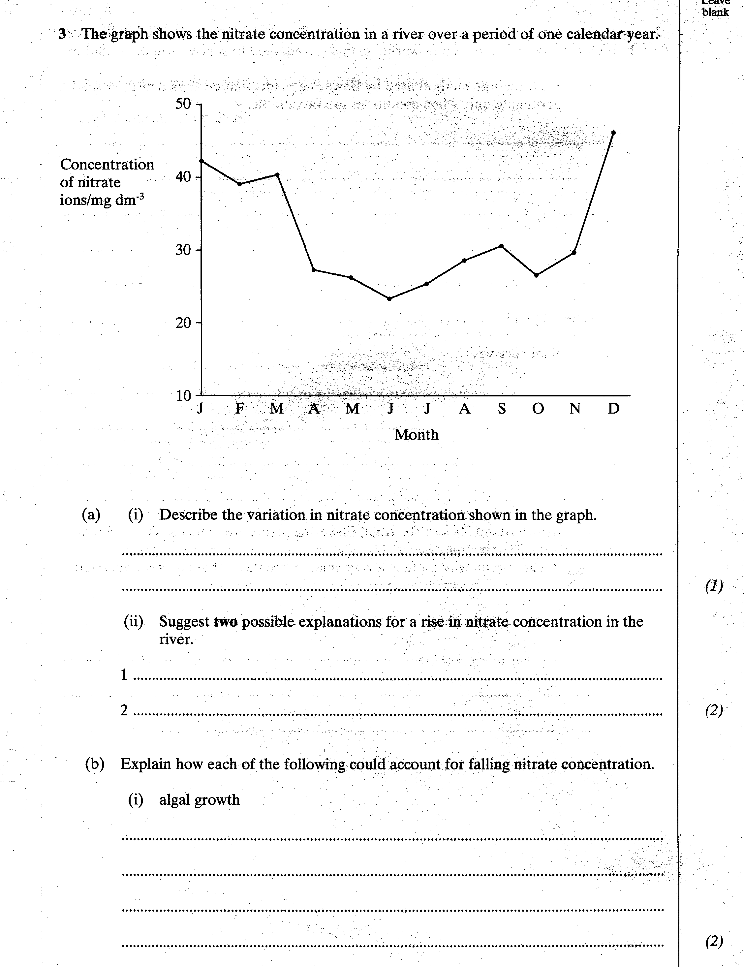
The nitrate concentration falls during spring and summer and rises during autumn and winter
Less algal growth as autumn begins
Possibly all plants have died

Slide 12
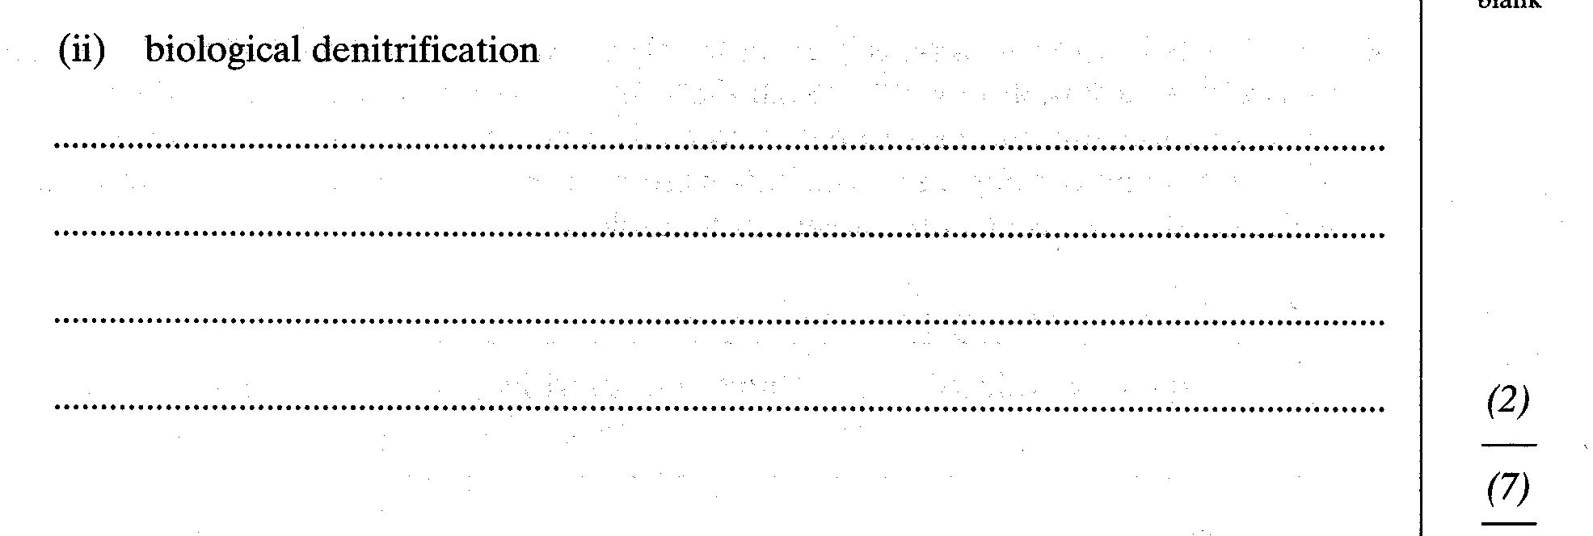

Slide 13
Pesticides

Slide 14
Pesticides
Include:
Herbicides
Insecticides
Fungicides
Bactericides

Slide 15
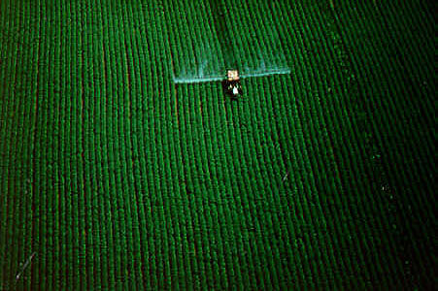

Slide 16
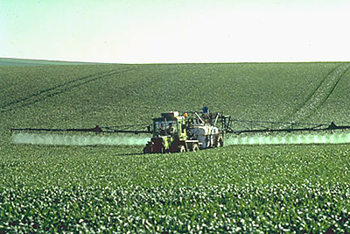
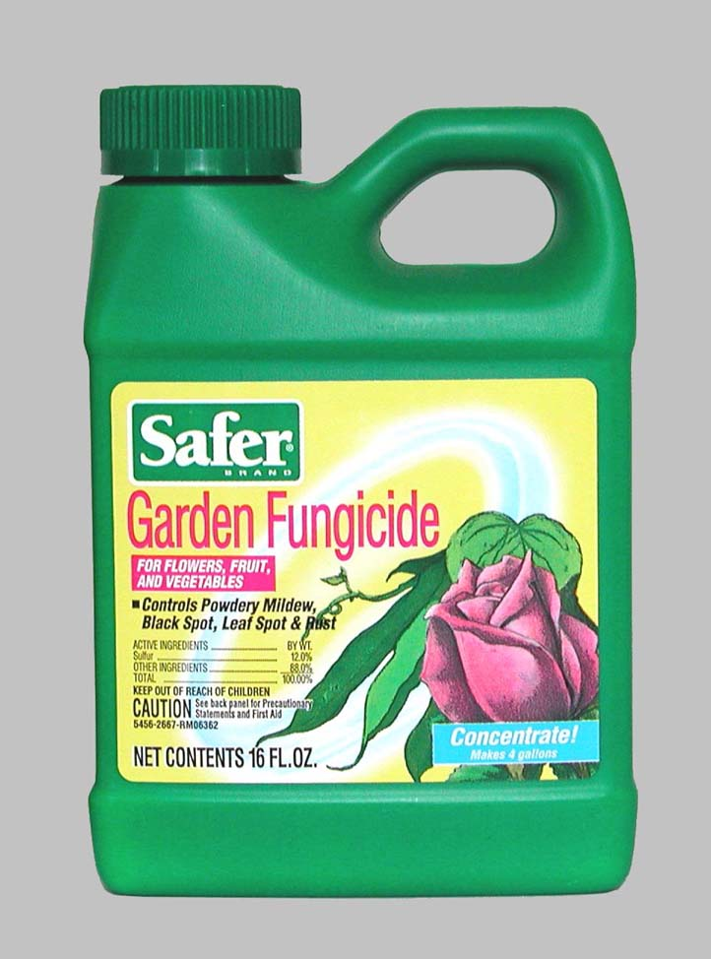
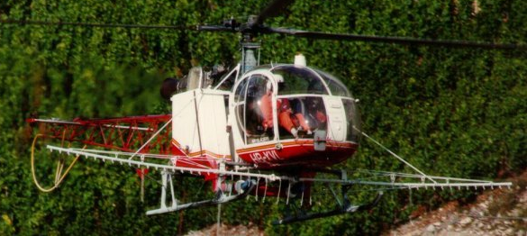

Slide 17
Pesticides
Persistence
+ Lipid solubility
= Bioacculmulation

Slide 18
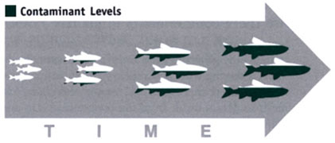
Bioaccumulation
E.g DDT

Slide 19
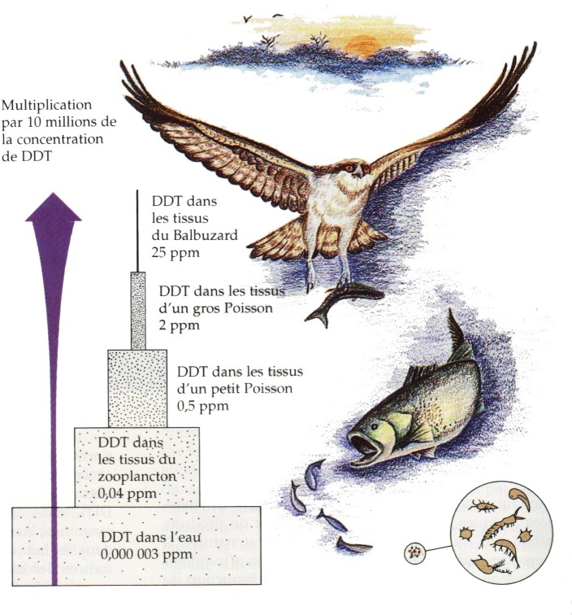

Slide 20
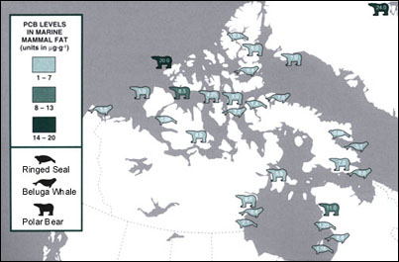

Slide 21
This powerpoint was kindly donated to www.worldofteaching.com
http://www.worldofteaching.com is home to over a thousand powerpoints submitted by teachers. This is a completely free site and requires no registration. Please visit and I hope it will help in your teaching.

