Slide 1
Food Production
Action in Plants

Slide 2

Plant cells
Plant cells contain a jelly-like cytoplasm
They all have a nucleus
They usually have a sap-filled vacuole
The cell is surrounded by a cell membrane
Around the cell membrane there is a cellulose cell wall
Plant cells in green parts of a plant like leaves also contain chloroplasts

Slide 3
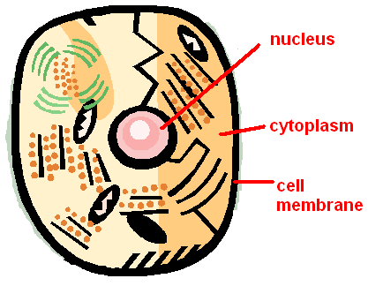
Animal cells
Animal cells contain:
a nucleus,
cytoplasm
cell membrane
but unlike plant cells they do not have cellulose cell walls or chloroplasts

Slide 4
Photosynthesis
This is the process by which plants produce their own food
Photosynthesis occurs in the chloroplasts found in cells in leaves
Carbon dioxide is reacted with water to produce glucose and oxygen
Chlorophyll and sunlight energy is required for this reaction to take place

Slide 5

Chloroplasts
The cells found in leaves have lots of chloroplasts for photosynthesis to take place in.

Slide 6
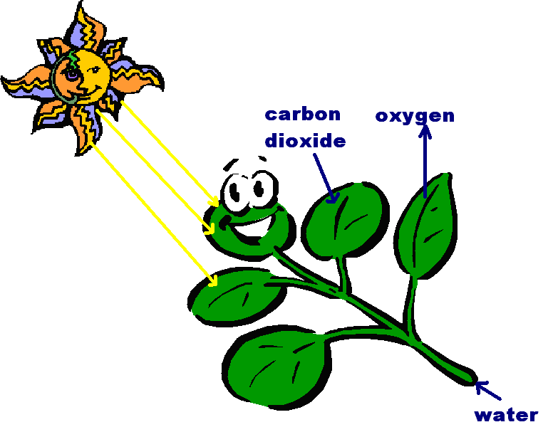
Sunlight & chlorophyll
CO₂ + H₂O C₆H₁₂O₆ + O₂

Slide 7
What factors can affect the rate of photosynthesis?
Water + carbon dioxide glucose + oxygen
6H₂O + 6CO₂ C₆H₁₂O₆ + 6O₂
The concentration of carbon dioxide will affect the rate of photosynthesis
As sunlight is needed for photosynthesis, the light intensity will also affect the rate of photosynthesis
Also, the temperature will also affect the rate of this reaction
From the equation for photosynthesis we can see that the amount of water available would also affect the rate of photosynthesis

Slide 8
The interdependance between plants and animals
Plants need to have a supply of carbon dioxide in the air so they can use it fir photosynthesis
Plants will give out oxygen produced from photosynthesis into the air
Animals need this oxygen for respiration to make energy
Animals produce waste carbon dioxide from respiration which is put into the air

Slide 9

How does carbon dioxide enter and oxygen go out of the leaves ?
On the under-side of leaves there are tiny holes called stomata
Special guard cells are responsible for opening and closing stomata
stoma
Guard cell

Slide 10
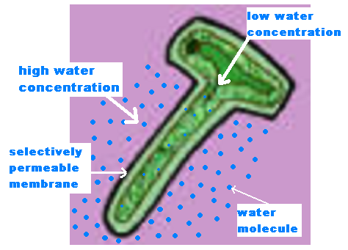
How does the water get into plants?
Water is absorbed through root hair cells by osmosis
In osmosis water moves from an area of high water concentration to a region of low water concentration
A root hair cell has a large surface area and thin walls to help water uptake

Slide 11

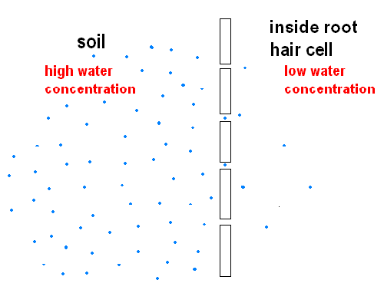
Osmosis
Selectively permeable membrane

Slide 12
Why is water needed in plants?
Water is required for photosynthesis
Water is needed to maintain turgidity i.e. to keep plants cells rigid and to stop them from losing their shape and going flaccid (floppy)
Evaporation of water through stomata cools the plant down on a hot day

Slide 13
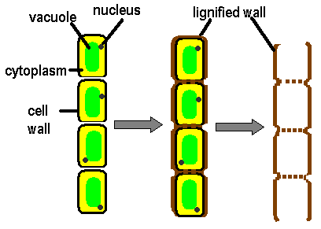
Transporting substances inside the plant
Xylem
Xylem tissue is made up of dead cells joined end to end (with no ‘end walls’)
Xylem tubes contain lignin which makes them strong and stiff
Xylem tubes take water up the plant, along with mineral salts dissolved in the water

Slide 14
Phloem
Phloem tubes are made of living cells with perforated end-plates (to let substances pass through)
Phloem tubes transport food made in the leaves to all other parts of the plant
Substances such as starch, fats and proteins are carried by phloem to the growing shoot tips and root tips, and to storage organs in the roots
Phloem can transport food in both directions

Slide 15
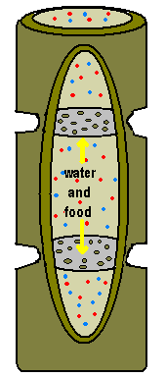
Phloem tubes

Slide 16
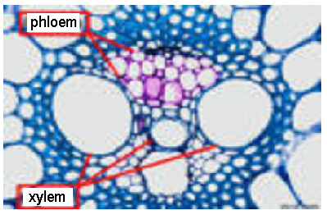
A cross-section through a stem, stained to show the phloem and xylem vessels

Slide 17
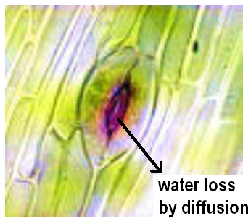
What else can get out of leaves through the stomata?
Water is lost through the stomata during transpiration

Slide 18
What is transpiration?
Transpiration is the constant flow of water up the plant
It is caused by the evaporation of water from the plant through the stomata
This creates a slight shortage of water in the leaf, which causes more water to be drawn up into the leaf from the rest of the plant
This in turn results in more water being drawn in through the roots

Slide 19

Why is transpiration useful?
It transports minerals from the soil
It cools the plant

Slide 20
What factors can affect the rate of water loss through stomata?
Temperature
Light
Air movement
Humidity

Slide 21
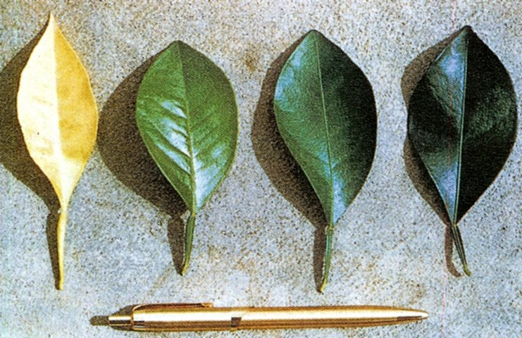
Why do plants need minerals?
Plants need minerals for healthy growth
Large amounts of nitrates are needed for making proteins
Smaller amounts of iron and magnesium are needed to make chlorophyll
Leaves showing varying amounts of magnesium deficiency

Slide 22
How do plants get their minerals?
Plants take up some dissolved mineral salts by diffusion
However, diffusion will not happen if the concentration of minerals in the soil is greater inside the root (which is usually the case)
If the concentration of minerals outside the root is lower than inside, then the root will take up mineral ions by active transport
These minerals are essential for a plants growth

Slide 23
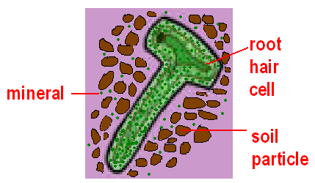
What is active transport?
Active transport allows the plant to absorb minerals against a concentration gradient
Energy is needed for active transport
The plant gets this energy from respiration

Slide 24
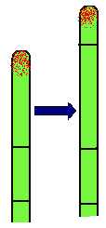
What are plant hormones?
These are chemicals known as auxins
Auxins are plant growth hormones
They control the growing parts of the plant, I.e. the tips of shoots and roots
Auxins are made in the tips, they diffuse backwards are lilttle way, and cause cells to elongate just behind the tips

Slide 25

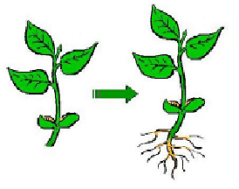
How can we use plant hormones commercially?
We can put rooting growth hormone onto the end of a cutting to make new roots grow
This enables farmers to make clones of desirable plants very quickly

Slide 26
Other uses for plant hormones
Killing weeds
Selective weedkillers have been developed using plant hormones
These weedkillers will broad-leaved plants (which are usually weeds)
Producing seedless fruit
Growth hormones can be applied to unpollinated flowers
The hormones will cause the fruit to develop and grow
However, as the flower was not pollinated, no seeds will grow

Slide 27

Plant tissue culture
Hormones are added to the agar jelly that is used for culturing plants
Some hormones will cause unspecialised cells to grow into specialised shoot cells
Another hormone is used to cause roots to grow
This is an important method for agriculture and for research

Slide 28
This powerpoint was kindly donated to www.worldofteaching.com
http://www.worldofteaching.com is home to over a thousand powerpoints submitted by teachers. This is a completely free site and requires no registration. Please visit and I hope it will help in your teaching.

