Slide 1
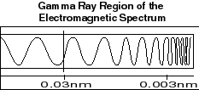
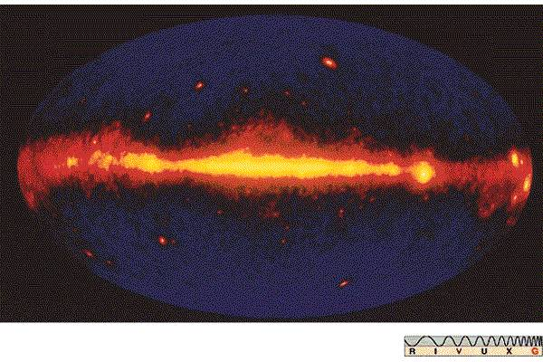
Project Gamma
By Wylie Ballinger and Sam Russell
Visit www.worldofteaching.com
For 100’s of free powerpoints

Slide 2
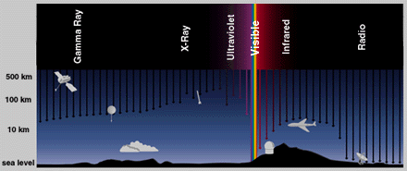
What are Gamma Rays?
The most potent particles on the electromagnetic scale and the known universe.
‘1 TeV (1,000,000,000,000 eV, where an optical photon has an energy of a few eV’ http://imagine.gsfc.nasa.gov/docs/science/how_l2/gamma_detectors.html
Smallest wavelength
Quite rare.
Only created by radioactive atoms and nuclear reactions.
The hottest regions of the universe produce them.
Formed by Supernovae, Pulsars, Neutron Stars, Black holes, and Gamma Ray Bursters.
‘electron volt
The change of potential energy experienced by an electron moving from a place where the potential has a value of V to a place where it has a value of (V+1 volt). This is a convenient energy unit when dealing with the motions of electrons and ions in electric fields; the unit is also the one used to describe the energy of X-rays and gamma rays. A keV (or kiloelectron volt) is equal to 1000 electron volts. An MeV is equal to one million electron volts. A GeV is equal to one billion (109) electron volts. A TeV is equal to a million million (1012) electron volts.’ http://imagine.gsfc.nasa.gov/docs/science/how_l2/gamma_detectors.html

Slide 3
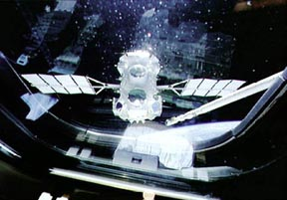
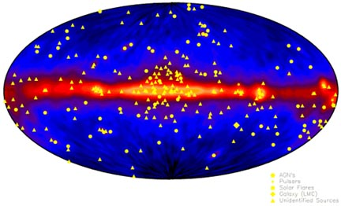
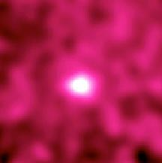
Seeing in Gamma
Explorer XI launched first satellite in 1961 was the first gamma ray receiver.
It picked up fewer than 100 cosmic gamma-ray photons total.
CGRO satellite.
The moon gives off more Gamma Rays than the sun.
Mirrors don’t work

Slide 4
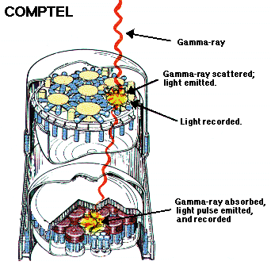
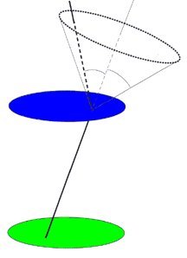
How Do We See Gamma?
1-30 MeV Is the ideal range that we wish to see.
Active galaxies, pulsars, and solar flares.
Compton Scattering and how it works.

Slide 5
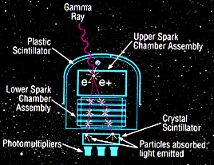
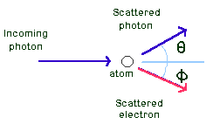
How Do We See in Gamma? Continued…
I’m a visual person…
http://learntech.uwe.ac.uk/radiography/RScience/interactions/comptonscatter.htm

Slide 6
So How Does That Work Again?
Crystal Scintillators
Crystals that emit low energy light (usually visible) when hit by high energy light such as gamma radiation.
Pair Production
The physical process whereby a gamma-ray photon, usually through an interaction with the electromagnetic field of a nucleus, produces an electron and an anti-electron (positron). The original photon no longer exists, its energy having gone to the two resulting particles. The inverse process, pair annihilation, creates two gamma-ray photons from the mutual destruction of an electron/positron pair. http://imagine.gsfc.nasa.gov/docs/dict_jp.html#pair_production
CGRO uses compton scattering and pair production.
Launched in April 5th, 1991 on Atlantis shuttle. Had a visual range of 30 KeV to 30 GeV
Burst And Transient Source Experiment (BATSE), the Oriented Scintillation Spectrometer Experiment (OSSE), the Imaging Compton Telescope (COMPTEL), and the Energetic Gamma Ray Experiment Telescope (EGRET). http://cossc.gsfc.nasa.gov/
Returned to Earth on June 4th 2000.
Gamma-ray Large Area Space Telescope is being sent up by Nasa in 2007.

Slide 7
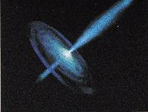
Gamma Ray Bursters
Does what it says on the box.
http://imagers.gsfc.nasa.gov/ems/gamma.html
The most energetic things in the universe that we know of.
More energy in 10 seconds than our sun can produce in its entire liftime of 10,000,000,000 years!

Slide 8
GLAST
Gamma-Ray Large Area Space Telescope Large Area Telescope
Funded Jointly by the US, Japan, France and Sweden
Accuracy of 30 Arc seconds
Launch in 2006

Slide 9
CGRO
Compton Gamma Ray Observatory
Four telescopes on it:
1. BATSE
Base and Transient Source Experiment
2. OSSE
Oriented Scintilliation Spectrometer Experiment
3. COMPTEL
Imaging Compton Telescope
4. EGRET
Energetic Gamma Ray Experiment Telescope

Slide 10
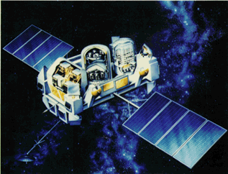
CGRO EGRET
The Compton Gamma Ray Observatory Energetic Gamma Ray Experiment Telescope
80° Field of View
Launched in 1991 as an Experimental Program
Re-entered in 2004

Slide 11
Major EGRET Discoveries
The finding of a new class of objects--high energy gamma-ray emitting blazars, or grazars
The emission of high energy gamma-rays from a gamma ray burst for over an hour, with some gamma rays having energies over a GeV and two having energies over 10 GeV.
The observation of an increased fraction of pulsar electromagnetic radiation going into gamma rays as the age of the pulsar increases to a million years
The determination with high certainty that cosmic rays are galactic
The detailed mapping of the galactic diffuse radiation and the measurement of the pion bump in the high energy gamma-ray spectrum
The absence of microsecond bursts and its implication for certain unification theories
The long trapping time of over ten hours for energetic solar particles following a flare
A measurement of the diffuse, presumably extragalactic, high energy gamma ray spectrum
http://lheawww.gsfc.nasa.gov/docs/gamcosray/EGRET/highlights.html

Slide 13
INTERGRAL
International Gamma-Ray Astrophysics Laboratory
European Space Agency
Demark, France, Germany, Italy, Spain and Switzerland
+ Czech Republic and Poland
With help from Russia and US
Giant molecular cloud in the center of the galaxy that was just recently discovered

Slide 14
Gamma-Ray Burst over 40 Seconds
http://www.rssd.esa.int/Integral/integ_images.html

Slide 15
A Cool Picture !!!

Slide 16
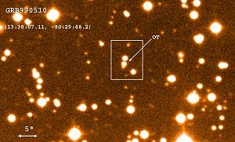
Sources
http://imagers.gsfc.nasa.gov/ems/gamma.html
http://science.nasa.gov/newhome/headlines/ast09feb99_1.htm
http://www.wordiq.com/definition/Gamma_ray_burst
http://imagine.gsfc.nasa.gov/docs/science/how_l2/compton_scatter.html
http://imagine.gsfc.nasa.gov/docs/science/how_l2/gamma_detectors.html
http://imagine.gsfc.nasa.gov/docs/science/how_l1/gamma_detectors.html
http://www.astro.utu.fi/~cflynn/astroII/l7.html
http://learntech.uwe.ac.uk/radiography/RScience/interactions/comptonscatter.htm
http://imagine.gsfc.nasa.gov/docs/science/how_l2/gamma_scintillators.html

