Slide 1
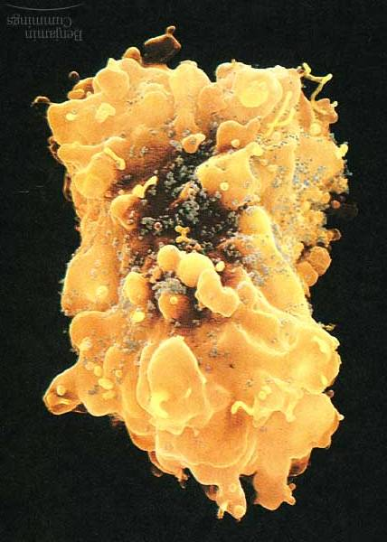
HIV Notes
HIV particles (grey) covering a white blood cell.

Slide 2
HIV History
HIV is thought to have entered into humans somewhere between 1914 and 1940.
In 1983, a retrovirus, now called human immunodeficiency virus (HIV), had been identified as the cause of AIDS.
The HIV antibody test has be used to screen all blood supplies in the U.S. since 1985.
People receiving blood or blood products before 1985 may have been infected.

Slide 4
AIDS Acquired Immune Deficiency Syndrome
The immune crippling disease caused by the HIV virus in which the body becomes unable to protect itself against any secondary infections.
HIV-Human Immunodeficiency Virus
HIV infects the immune system cell called the Helper T cells (-most important white blood cell involved in identifying infections.)

Slide 5
Body Fluids with High Concentrations of HIV
Blood
Semen/Vaginal fluids (as high as blood)
Breast milk
Pus from sores

Slide 6
Low concentrations of HIV
It is highly unlikely you will be infected if you come into contact with:
Sweat
Tears
Urine
Saliva (-highly possible if blood from mouth sores is present)

Slide 7
How is HIV Spread?
ANY type of sexual activity (highest risk)
Sharing used drug needles
Pregnancy-from mother to child
Sharing razors- if blood is present
Kissing- if even the smallest amount of blood is present. (-membranes of mouth are thin enough for HIV to enter straight into the body.)
Tattoos/body piercing if equipment is not clean.

Slide 8
How is HIV not spread?
Shaking hands
Hugging
Swimming pools
Toilet seats
Insect bites
Donating blood

Slide 9
Can HIV be cured?
NO! Drugs are available to manage the disease, but HIV stays in the body forever!
PROBLEM: RNA viruses mutate at a very high rate. A person with HIV under control can evolve resistance to the drug treatments.
Some infected persons have several strains of HIV in their bodies.

Slide 10
What does HIV look like?
Initial infection- flu like symptoms a few weeks after infection.
Stage 1-HIV positive with no symptoms- can stay at this stage for up to 10 years, but still can pass on the virus.
Stage 2-HIV positive with symptoms- at this point the person is said to have AIDS. Symptoms include:
swollen glands, chronic diarrhea, loss of weight and appetite, fever, fatigue, skin rashes (lesions), night sweats, oral thrush. Life expectancy: 2 to 5 years.

Slide 11
Death and AIDS
Stage III-Full blown AIDS-
Person dies of rare opportunistic infections that take advantage the weakened immune system:
Person dies in a matter of months.
AIDS related illnesses include rare cancers and Pneumonia.

Slide 12
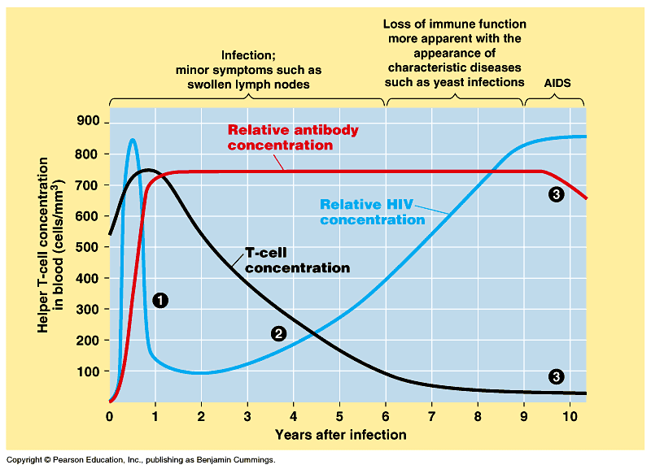
Stages of HIV Infection

Slide 13
This powerpoint was kindly donated to www.worldofteaching.com
http://www.worldofteaching.com is home to over a thousand powerpoints submitted by teachers. This is a completely free site and requires no registration. Please visit and I hope it will help in your teaching.

