Slide 1
Exercise and Health
Heart, Blood Vessels & Heart Disease

Slide 2
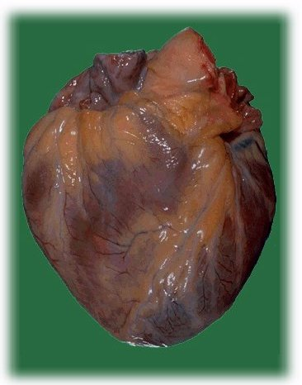

Slide 3
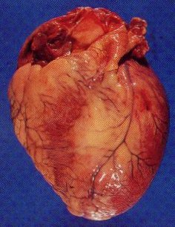

Slide 4
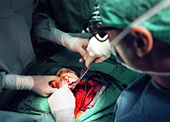

Slide 5
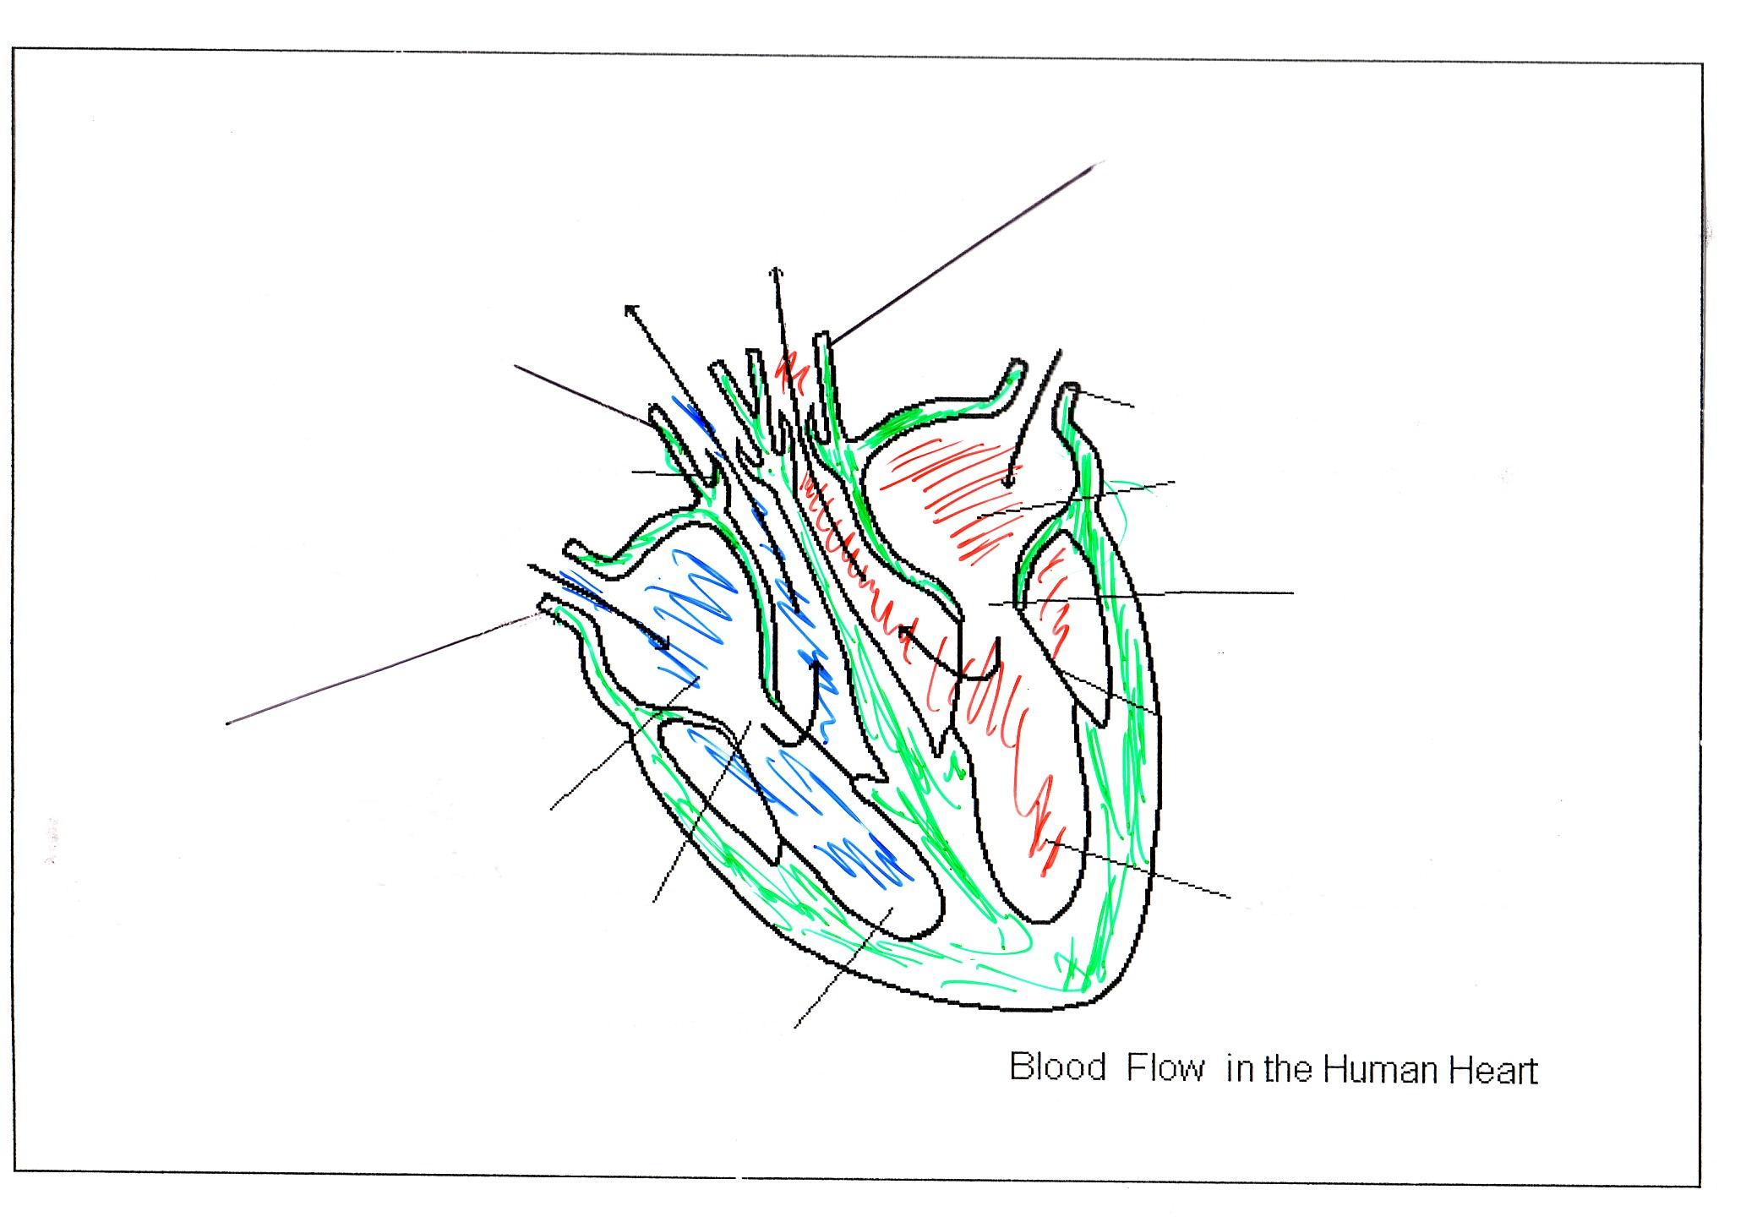

Slide 6
deoxygenated blood to the lungs

Slide 7
oxygenated blood to the body
deoxygenated blood to the lungs

Slide 8
oxygenated blood to the body
deoxygenated blood to the lungs

Slide 9
oxygenated blood to the body
pulmonary artery

Slide 10
aorta
oxygenated blood to the body
pulmonary artery

Slide 11
aorta
oxygenated blood to the body
pulmonary artery
pulmonary vein

Slide 12
aorta
oxygenated blood to the body
pulmonary artery
pulmonary vein
vena cava

Slide 13
aorta
oxygenated blood to the body
pulmonary artery
pulmonary vein
vena cava
right atrium

Slide 14
aorta
oxygenated blood to the body
pulmonary artery
pulmonary vein
left atrium
vena cava
right atrium

Slide 15
aorta
oxygenated blood to the body
pulmonary artery
pulmonary vein
left atrium
vena cava
right atrium
left ventricle
right ventricle

Slide 16
aorta
oxygenated blood to the body
pulmonary artery
pulmonary vein
left atrium
valve
vena cava
right atrium
valve
left ventricle
right ventricle

Slide 17
aorta
oxygenated blood to the body
pulmonary artery
pulmonary vein
left atrium
valve
vena cava
tendon
right atrium
valve
left ventricle
right ventricle

Slide 18
aorta
oxygenated blood to the body
pulmonary artery
pulmonary vein
valve
left atrium
valve
vena cava
tendon
right atrium
valve
left ventricle
right ventricle

Slide 19
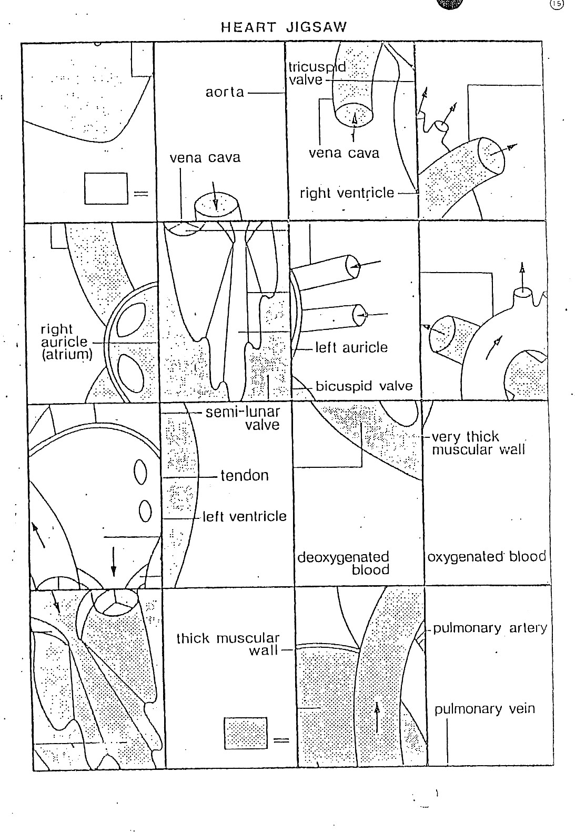

Slide 20
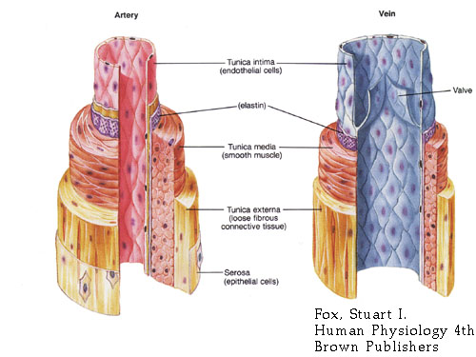
Blood vessels
Turn to p27 of Biology text
Sketch a diagram to show the structure of an artery, vein and capillaries.
Copy and complete the table on the next slide.

Slide 21
Artery | Capillary | Vein
Carry blood away from the heart
 |  | Lack muscle
Very elastic- walls can stretch
 | Leaky so that substances can pass out
Have valves that stop blood moving the wrong way

Slide 22
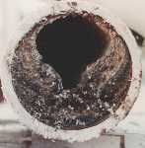
Heart disease
Arteriolosclerosis is a disease where the arteries harden or thicken.
Caused by smoking and cholesterol in the diet.
Leads to high blood pressure and increased risk of heart attack.

Slide 23
Heart disease
Collect the work sheet entitled “Heart Disease”
Read it carefully.
Answer fully questions number 1 to 7.

Slide 24
Heart disease
Collect the work sheet entitled “Heart Disease”
Read it carefully.
Answer fully questions number 1 to 7.
COMPLETE FOR HOMEWORK

Slide 25
This powerpoint was kindly donated to www.worldofteaching.com
http://www.worldofteaching.com is home to over a thousand powerpoints submitted by teachers. This is a completely free site and requires no registration. Please visit and I hope it will help in your teaching.

