Slide 1
Aims:
Learn about hedgerows and monocultures from a presentation
Consolidate and add to this knowledge by making a summary sheet (using your green booklets as well)
Find out how how much you have learned by doing a mini-test

Slide 2
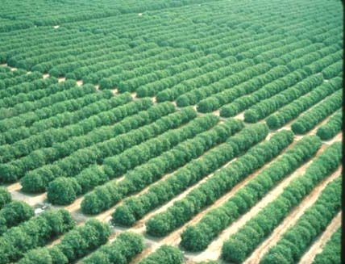
MONOCULTURE

Slide 3
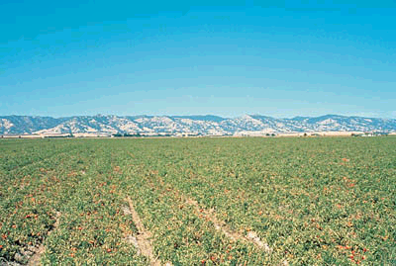
Monoculture the growth of the same plant species in close proximity, with few or no other types of plant present. (tomato field)

Slide 4
Monoculture:
Increases the productivity of farmland by growing only the best variety of crop.
Allows more than one crop per year.
Simplifies sowing and harvesting of the crop.
Reduces labour costs.

Slide 5
Monoculture has a major impact on the environment:
• Reduces genetic diversity and renders all crops in a region susceptible to disease.
• Fertilisers required to maintain soil fertility.
• Pesticides are required to keep crops healthy.
• Monoculture reduces species diversity.
• Less attractive countryside.

Slide 6
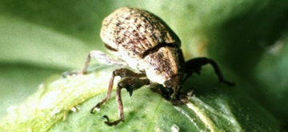
E.g of pests and monoculture.
The boll weevil eats the cotton plant. It wiped out much of the cotton crop in the affected states in the USA between 1895 and 1910. Severe economic consequences ensued, because cotton was the main crop, and only one strain of cotton was grown.

Slide 7
Traditional crop rotations, where different crops are grown in a field each year:
Breaks the life cycles of pests (since their host is changing)
Improves soil texture (since different crops have different root structures and methods of cultivation)
Can increase soil nitrogen (by planting nitrogen-fixing legumes).

Slide 8
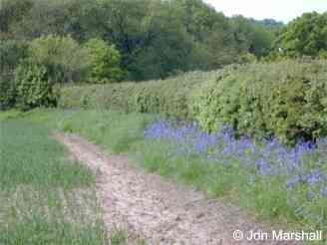
HEDGEROWS

Slide 13
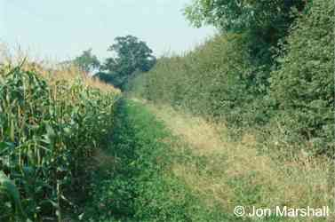
In general the larger the hedge, the more birds and more species are found.

Slide 14
This powerpoint was kindly donated to www.worldofteaching.com
http://www.worldofteaching.com is home to over a thousand powerpoints submitted by teachers. This is a completely free site and requires no registration. Please visit and I hope it will help in your teaching.

