Slide 1
Intensive farming
Minimising energy loss

Slide 2
Intensive farms are profitable
Maximise output by various methods
Specially bred animals for high growth rates
High digestibility diets that can include growth hormones and antibiotics if needed

Slide 3
Methodology
Wanted :
Maximum output for minimum input
High growth – low input
Energy costs money- so waste as little as possible whether from the animal itself or the environment in which it is kept

Slide 4
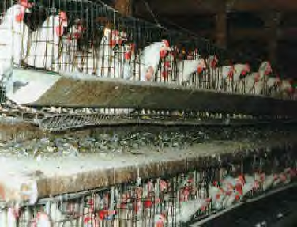
Poultry – battery hens
Restricted movement
High production diet
Controlled environment

Slide 5
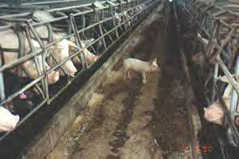
Pig battery
Restricted movement
High digestibility diet
Hormones for growth added
Controlled environment

Slide 6
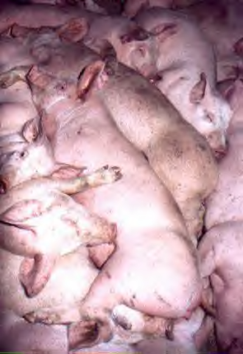
Pig farms - indoor
Many pigs occupy small space – pigs per square metre
Keep each other warm
Is it ethical??????
Animal welfare????

Slide 7
Animal welfare
What’s more important to you – the consumer
Quality of your food?
Cost of your food?
How the animals you eat are treated?
Do you care?
IGNORANCE IS BLISS

Slide 8
Welfare
Ability to perform natural acts e.g.
Spreading wings and flapping – chicken
Scratching or grubbing in soil – pigs/chickens
Preening or rolling in dirt etc etc

Slide 9
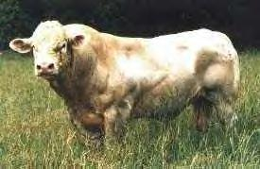
Selective breeding
Animals bred for food are bred for slaughter
More growth = more meat = more £

Slide 10
ethics
Problems :
Chickens - growth so fast that leg bones break because they can’t support the weight of muscle put on
Cow unable to give birth to calf that is too big so kill the cow (and sell carcass) save the calf – worth some money

Slide 11
Management Problems
Enclosed animals – disease spreads quickly
Use lots of antibiotics –don’t tell consumer
Hormone enhanced meat – growth hormones can affect the consumer
e.g. floppy man breasts

Slide 12
IGNORANCE IS BLISS
What you don’t know can’t hurt you
TRUE
Who or what does it affect??

Slide 13
This powerpoint was kindly donated to www.worldofteaching.com
http://www.worldofteaching.com is home to over a thousand powerpoints submitted by teachers. This is a completely free site and requires no registration. Please visit and I hope it will help in your teaching.

