Slide 1
Ch. 24 – Interactions of Life
Sec. 3 – Interactions within Communities
7th Grade Science
Saint

Slide 2
Objectives
Describe how organisms obtain energy for life.
Explain how organisms interact.
Recognize that every organism occupies a niche.

Slide 3
Energy
Living organisms need a constant supply of energy.

Slide 4
Energy
All of Earth’s energy comes from the Sun.

Slide 5
Photosynthesis
Some organisms use the Sun’s energy to create energy rich molecules through a process called photosynthesis.

Slide 6
Product of Photosynthesis
Energy rich molecules, usually sugars, serve as food. They are made up of oxygen, hydrogen, and carbon atoms.
Energy is stored in the chemical bonds of the atoms. When the bond is broken, energy is released to fuel life processes.

Slide 7
Photosynthesis

Slide 8
Producers
A producer is an organism that uses an outside energy source like the Sun to make energy-rich molecules.

Slide 9
Producers contain chlorophyll
Most producers contain chlorophyll, a chemical that is required for photosynthesis.

Slide 10
Green Plants
Green plants are producers

Slide 11
Chemosynthesis
Some producers make energy-rich molecules through a process called chemosynthesis.
These organisms are found near volcanic vents in the ocean floor. Inorganic molecules in the water provide the energy source for chemosynthesis.

Slide 12
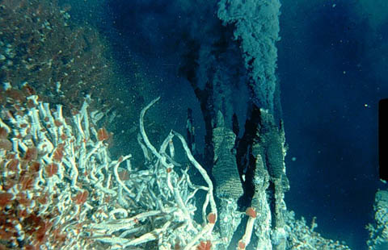
Hydrothermal Vents

Slide 13
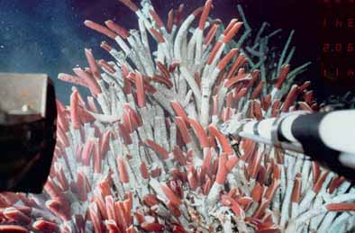
Tubeworms

Slide 14
Consumer
A consumer is an organism that cannot make their own energy-rich molecules. Consumers obtain energy by eating other organisms.
Wolves can’t make their own food. They are consumers.
The Cape Buffalo can’t make its own food. It is a consumer.

Slide 15
Producer or Consumer?
Tree
Dandelion
Weasel
Walrus
Diatom
Algae
Bacteria
Dog
You
Rhinoceros

Slide 16
Consumers
There are 4 general types of consumers:
Herbivores
Carnivores
Omnivores
Decomposers

Slide 17
Herbivores
Herbivores – Plant eaters
Deer
Rabbits
Grasshoppers

Slide 18
Herbivores
Zebras eat grass. They are herbivores.
Cows are herbivores.

Slide 19
Herbivores
Hippos are herbivores.
Rhinos are herbivores.

Slide 20
Carnivores
Carnivores – Meat Eaters – Eat other animals
Frogs
Spiders
Cougars

Slide 21
Carnivores
Not all carnivores have razor sharp teeth.
Lions definitely eat meat!

Slide 22
The Most Vicious Carnivore
The Shrew

Slide 23
Omnivores
Omnivores – Eat both plants and animals
Bears
Pigs
Humans

Slide 24
Omnivores
Raccoons are omnivores. They eat both plants and animals.
While the panda’s digestive system is that of a carnivore, their diet consists of 99% bamboo.

Slide 25
Decomposers
Decomposers – Consume waste and dead organisms. Decomposers help recycle once-living matter by breaking it down into simple, energy-rich substances. These substances might serve as food for decomposers , be absorbed by plant roots, or be consumed by other organisms.
Fungi
Bacteria
Earthworms
Vultures

Slide 26
Decomposers
Mushrooms and other fungi break-down dead decaying matter.

Slide 27
What type of consumer?
Elk
Bobcat
Mushroom
Buzzard
Bear
Hippopotamus
Box Turtle
Snapping Turtle
Shark
Seal

Slide 28
Food Chain
A food chain is a simple model of the feeding relationship in an ecosystem.

Slide 29
Food Chain
The mountain lion is the second organism of the food chain. It eats the deer. It is the secondary consumer.
For example, shrubs are food for deer, and deer are food for mountain lions.
Because shrubs make their own food through photosynthesis, they are called producers.
The deer is the first organism of the food chain to eat the shrub. It is the primary consumer.
Shrubs are the beginning of the food chain. They receive their energy from sunlight.

Slide 30
Food Chain
Algae make their own food from sunlight. They are the basis for the food chain in this example.

Slide 31
Food Chain
The first organism in a food chain is always a producer. They make their own food.

Slide 32
Food Chain

Slide 33
Food Chain

Slide 34
Food Chain

Slide 35
Food Chain

Slide 36
Food Chain

Slide 37
Food Chain

Slide 38
Food Chain

Slide 39
Food Chain

Slide 40
Food Chain

Slide 41
Food Chain

Slide 42
Symbiosis
Not all relationships among organisms involve food. Many organisms live together and share resources in other ways. Any close relationship between species is called symbiosis.

Slide 43
3 Types of Symbiosis
Mutualism
Commensalism
Parasitism

Slide 44
Mutualism
Mutualism – A symbiotic relationship in which both species benefit.

Slide 45
Mutualism
Examples:
Cowbirds and Large Animals
Termites and Trichonympha
Bees and Flowers

Slide 46
Cowbirds and Large Animals
The cowbird benefits by eating the ticks and mites off the large animal. The large animal benefits from have the parasites removed from them. The birds can also warn them of danger.

Slide 47
Termites and Trichonympha
You probably think termites eat wood; they do – in a way. Termites can’t digest cellulose, which is the main component of wood. Therefore, they get help from a protozoan called trichonympha. This protozoan lives in the gut of the termite. It breaks down the cellulose for the termite. The trichonympha gets a free meal and shelter; the termite is able to eat and receive nutrients from the wood.

Slide 48
Termite and Trichonympha

Slide 49
Termite and Trichonympha

Slide 50
Termite and Trichonympha

Slide 51
Termite and Trichonympha

Slide 52
Trichonympha

Slide 53
Trichonympha

Slide 54
Bees and Pollen
Bees receive nectar from the flowers in order to make honey. As the bees collect nectar, they collect pollen on their body. As they fly to another flower, they pollinate it by dusting the pollen on the flowers stamen.

Slide 55
Commensalism
Commensalism – A symbiotic relationship in which one organism benefits and the other is not affected.

Slide 56
Commensalism
Examples:
Clown fish and sea anemones
Shark and remora

Slide 57
Clown Fish and Sea Anemones
The clown fish is immune to the stings of the sea anemones tentacles. The clown fish makes its home in the tentacles for protection. The clown fish gets shelter, but the sea anemone gets nothing.

Slide 58
Shark and Remora
The remora hangs around the shark picking up any scraps it may leave. The remora gets food while the shark gets nothing.

Slide 59
Parasitism
Parasitism – A symbiotic relationship in which one organism benefits but the other is harmed.

Slide 60
Parasitism
Examples:
Tapeworm and Humans
Cuckoo bird and warbler
Ticks

Slide 61
Tapeworm and Humans

Slide 62
Tapeworms and Humans

Slide 63
Tapeworms and Humans

Slide 64
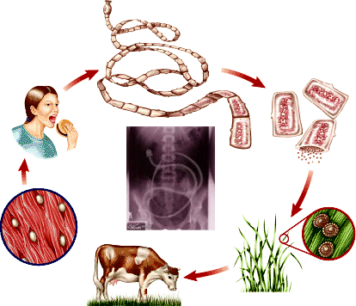
Tapeworms and Humans

Slide 65
Cuckoo and Warbler

Slide 66
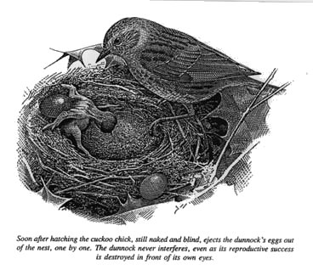
Cuckoo birds and warblers

Slide 67
Cuckoo and Warbler

Slide 68
Cuckoo and Warbler

Slide 69
Ticks

Slide 70
Tick

Slide 71
Even Athletes foot is a parasite

Slide 72
Parasitism

Slide 73
Parasitism

Slide 74
Symbiosis

Slide 75
Habitat
One habitat might contain hundreds or even thousands of species. A rotting log in a forest can be home to many species of insects, including termites that eat decaying wood and ants that feed on the termites. Other species that live on and under rotting log include millipedes, centipedes, spiders, and worms.

Slide 76
Niche
You might think that competition for resources would make it impossible for so many species to live in the same habitat. However, each species has different requirements for its survival. As a result, each species has its own niche. An organism’s niche is its role in its environment – how it obtains food and shelter, finds a mate, cares for its young, and avoids danger.

Slide 77
Niche

Slide 78
Predator and Prey
An organism’s niche includes how it avoids being eaten and how it finds or captures its food. Predators are consumers that capture and eat other consumers. The prey is the organism that is captured by the predator.

Slide 79
Predator and Prey
The deer is being eaten by the python. It is prey.
The python has captured and is eating the deer.

Slide 80
Predator and Prey
Predator
Prey

Slide 81
Predator and Prey
Predator
Prey

Slide 82
Predator and Prey
Prey
Predator

Slide 83
Predator and Prey
This alligator is the predator. It eats the python.
This python is the prey. It is eaten by the alligator.

Slide 84
Predator and Prey
The alligator did get some revenge. The meal was too big for the python and caused it bust.
This python swallowed the alligator. It is the predator.
This alligator was swallowed by the python. It was the prey.

Slide 85
Lynx vs. Hare

Slide 86
Predator/Prey Relationship

Slide 87
Predator/Prey Relationship

Slide 88
Predator/Prey Relationship
The presence of predators usually increases the number of different species that can live in an ecosystem. Predators limit the size of prey populations. As a result, food and other resources are less likely to become scarce, and competition between species is reduced.

Slide 89
Cooperation
Individual organisms often cooperate in ways that improve survival.

Slide 90
Whitetail Deer Cooperation
Whitetail Deer – Whitetail deer will lift their tail to alert others when they feel threatened.

Slide 91
Ants and Honeybees
Ants and honeybees live in social groups. Certain individuals have specific jobs within the colony.
Soldiers – Protection of colony
Workers – gather food and take care of young (larva)

Slide 92
Cooperation
These cooperative actions improve survival and are a part of the specie’s niche.

Slide 93
Section Summary
All life requires a constant supply of energy.

Slide 94
Section Summary
Most producers make food by photosynthesis using light energy.

Slide 95
Section Summary
Consumers cannot make food. They obtain energy by eating producers and other consumers.

Slide 96
Section Summary
A food chain models the feeding relationships between species.

Slide 97
Section Summary
Symbiosis is any close relationship between species.

Slide 98
Section Summary
Mutualism, commensalism, and parasitism are types of symbiosis.

Slide 99
Section Summary
An organism’s niche describes the ways in which the organism obtains food, avoids danger, and finds shelter.

Slide 100
Question
1. Explain why all consumers depends on producers for food.

Slide 101
Question
2. Describe a mutualistic relationship between two imaginary organisms. Name the organisms and explain how each benefits.

Slide 102
Question
3. Compare and contrast the terms habitat and niche.

Slide 103
Question
4. A parasite can obtain food only from a host organism. Explain why most parasites weaken, but do not kill, their hosts.

Slide 104
This powerpoint was kindly donated to www.worldofteaching.com
http://www.worldofteaching.com is home to over a thousand powerpoints submitted by teachers. This is a completely free site and requires no registration. Please visit and I hope it will help in your teaching.

