Slide 1
Kinematics
The Study of Motion

Slide 2
Scalar and vector
I drove 125 kms and reached my destination
I drove 125 kms south and reached my destination

Slide 3
Scalars
Described by their magnitude only
ex. distance(d) = 5 km
speed(v) = 20ft/s
mass(m) = 0.56 g
time(t) = 3.7 s

Slide 4
Vector
quantities are described by both their magnitude and direction
ex. displacement (d) =5km [north]
velocity (v) = 20ft/s [NW]
force (F) = 340N [fwd]

Slide 5
distance and displacement
distance - how far an object has travelled from its original position
displacement - how far away an object is from its original position

Slide 6
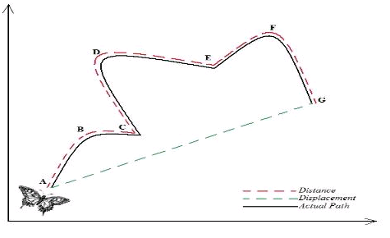
How is the butterfly’s distance different than its displacement?

Slide 7
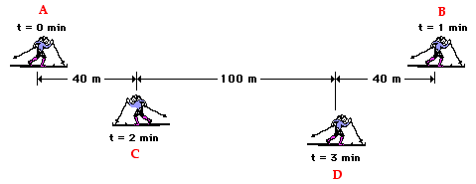
What is the skiers distance and displacement at t=1min, t=2 min and t=3 min?

Slide 8
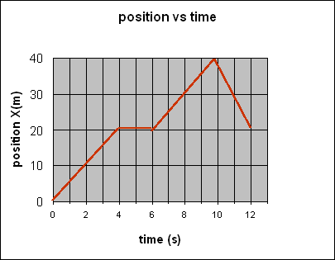
Graphing time and position
What does the graph tell us about the objects movement?

Slide 9
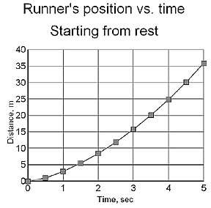
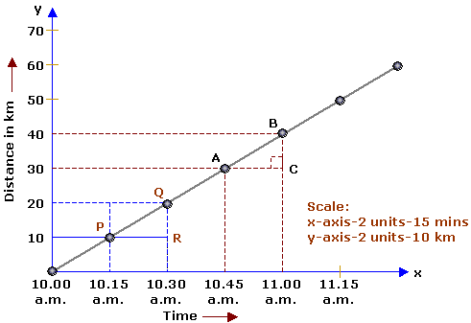
How are these two graphs different? What do they tell us about how the motion is different?

