Slide 2
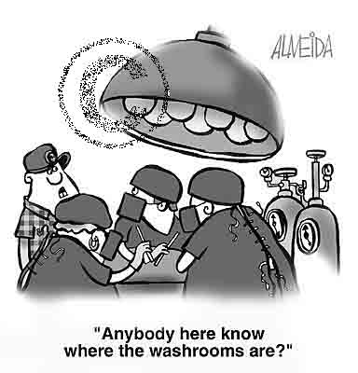

Slide 3
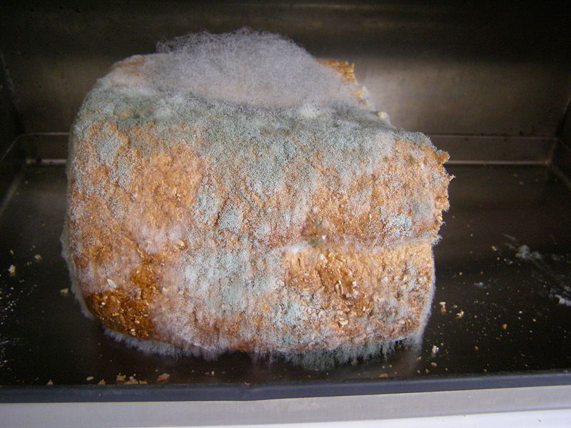

Slide 4
This powerpoint was kindly donated to www.worldofteaching.com
http://www.worldofteaching.com is home to over a thousand powerpoints submitted by teachers. This is a completely free site and requires no registration. Please visit and I hope it will help in your teaching.

