Slide 1

Magnetism

Slide 2
Magnets have been known for centuries.
The Chinese and Greeks knew about the “magical” properties of magnets. The ancient Greeks used a stone substance called “magnetite.” They discovered that the stone always pointed in the same direction. Later, stones of magnetite called “lodestones” were used in navigation.

Slide 3
William Gilbert, an English physician, first proposed in 1600 that the earth itself is a magnet, and he predicted that the Earth would be found to have magnetic poles.

Slide 4
What is Magnetism?
Magnetism is the force of attraction or repulsion of a magnetic material due to the arrangement of its atoms, particularly its electrons.

Slide 5
All magnetic phenomena result from forces between electric charges in motion.

Slide 6
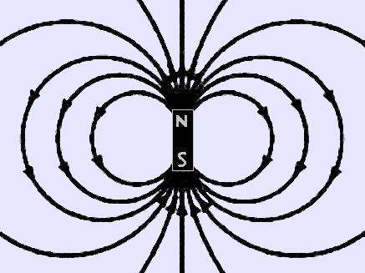
The ends of a magnet are where the magnetic effect is the
strongest. These are called “poles.” Each magnet has
2 poles – 1 north, 1 south.

Slide 7

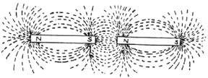
Like repels like…
Opposites attract!

Slide 8
Poles of a magnet always
Come in pairs!

Slide 9

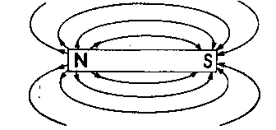
If you cut a magnet in half,
S
N
S
N
S
N
you get 2 magnets!

Slide 10
No Monopoles Allowed
It has not been shown to be possible to end up with a single North pole or a single South pole, which is a monopole ("mono" means one or single, thus one pole).
Note: Some theorists believe that magnetic monopoles may have been made in the early Universe. So far, none have been detected.
S
N

Slide 11
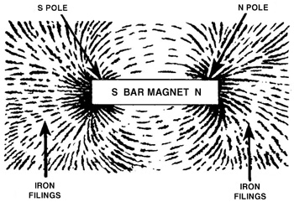
Magnetic Fields
The region where the magnetic forces
act is called the “magnetic field”

Slide 12
Defining Magnetic Field Direction
Magnetic Field vectors as written as B
Direction of magnetic field at any point is defined as the direction of motion of a charged particle on which the magnetic field would not exert a force.
Magnitude of the B-vector is proportional to the force acting on the moving charge, magnitude of the moving charge, the magnitude of its velocity, and the angle between v and the B-field. Unit is the Tesla or the Gauss (1 T = 10,000 G).

Slide 13
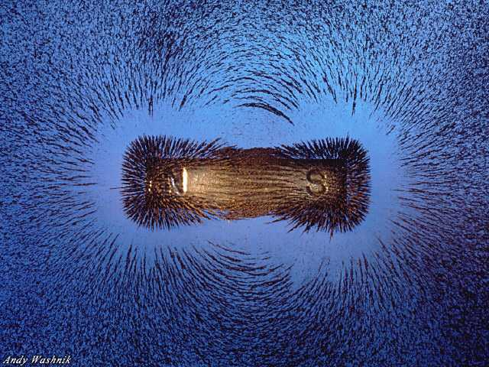

Slide 14
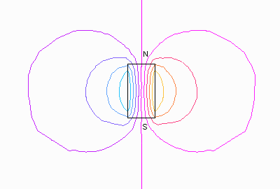
Field Lines Around a Bar Magnet

Slide 15
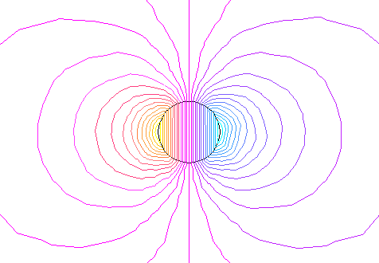
Field Lines Around a Magnetic Sphere

Slide 16
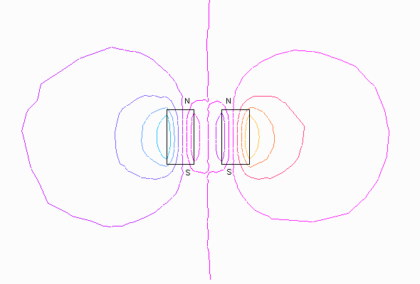
Field Lines of Repelling Bars

Slide 17
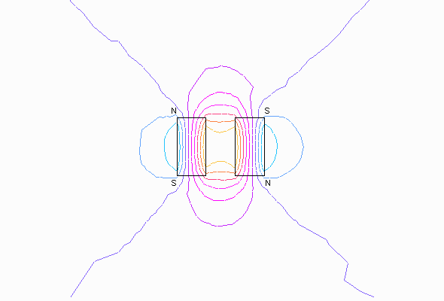
Field Lines of Attracting Bars

Slide 18
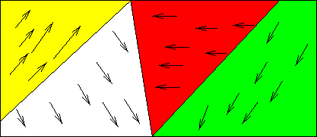
Atoms themselves have magnetic properties due
to the spin of the atom’s electrons.
Groups of atoms join so that their magnetic fields
are all going in the same direction
These areas of atoms are called “domains”

Slide 19
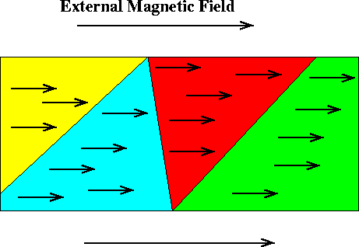
When an unmagnetized substance is placed in a magnetic
field, the substance can become magnetized.
This happens when the spinning electrons line up in the
same direction.

Slide 20

An unmagnetized substance looks like this…

Slide 21

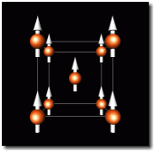
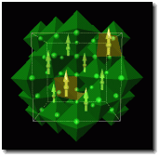
While a magnetized substance looks
like this…
Iron
Lodestone (Magnetite)

Slide 22

How to break a magnet:
1. Drop it
2. Heat it
This causes the domains to become random again!

Slide 23
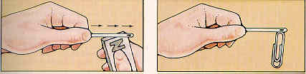
Making and Breaking Magnets
In most materials, if you add energy to the electrons, you can get them to move and realign
Can you think of ways to add energy to electrons?
How can you make a magnet?
How can you demagnetize a magnet?
What happens when you break a magnet?

Slide 24
Magnetic Field Vectors Due to a Bar Magnet
N
S

Slide 25
N
S

Slide 26
N
S

Slide 27
N
S

Slide 28
N
S

Slide 29
N
S

Slide 30
N
S

Slide 31
N
S

Slide 32
N
S

Slide 33
N
S

Slide 34
Magnetic Field Lines
The direction of the magnetic field at any point is tangent to the magnetic field line at that point.

Slide 35
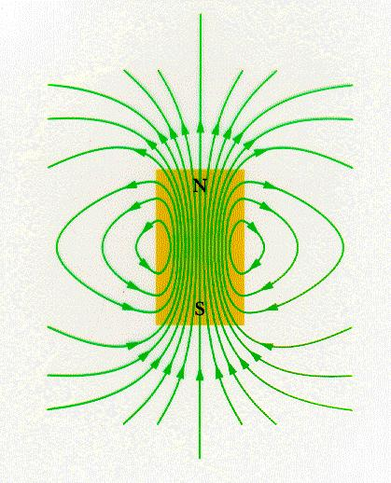
N
S

Slide 36
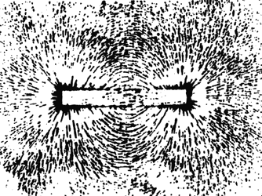
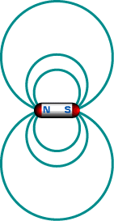

Slide 37
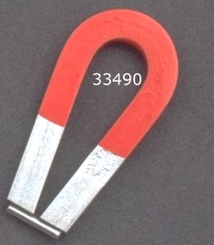
Vocabulary for ELL
Magnet: material that can both attract and repel other magnets. Iron is most common.
Pole: Part of the magnet where the force is the strongest
Metal: material that is often attracted to magnets and a good electrical conductor
Horseshoe magnet:
U-shaped magnet
S
N

Slide 38
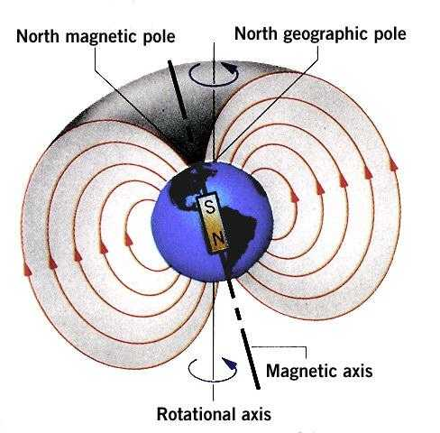
The Earth is a magnet:
It exerts magnetic forces and is surrounded by a
magnetic field that is strongest near the
North and South
magnetic poles

Slide 39
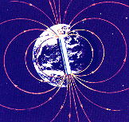
Sometimes, the Earth’s magnetic poles flip. This happens every half-million years or so.
Magnetic North Pole
Magnetic South Pole

Slide 40
We use the Earth’s magnetic field
to find direction.
The needle of a compass always points toward the magnetic south pole.
We call this direction “North”
(remember, opposites attract)

Slide 41
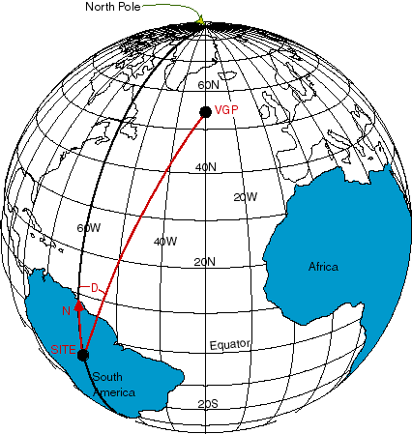
Vocabulary for ELL
Geographic North pole: the north end of the axis around which the Earth rotates
Magnetic North pole: the point on the Earth to which a compass needle points

Slide 42
The sun has a magnetic field, too. It extends far above the sun’s surface.
Other planets in the solar system also have these magnetic fields

Slide 43
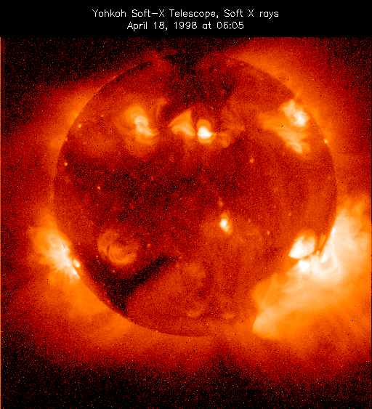

Slide 44
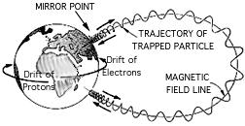
When a charged particle enters a magnetic field, an electric force is exerted on it. If a charged particle moves at an angle to a magnetic field, the magnetic force acting on it will cause it to move in a spiral around the magnetic field lines.

Slide 45

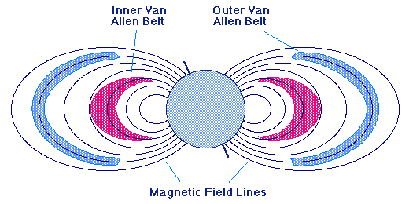
The solar wind is constantly bombarding the Earth’s magnetic field. Sometimes these charged particles penetrate that field. These particles are found in two large regions known as the Van Allen Belts.

Slide 46
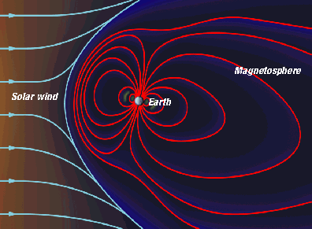
The Earth’s magnetic field extends far into space. It is called the “magnetosphere.”
When the magnetic particles from the sun, called “solar wind”, strike this magnetosphere, we see a phenomenon called…

Slide 47
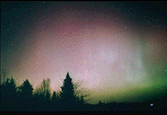
The Aurora Borealis in the Northern Hemisphere
And the Aurora Australis in the Southern Hemisphere

Slide 48
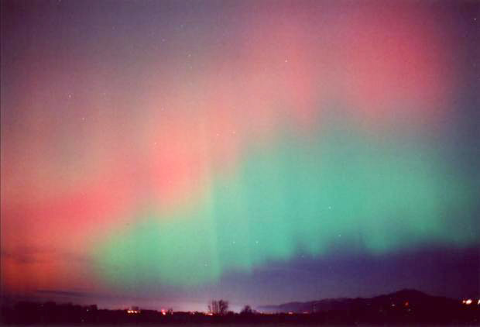

Slide 49
Electricity and Magnetism
Electric forces hold atoms and molecules together.
Electricity controls our thinking, feeling, muscles and metabolic processes.
Electricity and magnetism underpin much of our current technology (e.g. computers).
Electricity and magnetism are linked on a fundamental level.

Slide 50
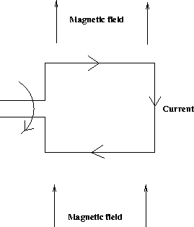
Electric Motor
An electric motor, is a machine which converts electrical energy into mechanical (rotational or kinetic) energy.
A current is passed through a loop which is immersed in a magnetic field. A force exists on the top leg of the loop which pulls the loop out of the paper, while a force on the bottom leg of the loop pushes the loop into the paper.
The net effect of these forces is to rotate the loop.

Slide 51
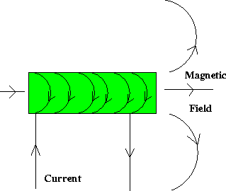
Electromagnet (Magnetism from Electricity)
An electromagnet is simply a coil of wires which, when a current is passed through, generate a magnetic field, as below.

Slide 52
Magnetic Properties of Matter
In other words….materials which produce magnetic fields with no apparent circulation of charge.
All substances - solid, gas, and liquid - react to the presence of a magnetic field on some level. Remember why?
How much they react causes them to be put into several material “types”.

Slide 53
Top Ten List
What We Will Learn About Magnetism
1. There are North Poles and South Poles.
2. Like poles repel, unlike poles attract.
3. Magnetic forces attract only magnetic materials.
4. Magnetic forces act at a distance.
5. While magnetized, temporary magnets act like permanent magnets.

Slide 54
Top Ten Continued
9. A charged particle experiences no magnetic force when moving parallel to a magnetic field, but when it is moving perpendicular to the field it experiences a force perpendicular to both the field and the direction of motion.
10. A current-carrying wire in a perpendicular magnetic field experiences a force in a direction perpendicular to both the wire and the field.

Slide 55
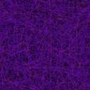
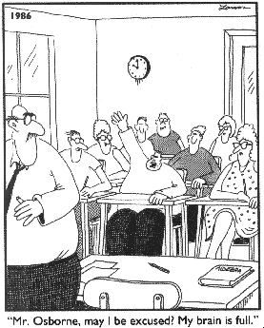

Slide 56
Let’s Play!

